Slide 1
(formerly known as ONE ROTARY SUMMIT)
DISTRICT 5970
Title Page Option

Slide 2
Tonight’s Agenda…
Hear from District Gov and DG-Elect
Welcome from RI President Jennifer Jones
Overview on Membership, Public Image & Rotary Foundation from chairs & committee members
Brainstorm & share ideas
Do a simple plan to take home
Final comments, Q&A & adjourn

Slide 3
As an Attendee You Will…
Be excited to “Imagine Rotary.”
Learn about the IMPACT of Membership, Public Image & Foundation when they work together.
Gain new ideas and best practices from other clubs.
Take your “Imagination to Action Plan” home to your club.

Slide 4
When meeting online, let’s agree to:
Mute when
not talking
Turn the camera on
Be fully present
Raise hands to
contribute or comment
Speak and listen
with kindness

Slide 5
District Governor
DON MEYER
“The Three Areas”

Slide 6
Positive Public Image
Increased Membership
Membership, Public Image, & The Rotary Foundation support Rotary’s Action Plan Priorities
Expand our Reach
Increase our impact
Strong Clubs
Adapt
Enhance Engagement
More Donors
Great Projects
Notes:
Rotary International and your district have three strategic goals:
Support & Strengthen Clubs
Increase Humanitarian Service
Increase Public Image & Awareness
Why do these matter?
“The time is right to move toward a new vision that brings more people together, increase our image and creates lasting change around the world”

Slide 7
M + PI + TRF = IMPACT!
Public Image
The
Rotary
Foundation
Membership
IMPACT!

Slide 8
Rotary’s Action Plan Priorities
Notes:
Increase our impact;
Expand our reach;
Enhance participant engagement; and,
Increase our ability to adapt.

Slide 9
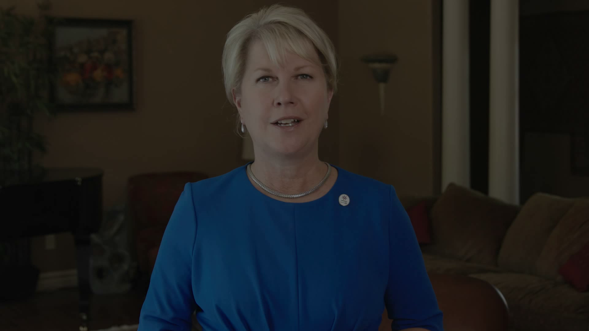
Rotary International President Jennifer Jones

Slide 10
Setting the Stage…
Membership
Public Image
The Rotary Foundation

Slide 11
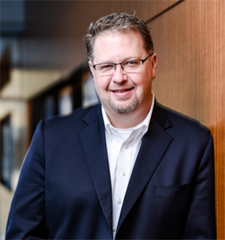
“Membership”
District Membership Chair
Dennis Jordan

Slide 12
District Membership Committee Members
Dennis Jordan, Committee Chair, Assistant District Governor
Don Meyer, District Governor
Carole Bernhard, District Governor Elect
Shannon Duncan, District Governor Nominee
Jeff Hassman, Past District Governor
Lowell Stoolman, Past District Governor
Jim Coloff, Past District Governor
Bruce Lindholm
Cindy Bathgate
Jamie Toledo
Wendy Bowman
Steve Heyer

Slide 13
Membership Basics…
Meeting location- is it inviting?
Food- cost & quality are important!
Greeters- who is meeting them at the door?
Club meeting- is it organized and fun?
Club program/speaker- be purposeful and picky!
Club leadership- how strong is your Board?

Slide 14
It’s all about the Members…
Membership Chair- who is it and do they have a plan?
Membership Committee- it takes a team!
Membership Recruitment- plan and execute!
Member Sponsor- who is guiding their experience?
Member Engagement- critical for retention!

Slide 15
Do you need some tools?
PLANNING TOOL BOX: www.district5970.org
Creating your club leadership plan
Action Plan Worksheet
Best Practices for Rotary Clubs
Strategic Planning Guide
Vision Exercise for Rotary Clubs
Why ________ Rotary Club?

Slide 16
Have you considered a satellite club?
1. Although a satellite meets at a different time, all members are Rotarians who belong to your club. You are one club that meets at two different times.
2. For prospective new members, having two meeting options is a big advantage.
3. Most After Work satellites meet from 5:30 to 6:30. This allows those who get off work at 5:00 to come to Rotary and still be home for dinner and evening activities.
4. Clubs that meet at 5:30 do not usually serve a meal. Often, beer & wine are available for purchase.
5. Some satellite clubs meet weekly, however most meet twice a month; for example 1st & 3rd Thursday @ 5:30.

Slide 17
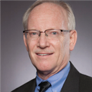
“Public Image”
District Public Image Chair
David Drewelow

Slide 18
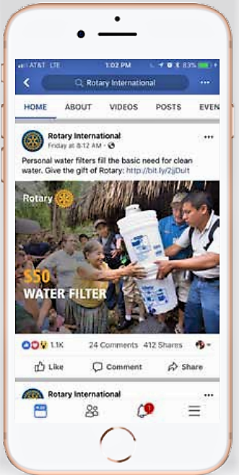
Public Image…
5 Things for each club:
PI Chair & Committee
A consistent brand
Social Media page(s) & weekly posts (new members)
Newsletter weekly (existing members)
RI Resource Center
Public Image is…
Communicating with people.
Connecting with them to take action!

Slide 19
Public Image… 5 Things:
1. PI Chair/Committee
More hands make lighter work & allows more to be done…
Determine local purpose
Have a plan for PI team
Identify roles and responsibilities
Utilize Rotary resources

Slide 20
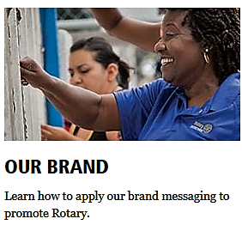
Public Image… 5 Things:
2. Consistent Brand
Be memorable with brand consistency…
Brand compliant website & social sites
Banners & materials
Brand guidelines
“Masterbrand Signature”
“Mark of Excellence”

Slide 21
Public Image… 5 Things:
3. Social Media page(s) w/ weekly posts
External communication to the public…
Simple & inexpensive
Tell your club stories
Photos, videos & more

Slide 22
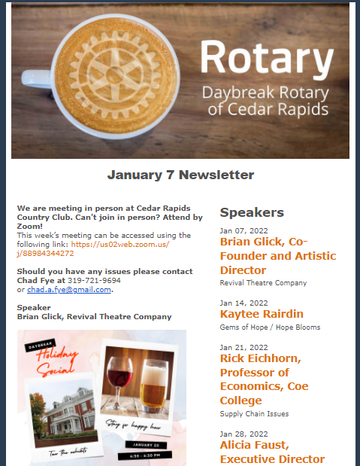
Public Image… 5 Things:
4. Newsletter weekly
Internal communication to your members…
Keeps every member in the loop
Updates on speakers
Club announcements
Upcoming events
Great resource for prospective members

Slide 23
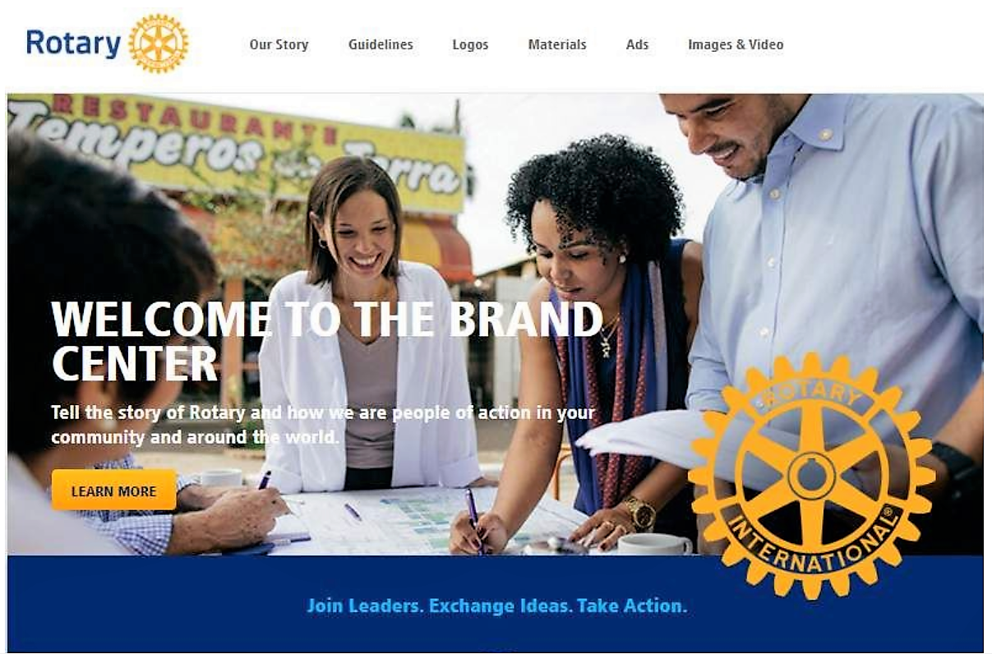
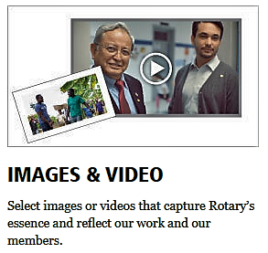
Public Image… 5 Things:
5. Use Rotary Resource Center
Materials & resources…
People of Action campaign
Training resources
Images & videos

Slide 24
Public Image…
5 Things for each club:
PI Chair & Committee
Consistent brand
Social Media & weekly posts
Newsletter weekly
Use RI Resource Center
Public Image is…
Communicating with people.
Connecting with them to take action!

Slide 25
PUBLIC IMAGE… Reputation & Perception Questions…
Does the average person know about Rotary?
Do they know what being a member in Rotary is all about?
Are they aware of the money your club raises to support local and global projects?
Do they know about the impact Rotary has made in your community over the years?

Slide 26
Public Image can tell your story to your community!

Slide 27
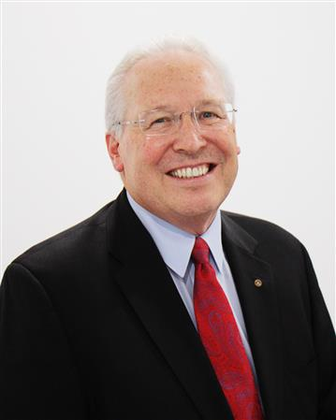
“The Rotary Foundation”
District Foundation Chair
John Wasta

Slide 28
Over 100 Years of Doing Good in the World
Over $3 billion contributed to Foundation in its first hundred years!

Slide 29
WHY Is The Rotary Foundation Important To You?

Slide 31
One Top Priority…End Polio
1988: 350,000 cases in 125 countries
2021: 6 reported cases of wild polio, 236 of all types of polio.
$0.60 – Cost per polio immunization
Minimum of 4 immunizations needed per child (CDC)
$3.00 cost to immunize one child
Bill and Melinda Gates Foundation: $2 match for every $1

Slide 32
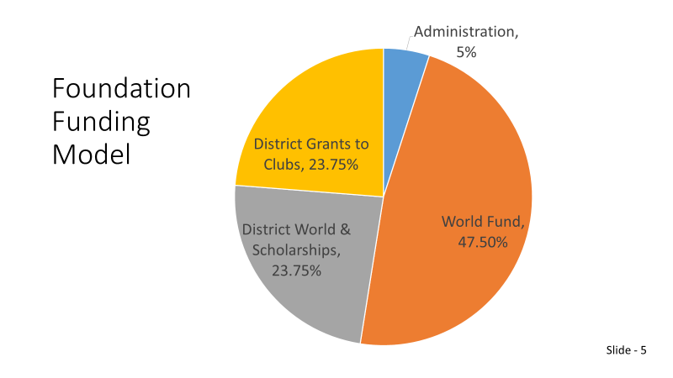

Slide 33
How Close Are You to Paul Harris Fellow?
Your Club President or Foundation Chair can let you know by email.
The email would give each Rotarian the following information:
Amount of gift + points (from others) needed to reach PHF level or multiple level
Many options for making your gift

Slide 34
Fundraising Plan for Your Club
If you would like a fundraising plan for your club to help you raise more money for the Rotary Foundation,
Please contact John Wasta, District 5970 Foundation Chair, and he will help you build a plan. His contact information:
foundationchair@district5970.org
319-440-5959

Slide 35
5970 Foundation Org Chart

Slide 36
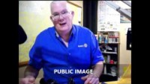
Rotary Club of Ely, MN – Synergy Success Story

Slide 37
Breakout Groups (30 Minutes)
Select a facilitator & VERY Brief introductions
Discuss sample questions (see handout)
Share ideas, best practices, tell stories

Slide 38
Share with Group (20 Minutes)
Facilitator from each group share ONE idea with the rest of the room

Slide 39
Complete Action Plan (5 Minutes)
Attendees complete “Imagination to Action Plan” (see handout)
Take back and share with your club

Slide 40
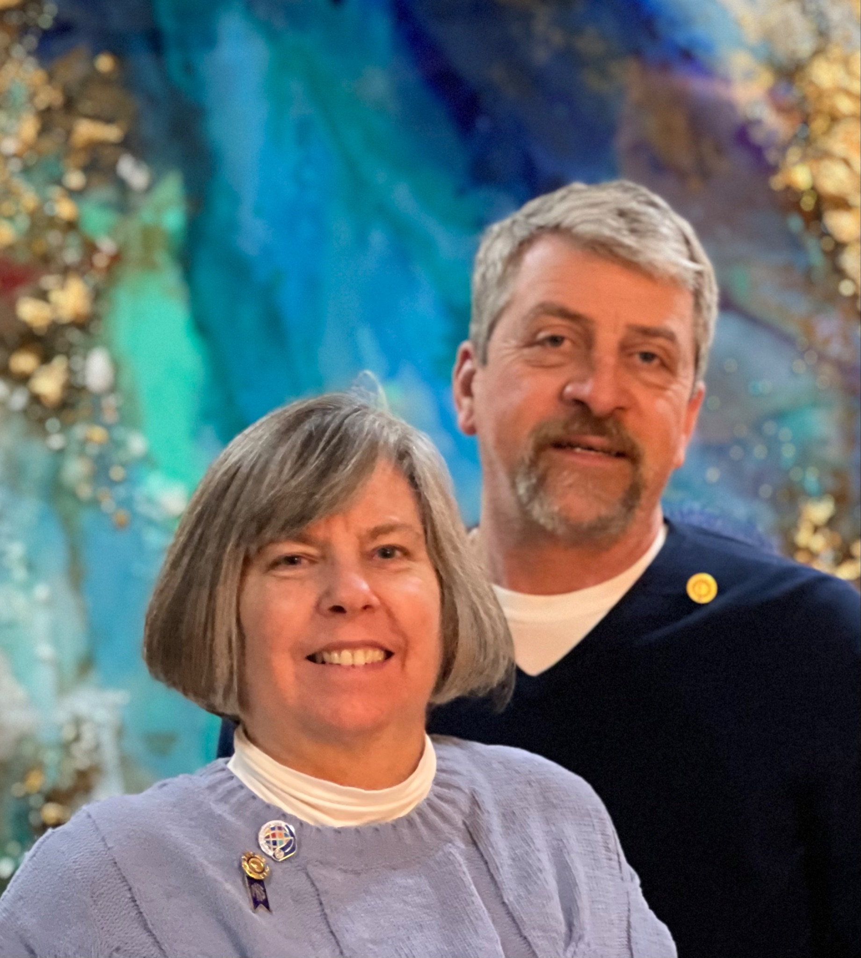
District Governor-Elect
Carole Bernhard
“Closing Remarks”
Photo of
Carole

Slide 41
We’re nearly there in our quest to eradicate Polio, but the last mile can sometimes be the most difficult.

Slide 42
Working together to have an IMPACT.
Moving from Imagination to Action.
That’s what PEOPLE of ACTION do.

Slide 43
Learning together to explore what’s possible.
Moving from Imagination to Action.
That’s what PEOPLE of ACTION do.

Slide 44
District Contact List:
District Governor - Don Meyer - donmeyer573@gmail.com
District Governor Elect – Carole Bernhard - carolebernhard50517@gmail.com
District Trainer - Helen Beneke - hbeneke2@hotmail.com
Membership Chair - Dennis Jordan - dennis-jordan@uiowa.edu
Public Image Chair - David Drewelow - dl@drewelow.com
Foundation Committee Chair - John Wasta - foundationchair@district5970.org
District Secretary - Suellen Kolbet - des@district5970.org
Website - www.district5970.org
Upcoming Events:
North Central PETS - March 22-24, 2023
2023 District Conference - April 21-22, 2023

Slide 45
Please take a few minutes to give us your feedback on this One Summit
You will receive the link by email

Slide 46
Thank You!
For Attending and Your Participation!

