Slide 1
Making an Impact with
In-Meeting Service Projects

Slide 2
Marnee Obendorf, South Puget Sound Rotary District Trainer, District 5020
Welcome to District Training Assembly!

Slide 3
A few things I hope you’ll learn from today’s session on in-meeting projects:
Ideas to help your club identify hands-on projects to benefit your community.
How in-meeting projects can impact your club’s membership recruitment & retention.
How to make some club meetings more impactful with smaller hands-on projects.
What some clubs have learned from their experience with in-meeting projects.

Slide 4
What does an in-meeting project need to be effective?
Needs to be Time Limited
Needs to be Productive
Requires Planning – Committee or Single Champion
Needs to Produce Tangible Results

Slide 5
How does a Club get started doing in-meeting (mini) projects?
Get member buy-in of the concept
Identify community needs - Who could beneficiaries be?
Determine budget – Are there costs associated?
Will there be enough for everyone present to have something to do?

Slide 6
How does a club get started doing in-meeting (mini) projects?
How will the finished project items get to their intended destination?
Set Up – How will you transition from your meal (if you have one) to the project?
Clean Up – Be sure to allow for clean up time. Don’t overwhelm your venue!
Publicity – Invite guests! Project meetings are the perfect time to invite a potential new member!

Slide 7
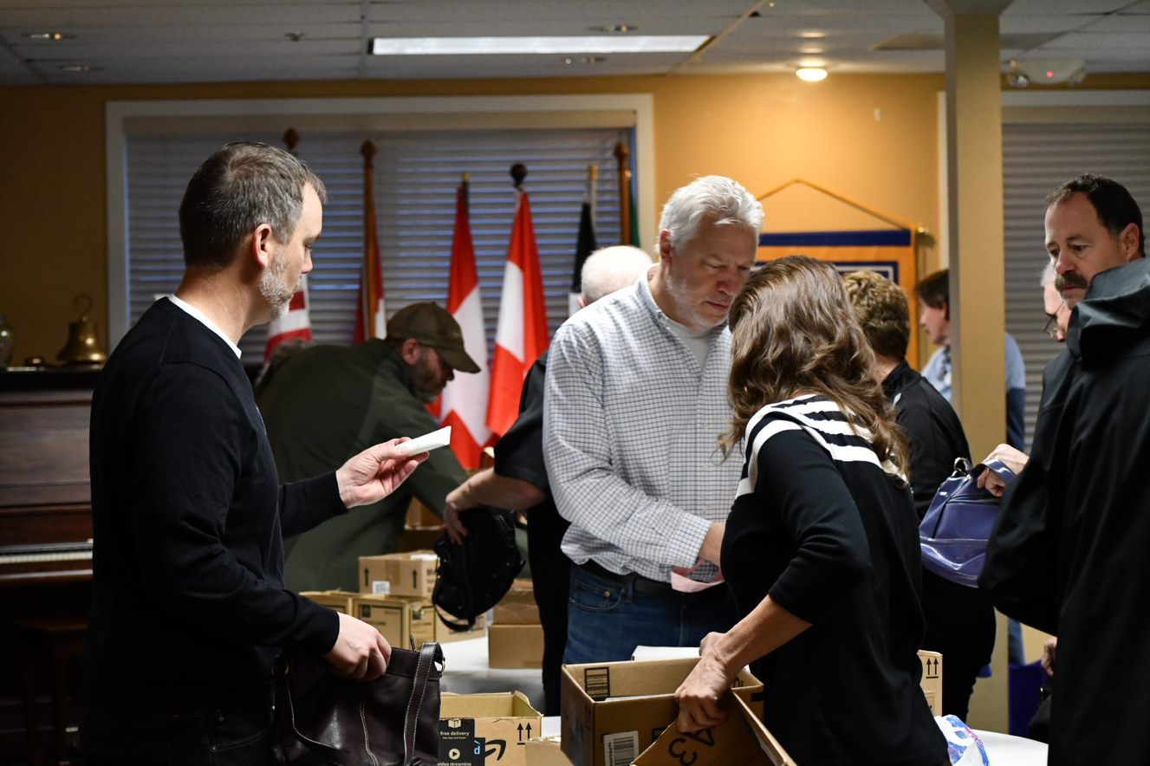
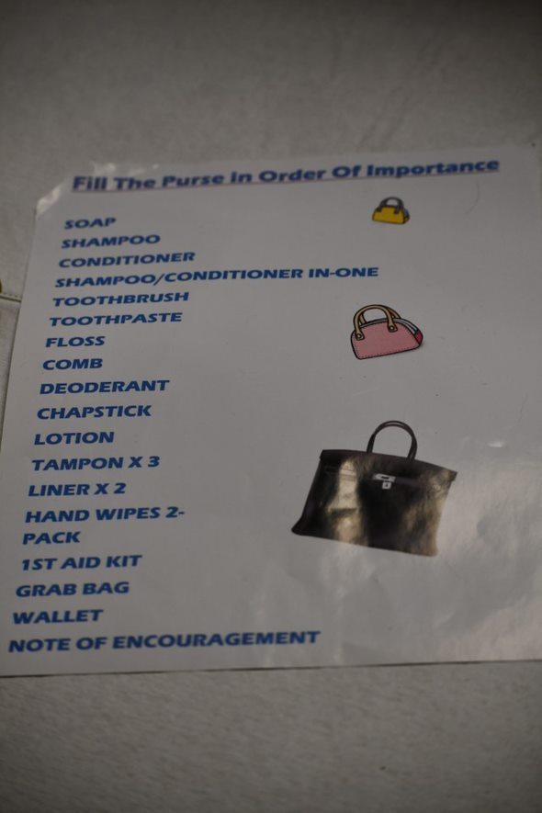
What kind of projects could you consider doing?

Slide 8
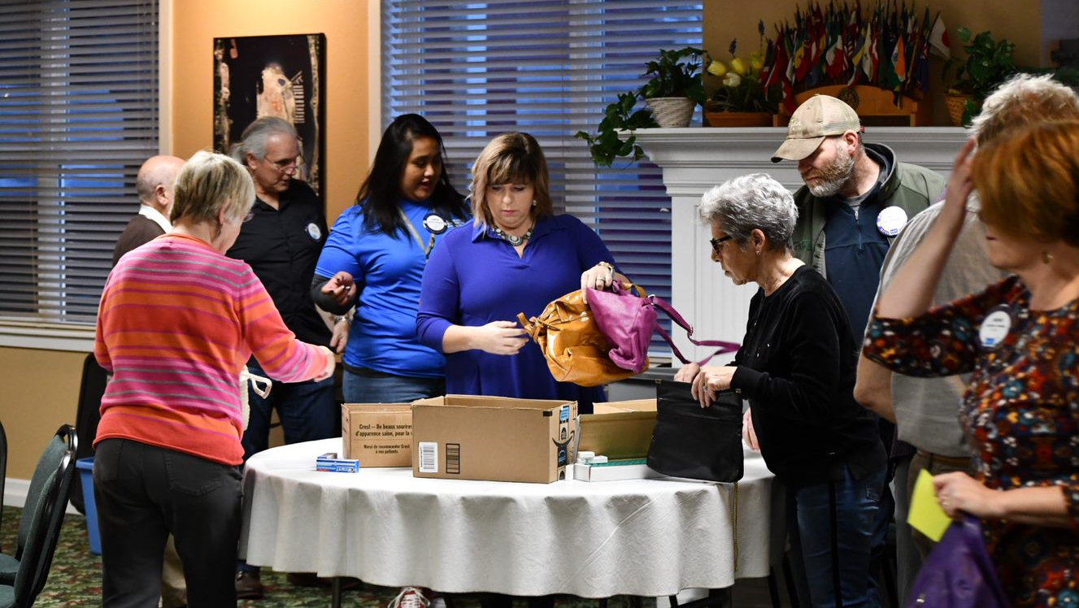

Slide 9
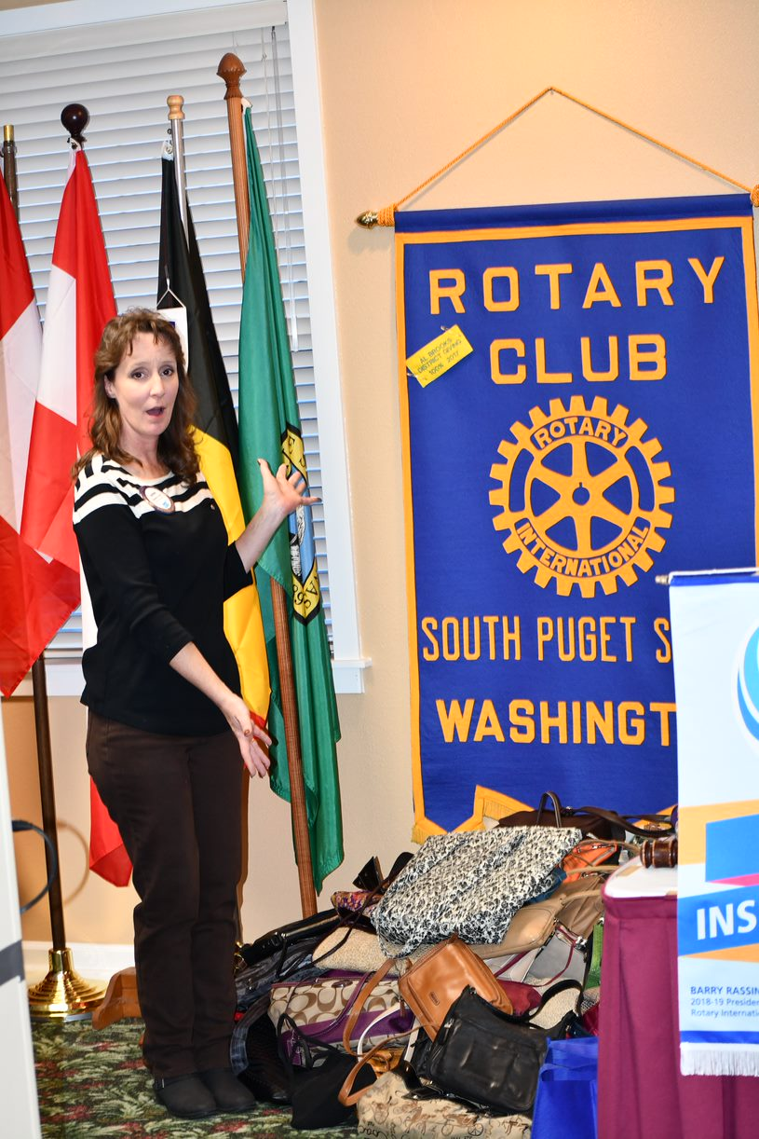
100 Donated Purses Were Filled With Necessities & Were Ready to be Delivered to a Local Domestic Violence Center in 30 minutes!

Slide 10
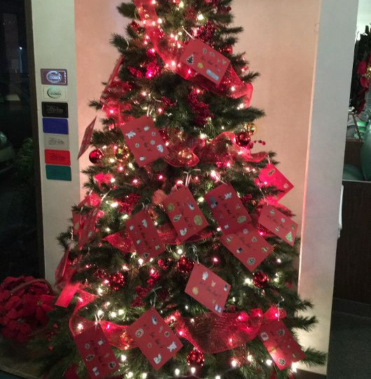
Christmas
Giving Tree
Rotarians Collected & Wrapped Gifts for needy families

Slide 11
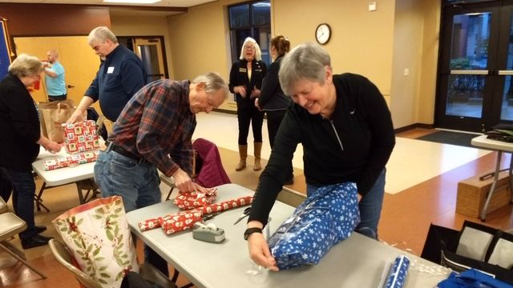

Slide 12
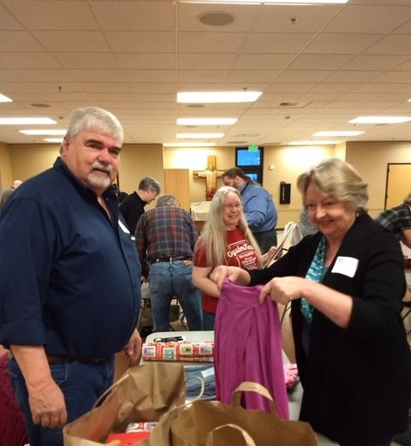
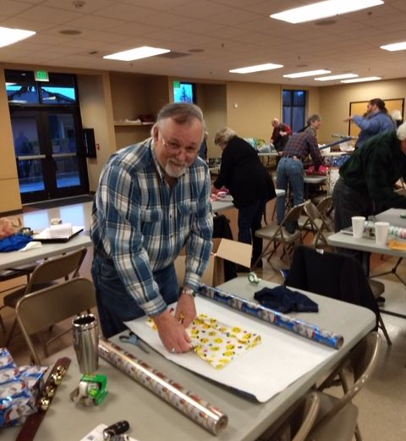

Slide 13
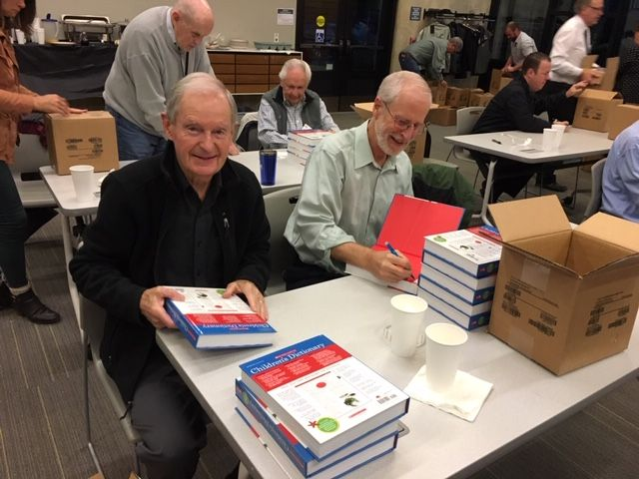
400 Dictionaries were signed with personalized notes included and delivered by Rotarians to 4th graders. The Rotarians were instrumental in teaching the children how to use a dictionary!

Slide 14
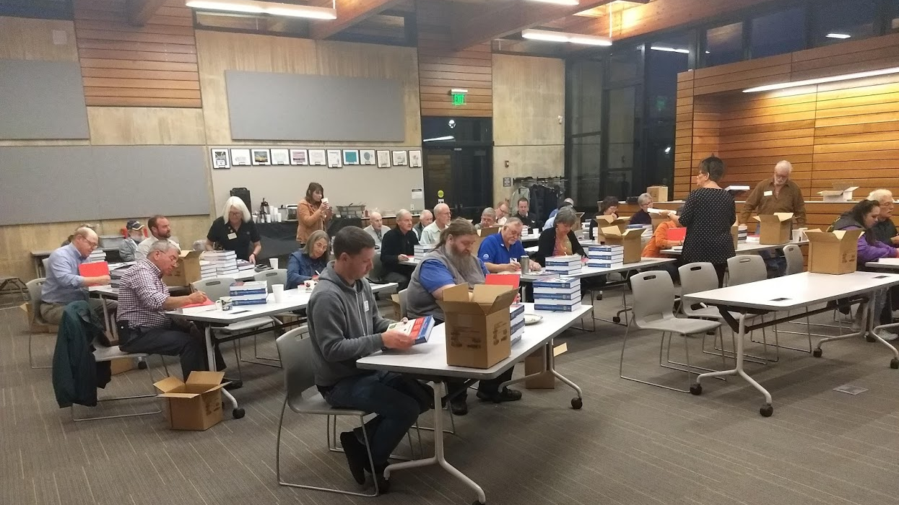

Slide 15
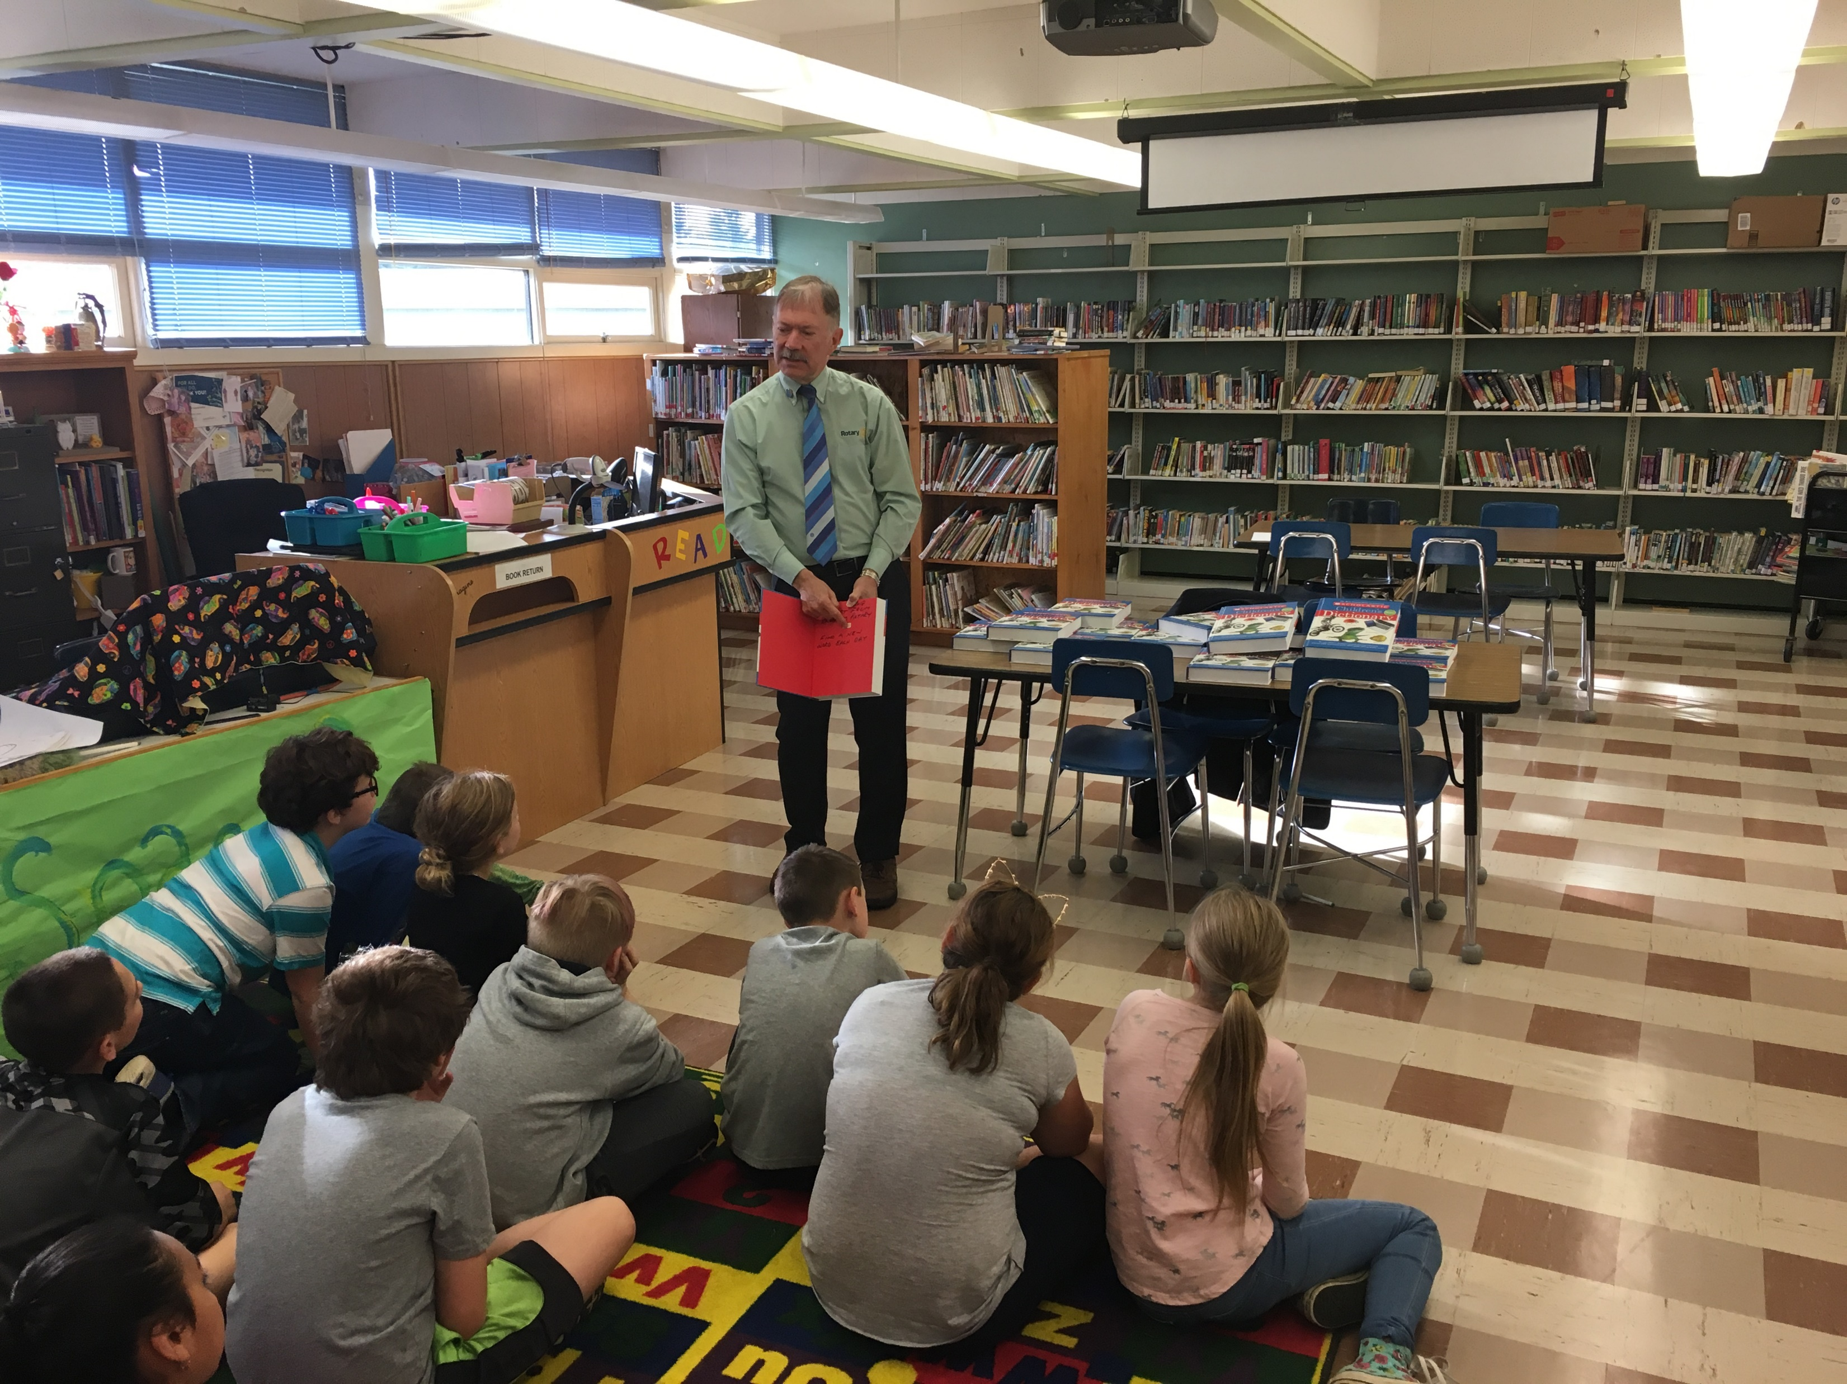
District Governor Craig Gillis Even Got Involved!

Slide 16
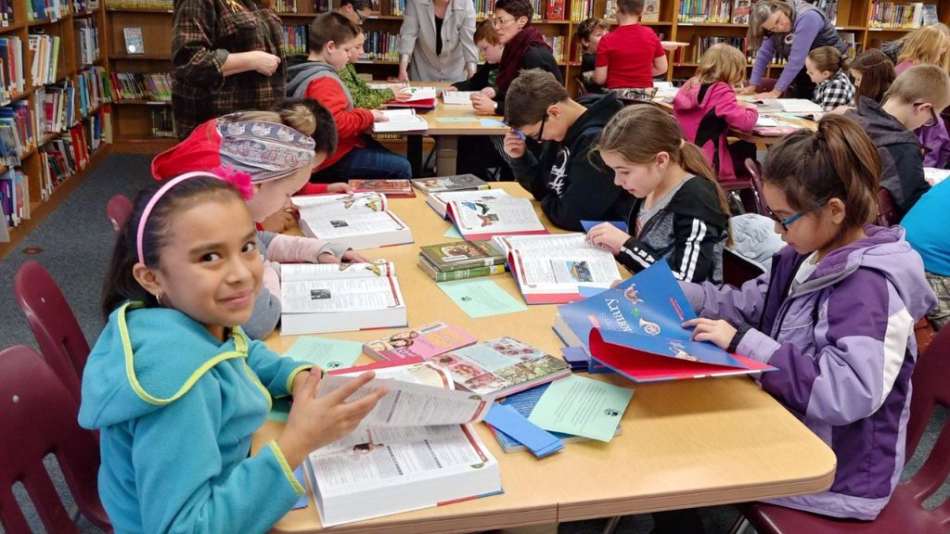

Slide 17
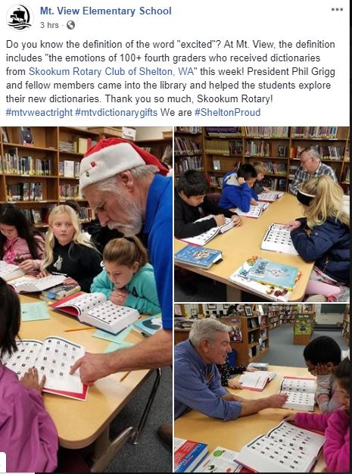
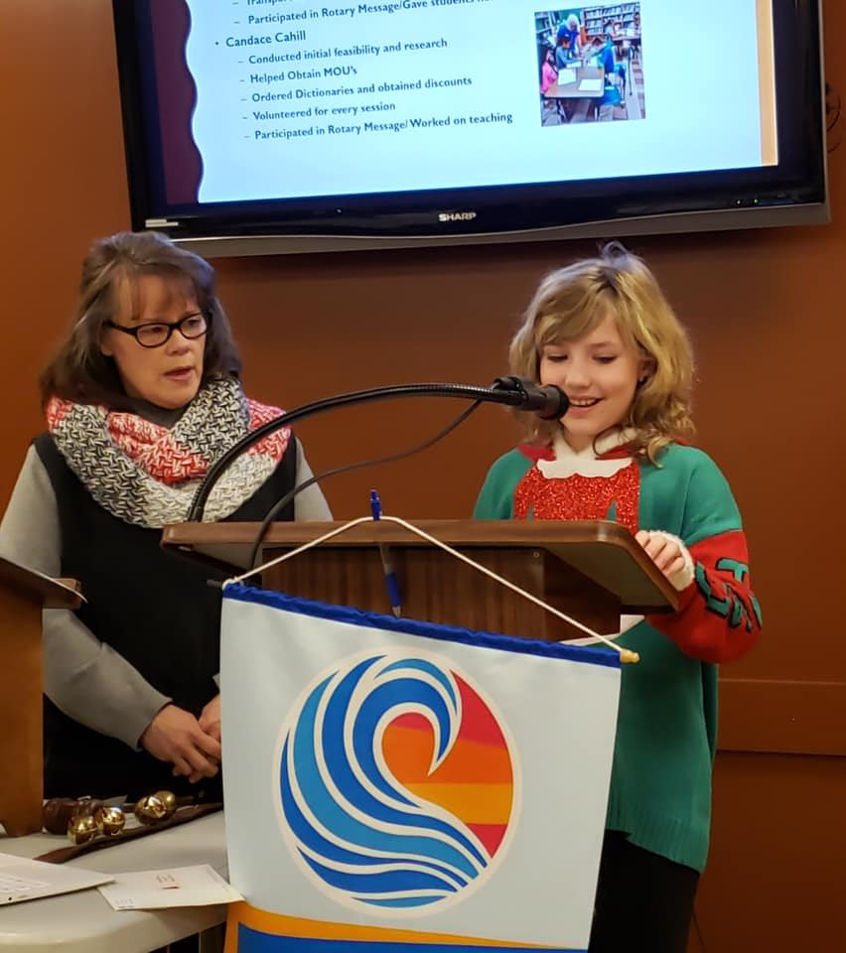
Personal Thank You From a 4th Grader!

Slide 18
Holiday Cookies – Ask members to bring in 2 dozen cookies. Have members separate and vary the cookies into appropriate portions, label with a sticker and deliver to Senior Services.

Slide 19
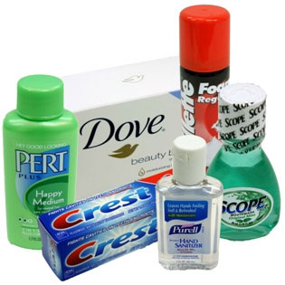
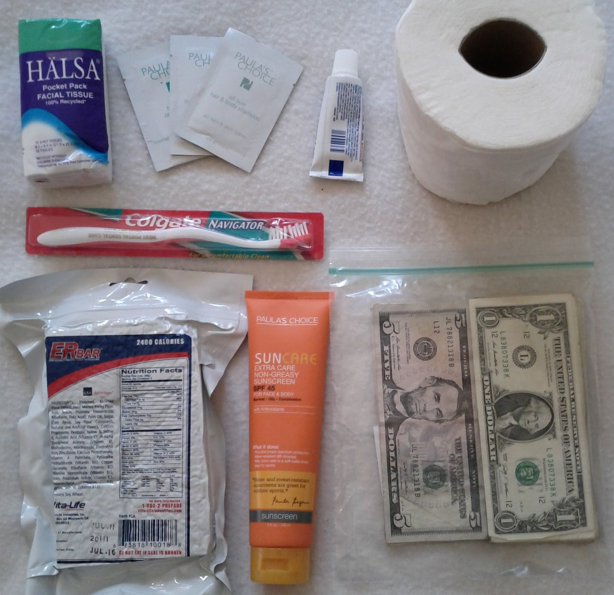
Warm/Hygiene Kits for Homeless or Domestic Violence Victims. Include toothbrushes, soap, toilet paper, hats, gloves, socks, mylar blanket, lip balm, sweatshirts

Slide 20
Valentines or other Holiday Cards for Troops – Bring in markers, stickers, stamps and all kinds of art supplies. Ask members to personally create a card for our active duty service men and women with a personal note.

Slide 21
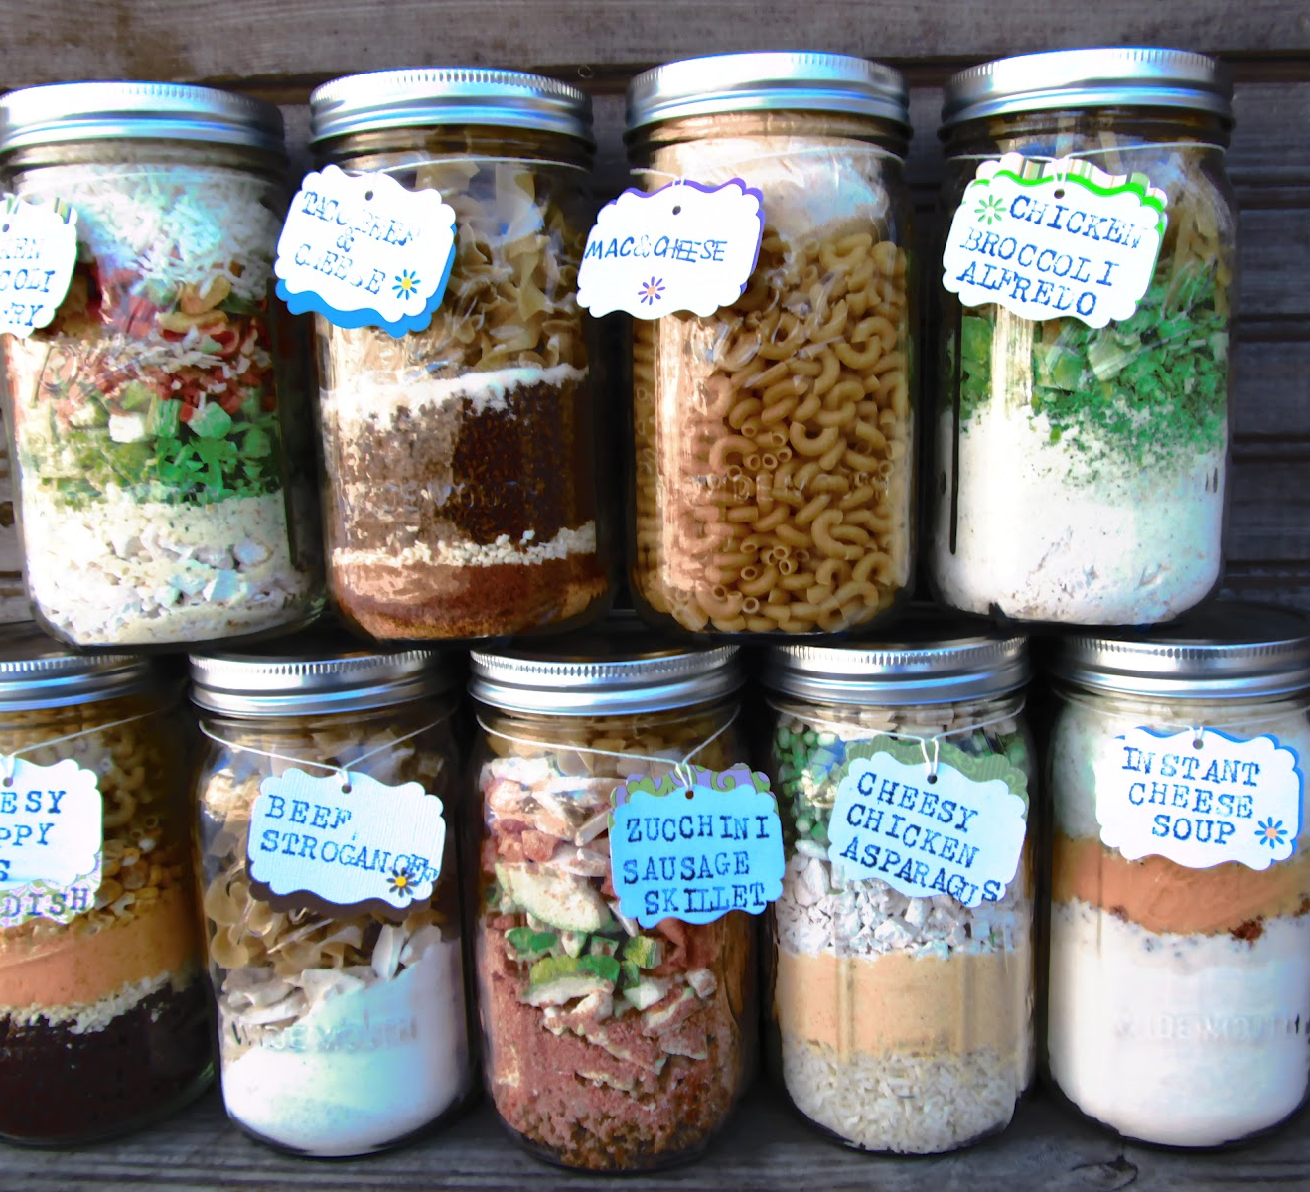
Homemade Soup – Have members bring in a recipe and ingredients to make homemade soup. Pack them neatly in containers and deliver to the Senior Center or Food Pantry

Slide 22
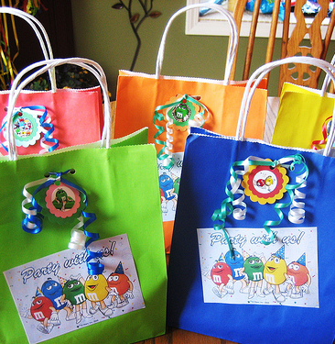
My Personal Favorite!
PARTY IN A BAG

Slide 23
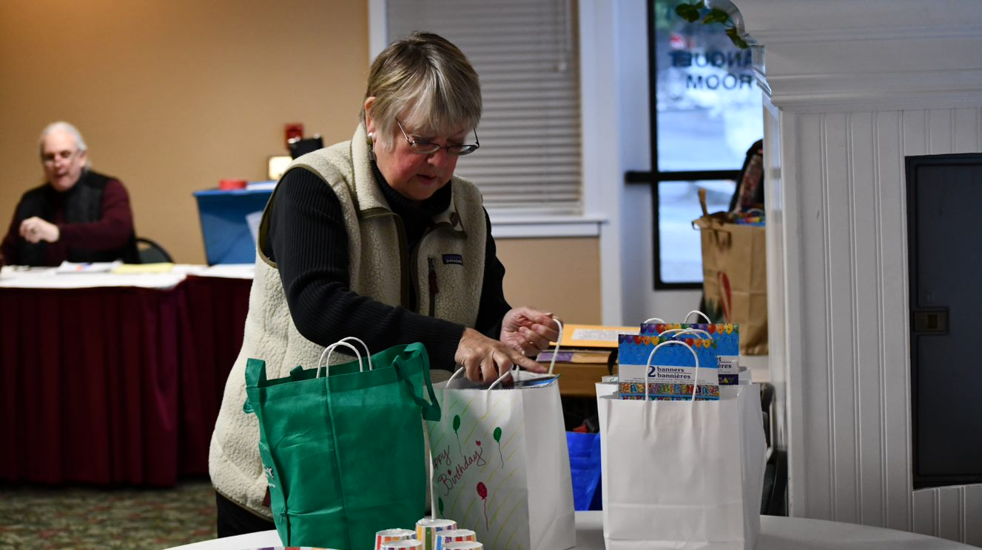

Slide 24
Any excuse for a party!

Slide 25
There are so many more ideas! How about some of these?
Project Linus Blankets – Pre-cut fabric for no sew blankets. Deliver to children’s units in hospitals.
Go off-site & plant flowers or bulbs outside of a nursing home or assisted living facility to cheer up residents.
Build/decorate collection boxes for a sock drive. Deliver to local businesses, collect & package them for Veterans, homeless, kids – anyone who needs socks!

Slide 26
Or maybe these?
Create support signs for local events like Relay for Life, Special Olympics, fundraising races.
Fill bags with school supplies to supplement teacher’s needs.
Prepare & take a meal to first responders at their fire station or police department.

Slide 27
What Ideas Do YOU Have?
This Photo by Unknown Author is licensed under CC BY-NC-ND
This Photo by Unknown Author is licensed under CC BY-NC-ND

