Slide 1






Save The Date
DISTRICT 5950
ANNUAL MEETING
May 9, 2024
7:00pm - 8:00pm
Via Zoom

Slide 2
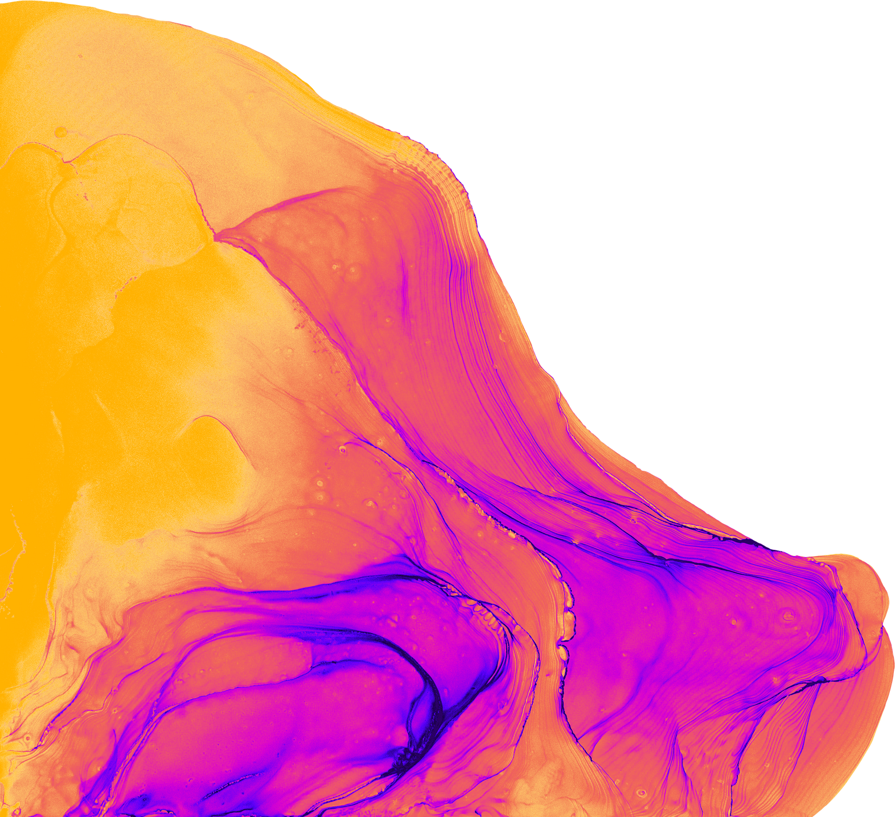

7:00pm - 7:45 PM CST
Staying Engaged
January 8th: Shelter Box
February 5th: North Star Youth Exchange
March 4th: End Human Trafficking
April 1st: Friendship Exchange
May 5th: TBD

Slide 3
Staying Engaged
January 8th
7:00pm - 7:45 PM CST
SHELTER BOX
TIM CONNELLY

Slide 4
Staying Engaged
February 5th
7:00pm - 7:45 PM CST
NORTH STAR YOUTH EXCHANGE
ERIC JOHNSRUD

Slide 5
Staying Engaged
March 4th
7:00pm - 7:45 PM CST
END HUMAN TRAFFICKING
Karen Walkowski

Slide 6
Staying Engaged
April 1st
7:00pm - 7:45 PM CST
FRIENDSHIP EXCHANGE
SAM DALAL

Slide 7
Staying Engaged
May 6th
7:00pm - 7:45 PM CST
TBD

Slide 8

Virtual
&
LUNCH LEARNS
Club Runner hints
Wednesday - December 13th - Updating Club Leadership
Thursday - January 18th - Creating a Club Logo
Thursday - February 22nd - Bulletins by Mark Shockey
Monday - March 11th - Website Homepage by Mark Shockey
Wednesday - April 17th - Events & Club Calendar
Friday- May 10th - Club Documents
An online series focused on expanding
Club Runner knowledge through monthly topics

Slide 9
Virtual
&
LUNCH LEARN
Public Image Hints
Thursday - January 18th
11:45am - 12:30 PM CST
CREATING A ROTARY CLUB LOGO
An online series focused on expanding
Club Runner knowledge through monthly topics

Slide 10
Virtual
&
LUNCH LEARN
Club Runner Hints
Thursday - February 22nd
11:45am - 12:30 PM CST
BULLETINS
LED BY MARK SHOCKEY
An online series focused on expanding
Club Runner knowledge through monthly topics

Slide 11
Virtual
&
LUNCH LEARN
Club Runner Hints
Monday - March 11th
11:45am - 12:30 PM CST
WEBSITE - HOMEPAGE
LED BY MARK SHOCKEY
An online series focused on expanding
Club Runner knowledge through monthly topics

Slide 12
Virtual
&
LUNCH LEARN
Club Runner Hints
Wednesday - April 17th
11:45am - 12:30 PM CST
EVENTS & CLUB CALENDAR
An online series focused on expanding
Club Runner knowledge through monthly topics

Slide 13
Virtual
&
LUNCH LEARN
Club Runner hints
Friday- May 10th
11:45am - 12:30 PM CST
DOCUMENTS
An online series focused on expanding
Club Runner knowledge through monthly topics

Slide 14



Entering Club Goals
Tips and How-To Guide
Friday - December 1, 2023
9:00am-10:00am CST
Via Zoom (register for link)

Slide 15
Entering Club Goals
Tips and How-To Guide
Thursday - November 30, 2023
4:30pm-5:30pm CST
Via Zoom (register for link)

Slide 16

ELEVATING IMPACT TOGETHER
Friendship & Funds Fest
Morning of
January 27th
At Plymouth Community Center
14800 34th Ave N, Plymouth, MN 55447
Engage in informative breakouts, explore the Hall of Friendship, and enjoy the spirit of fellowship as we gain insights from successful Rotary clubs in fundraising and membership growth.

