Slide 1
“Get to Know Rotary”
Western Douglas County Rotary

Slide 2
ROTARY INTERNATIONAL
Chartered in 1905
World-wide Organization …
Only Non-Governmental Member of the United Nations
1.4 Million Members
46,000 Clubs
Founding Partner of the Global Polio Eradication Initiative
Reduced polio by 99.9%
Vaccinated nearly 3 Billion Children in 122 Countries
Contributed over $2.1 Billion to the cause since 1979
Rotary International … www.rotary.org
District 5650 … www.rotarydistrict5650.org

Slide 3
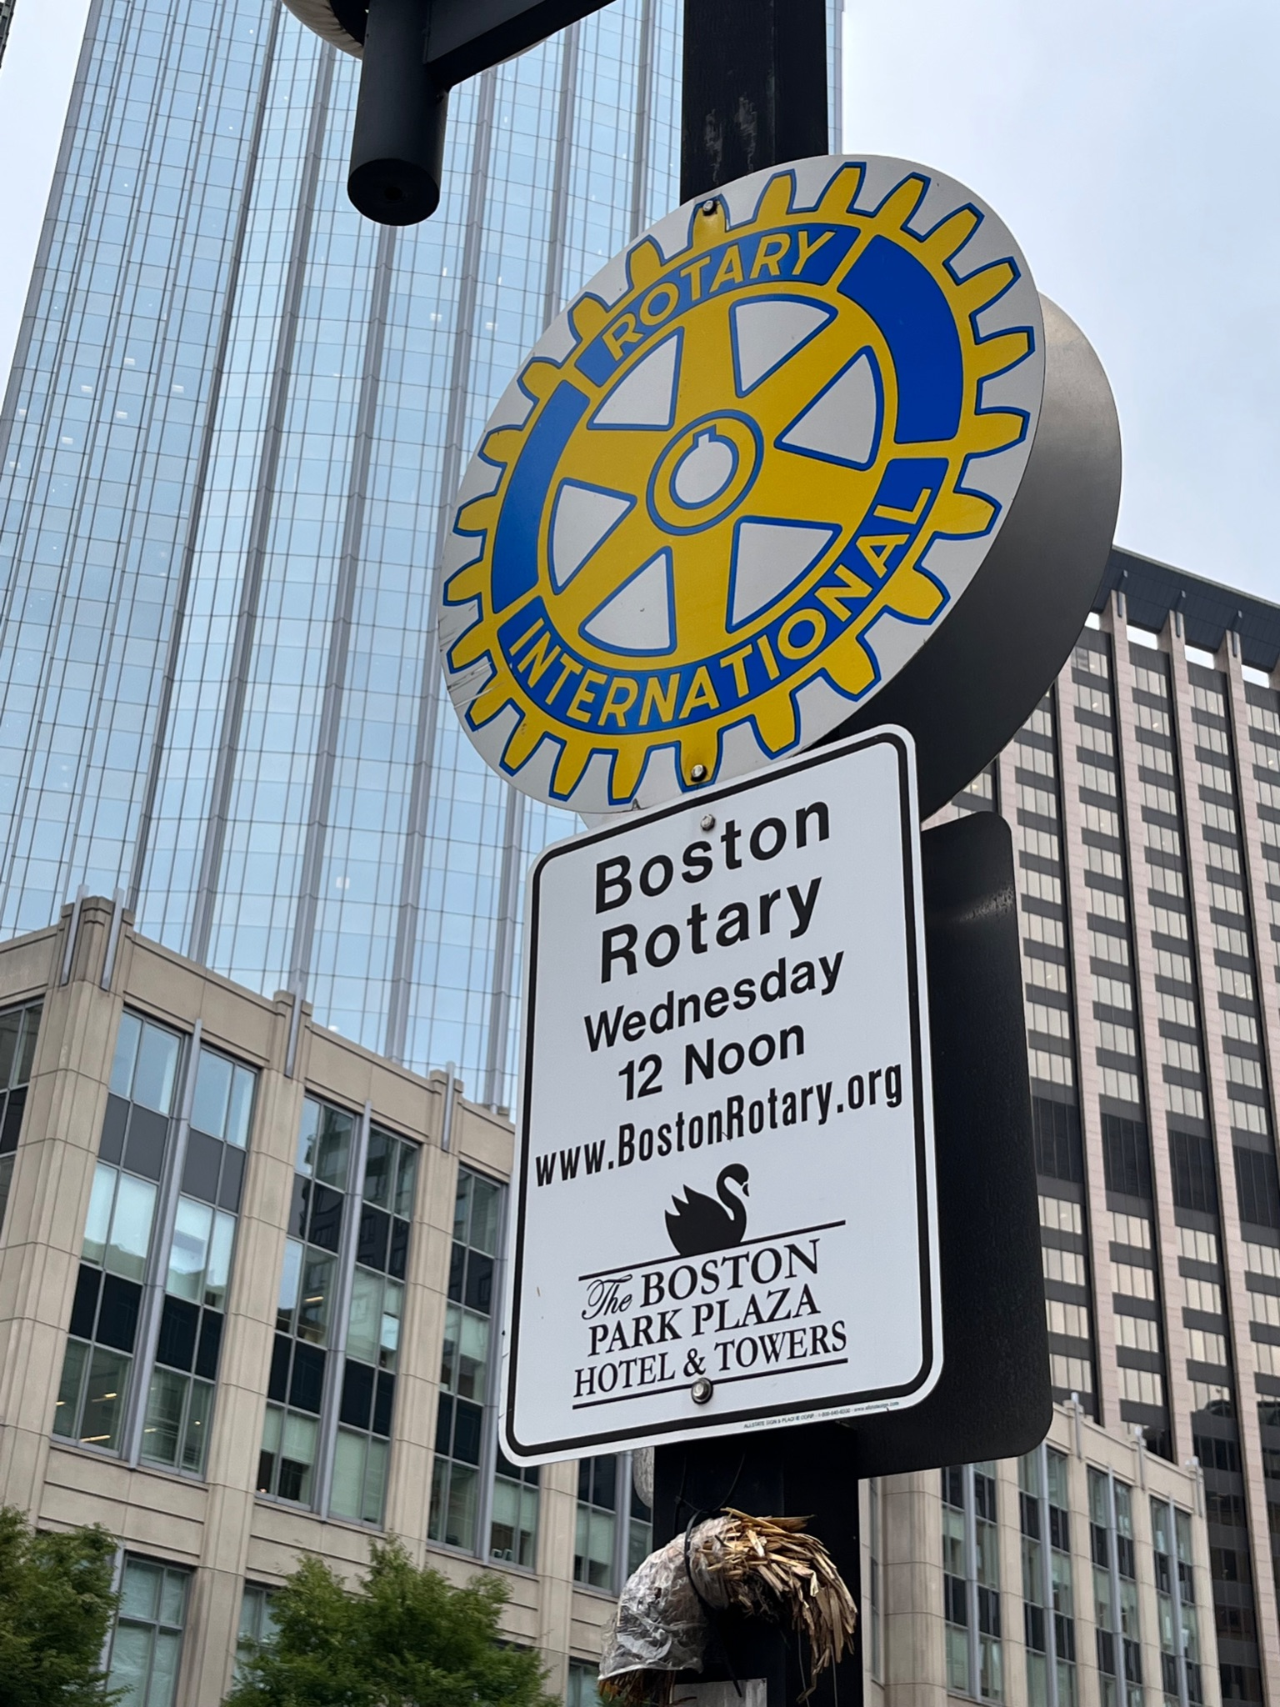
Rotary International “Wheel” is a universal, world-wide symbol

Slide 4
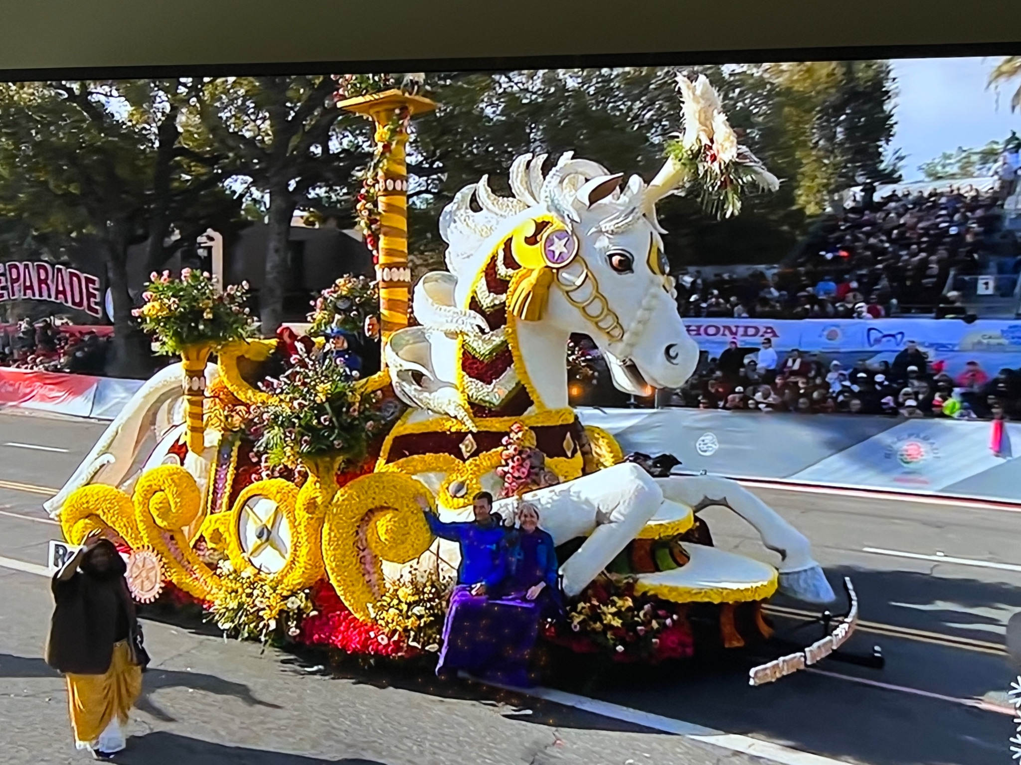
2023 Tournament of Roses Parade
“Serving with Imagination and Hope”

Slide 5
ROTARY INTERNATIONAL …
Our Motto is “SERVICE ABOVE SELF”
Primary Missions …
Promote Peace and Understanding in the World
Fight Disease and Provide Clean Water
Support Mothers and Children
Support Education
Grow Local Economies
Rotary Foundation (2022) …
$434 million raised
1,190 Global Grants
470 District Grants
225 Disaster Response Grants

Slide 6
ROTARY INTERNATIONAL …
4-Way Test …
Is it the Truth?
Is it Fair to All Concerned?
Will it Build Goodwill and Better Relationships?
Will it be Beneficial to All?
(Non-Political and Non-Religious Organization)

Slide 7
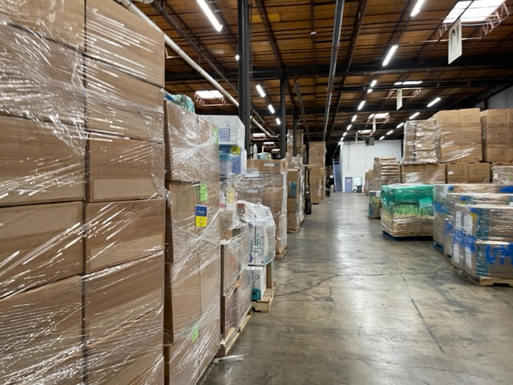
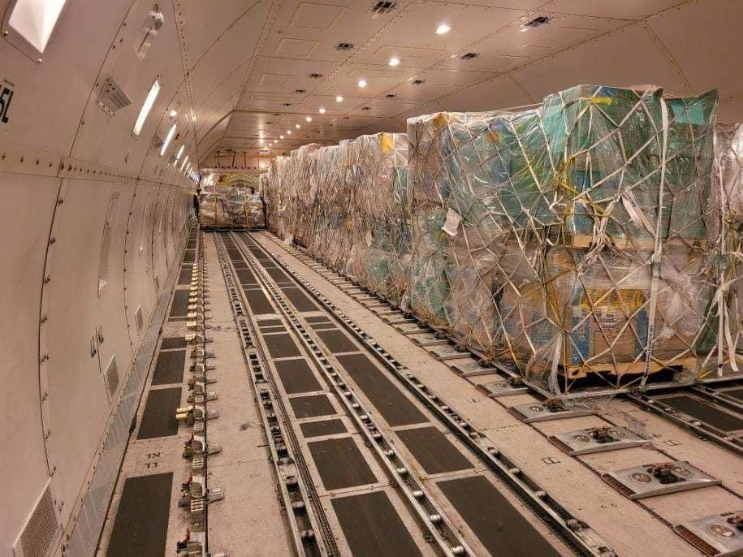
2022 … Major Effort to Support the Citizens of Ukraine ($15m in 45 days)

Slide 8
Activities and Events are sponsored everywhere!

Slide 9
WESTERN DOUGLAS COUNTY ROTARY …
Chartered in 1990
Member of District 5650 (Eastern Nebraska & Western Iowa)
Elkhorn, Waterloo & Valley Areas
Former and Current Business Leaders

Slide 10
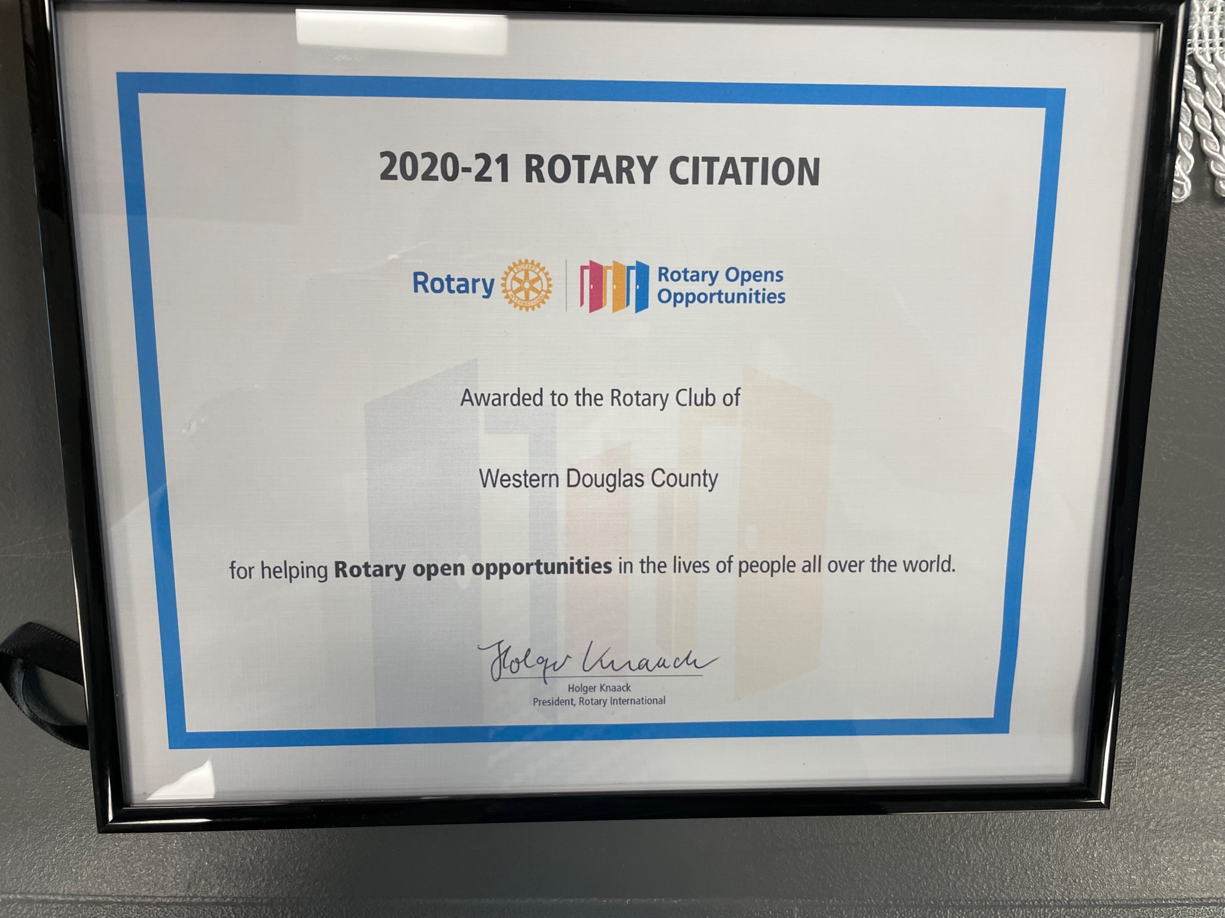
39 Clubs in District 5650

Slide 11
WESTERN DOUGLAS COUNTY ROTARY …
Locally, We Support …
DC West Food Pantry
COPE (Christian Outreach Program of Elkhorn)
Salvation Army Bell-Ringing
High School Scholarships (Elkhorn High, Elkhorn South, Elkhorn North & DC West High) $1,500 each school
Annual Golf Outing (The Pines Country Club) … July 17, 2023
Weekly Meetings at the Elkhorn Public Schools Foundation (12:00 Noon)
Guest Speakers, Fellowship, Service Projects
Informal, Educational and Entertaining

Slide 12
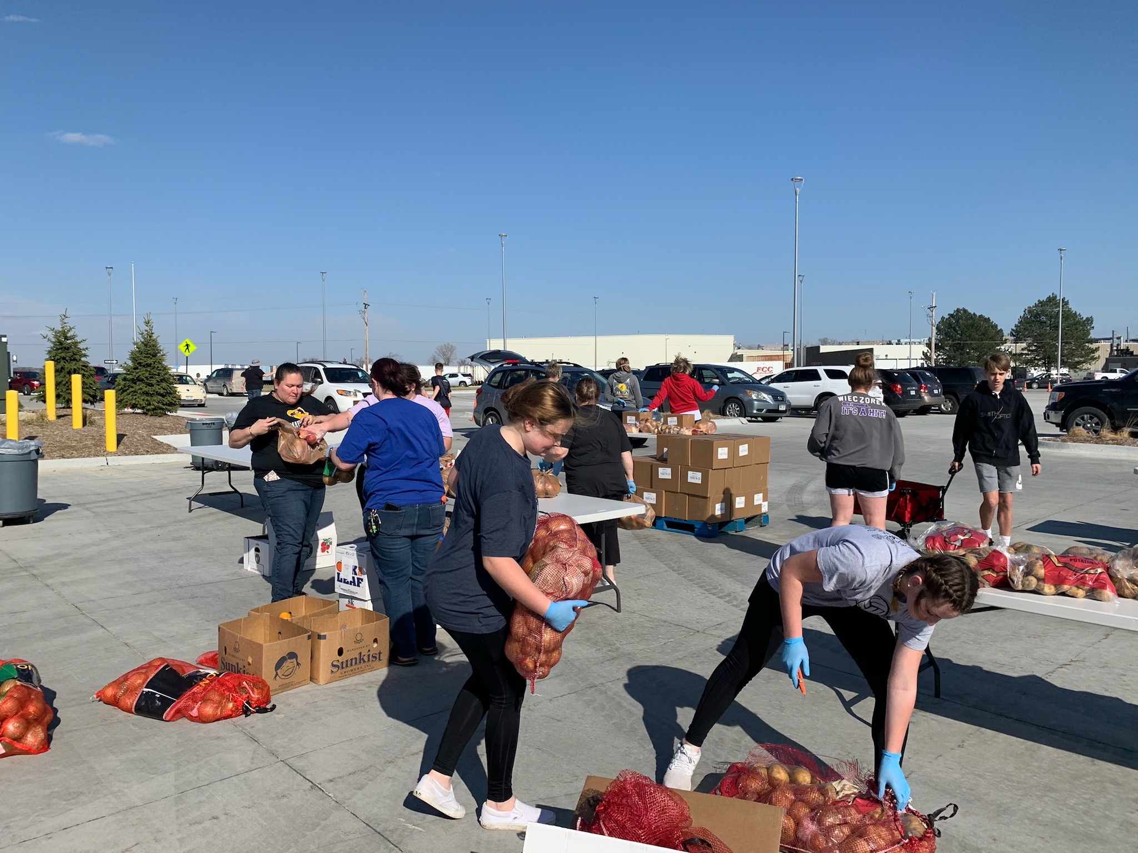
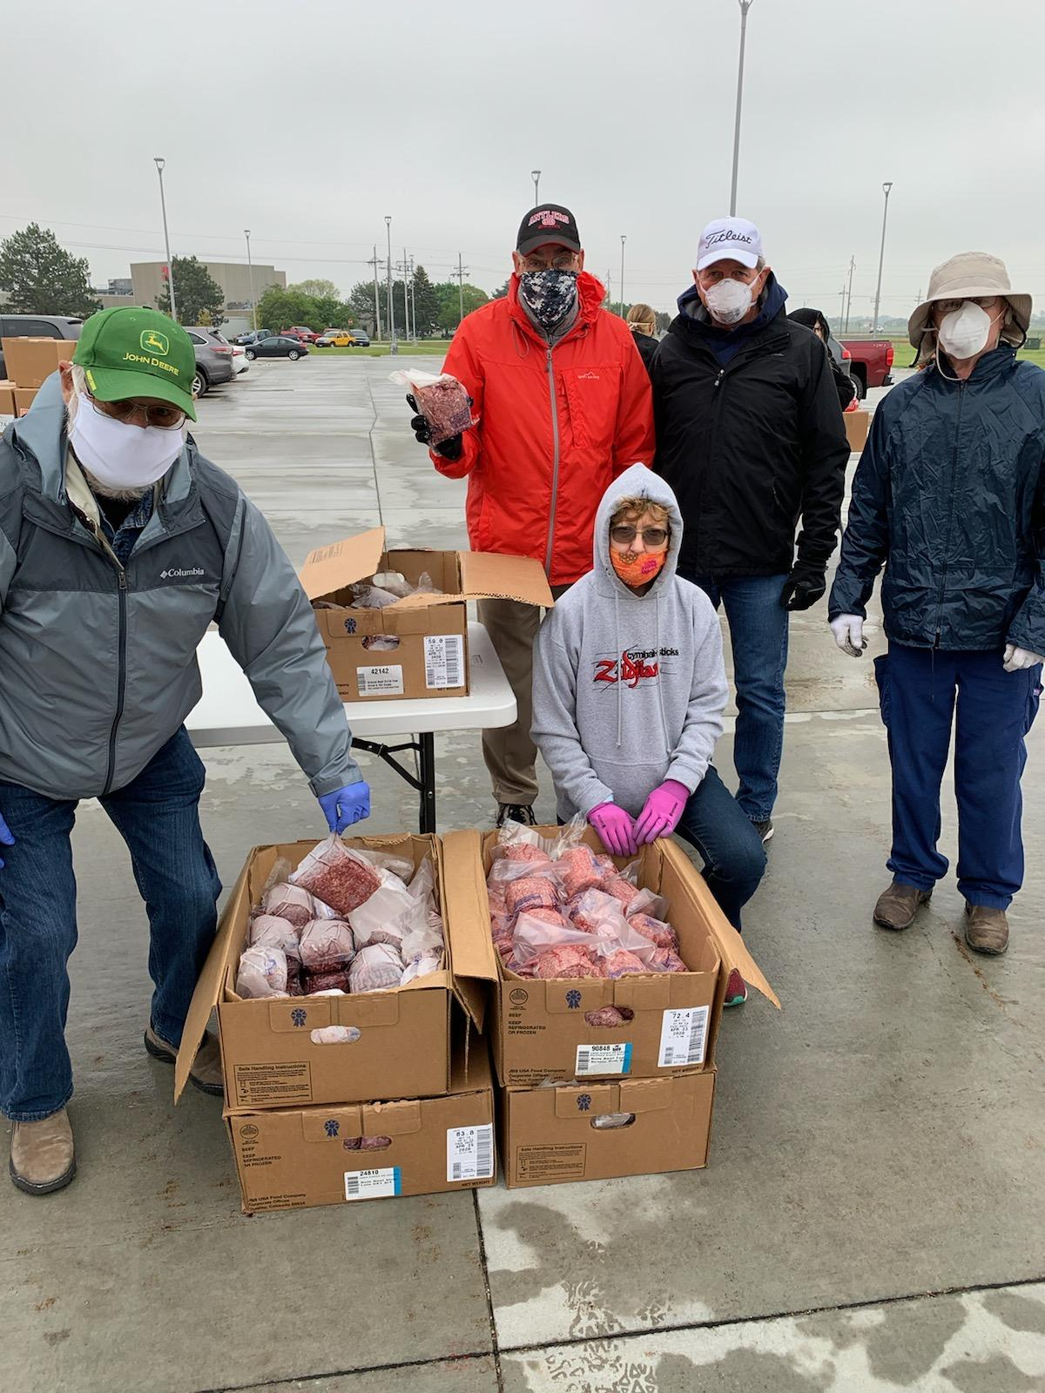
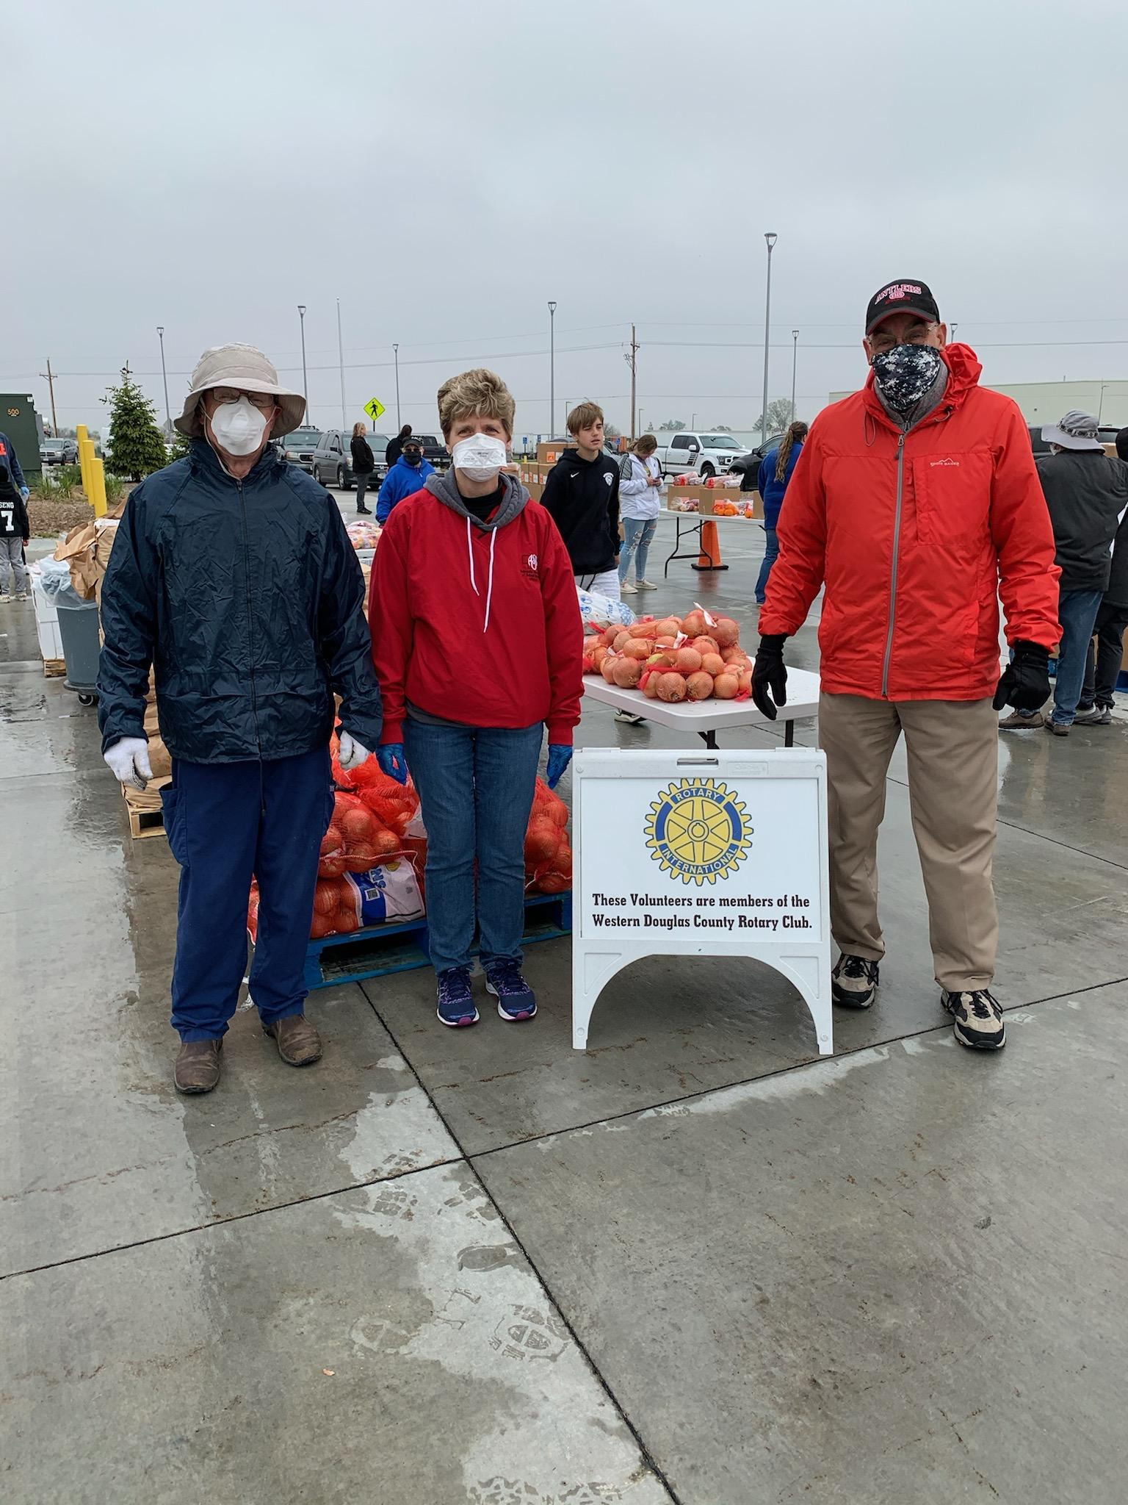
DC West Food Pantry … Club Volunteers at Work!

Slide 13
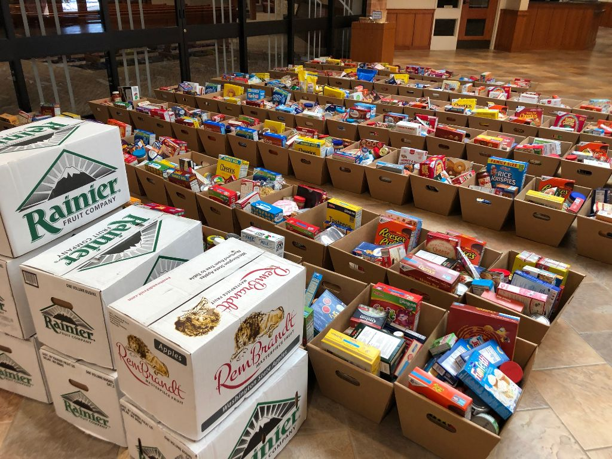
West “O” Chamber
Food Drive
(530 families served)

Slide 14
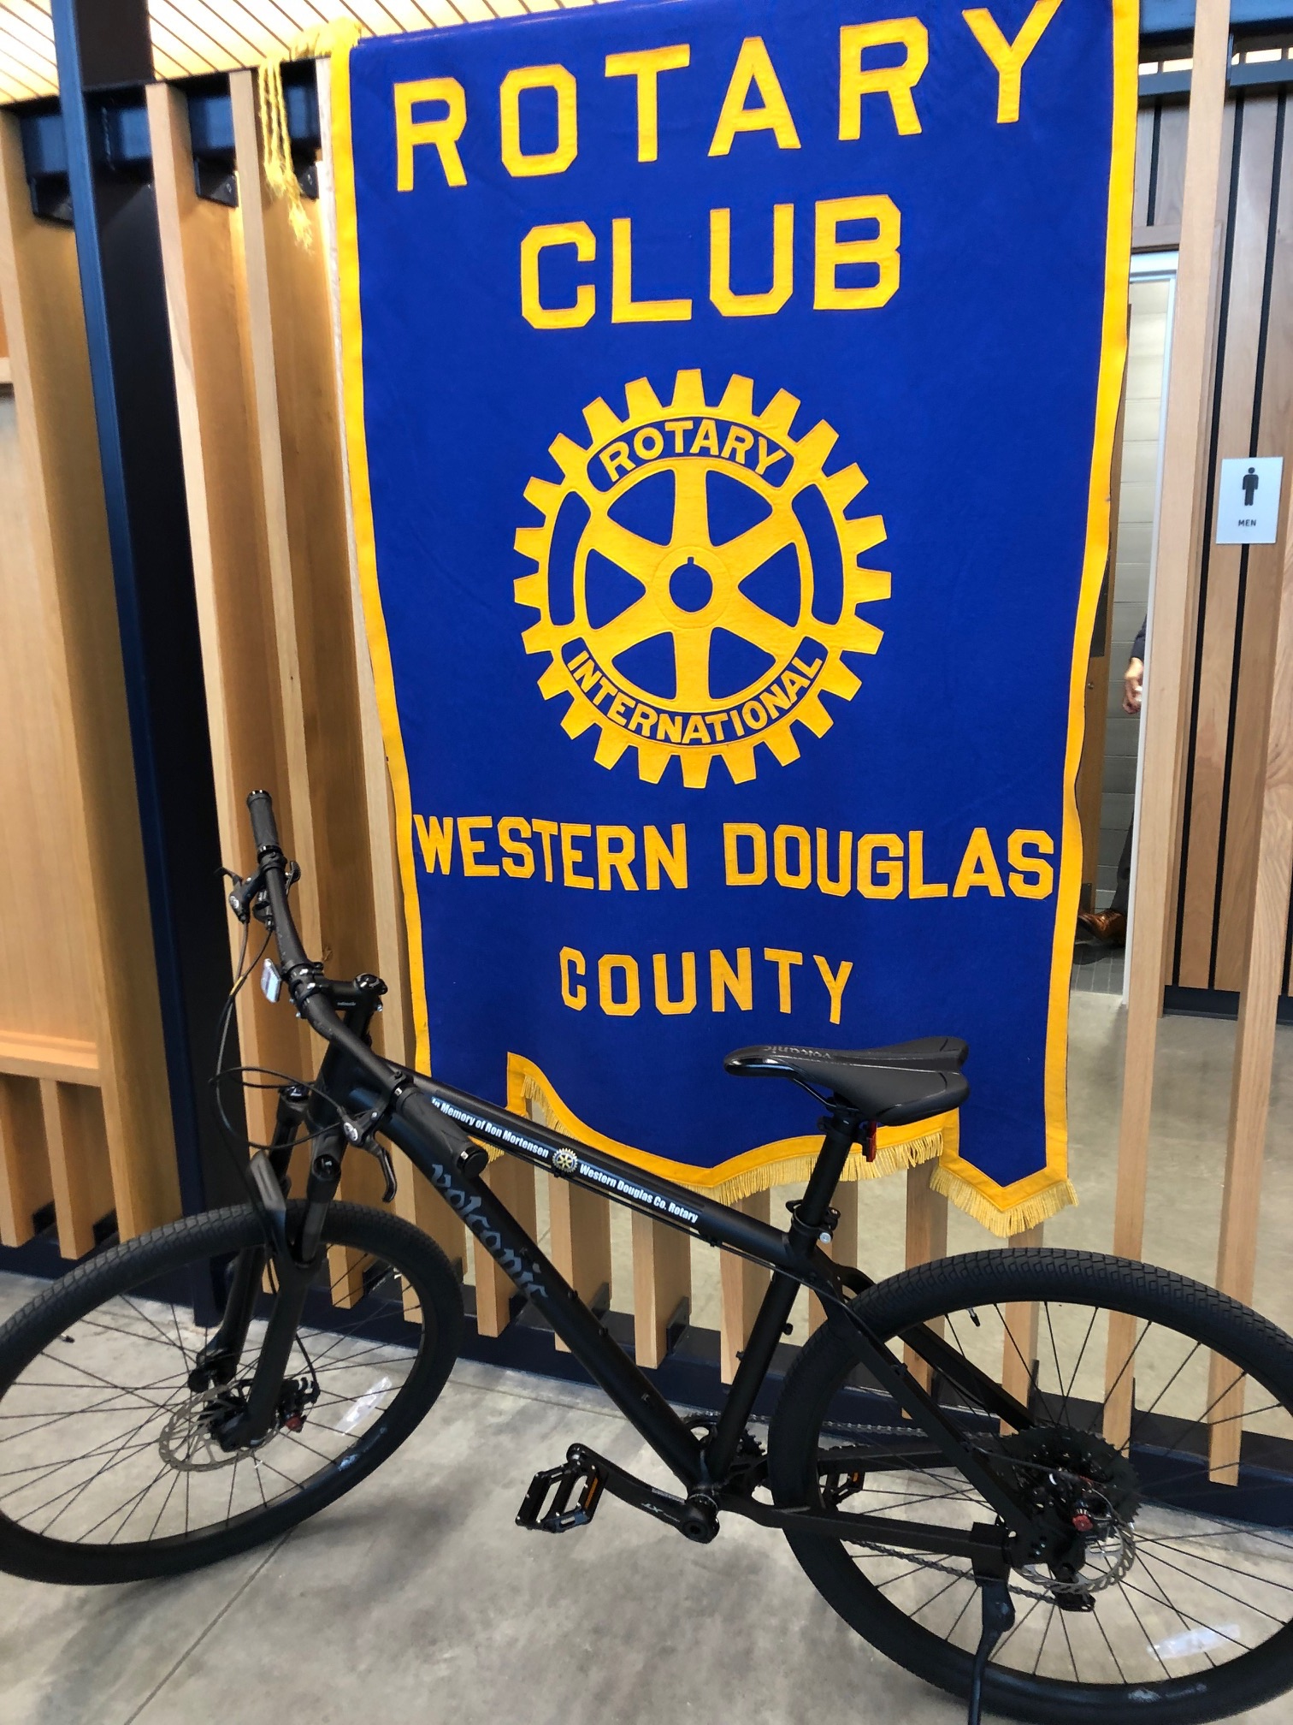
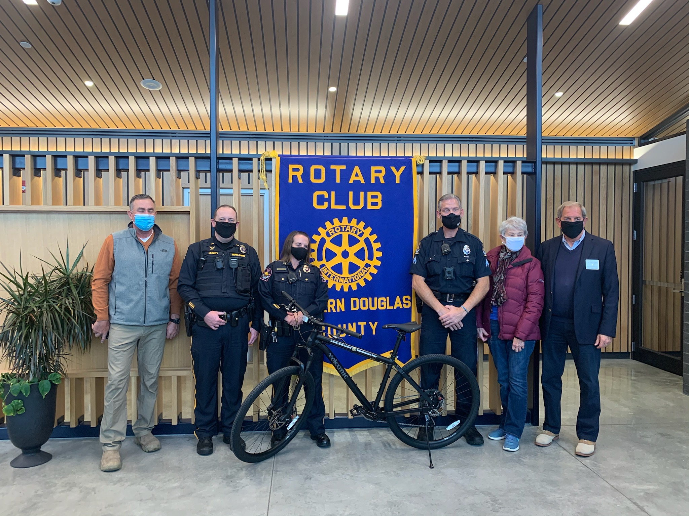
Community Service Projects
Custom-Made Bike for the
Omaha Police Department

Slide 15
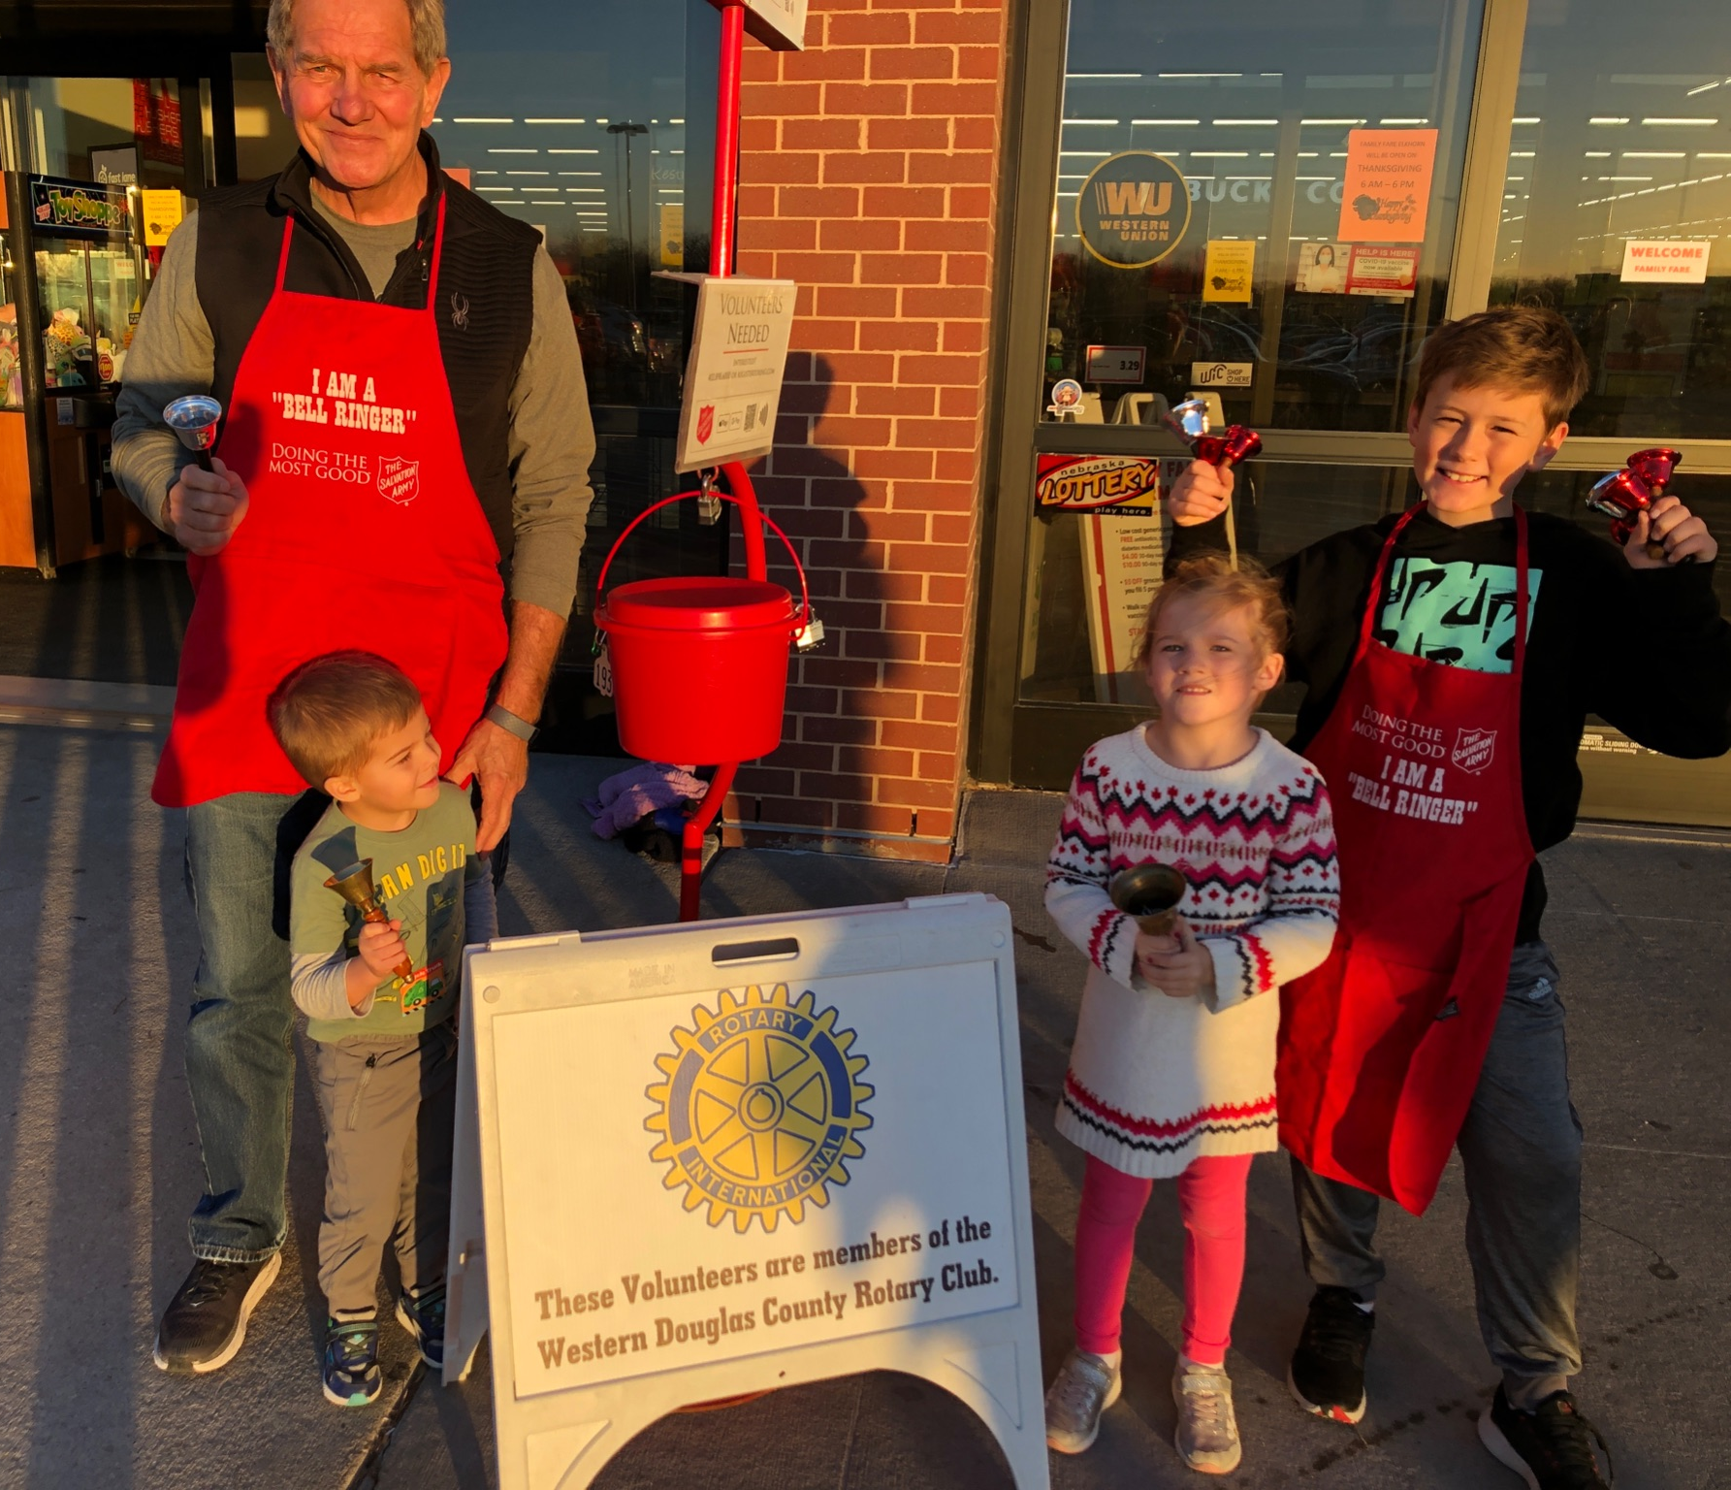
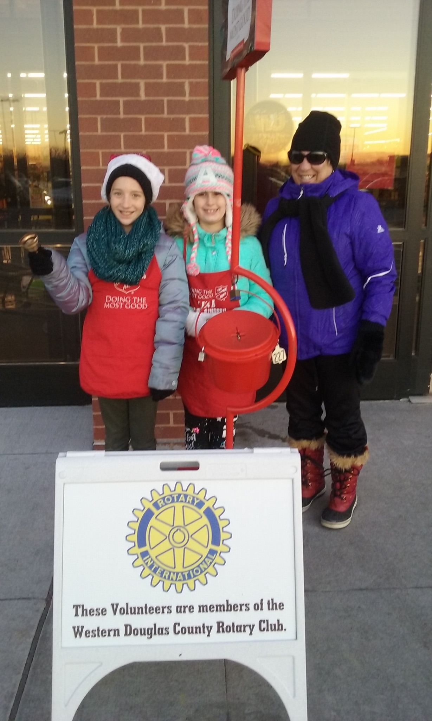
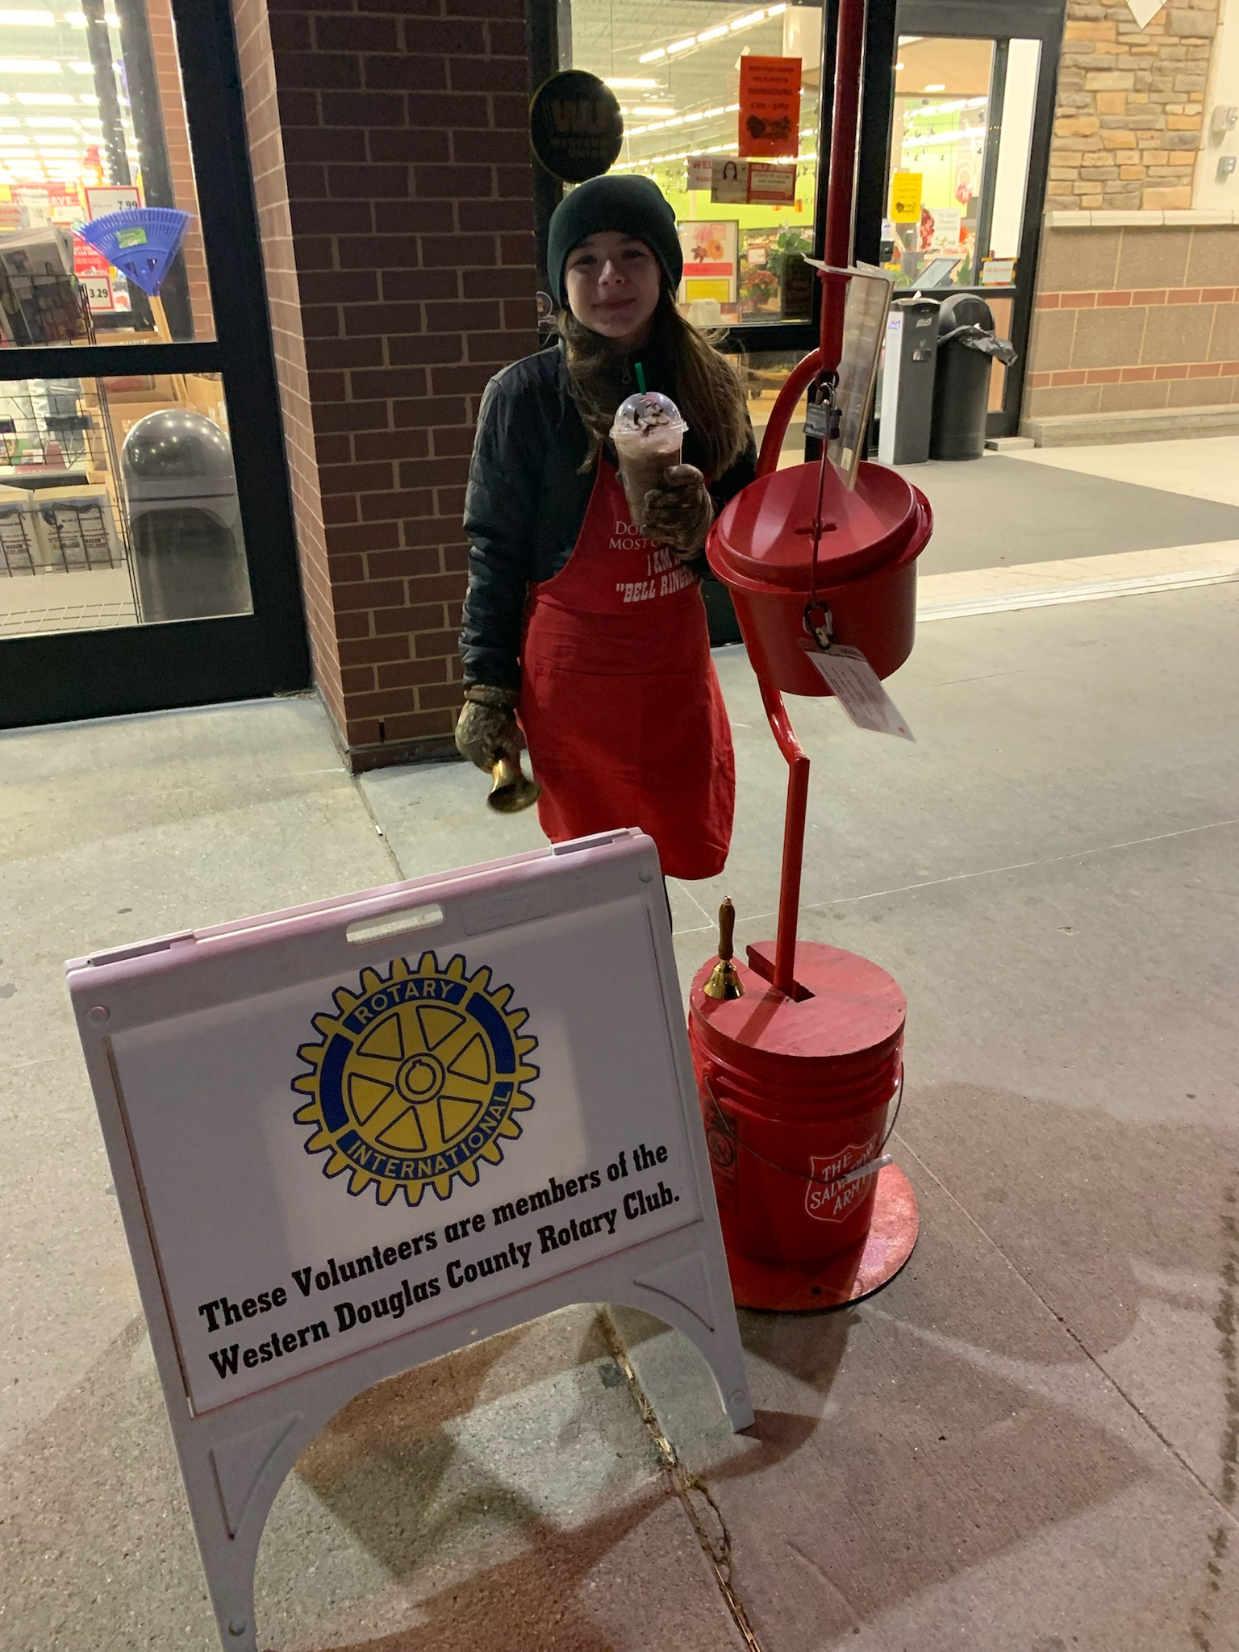
Salvation Army
Bell-Ringing

Slide 16
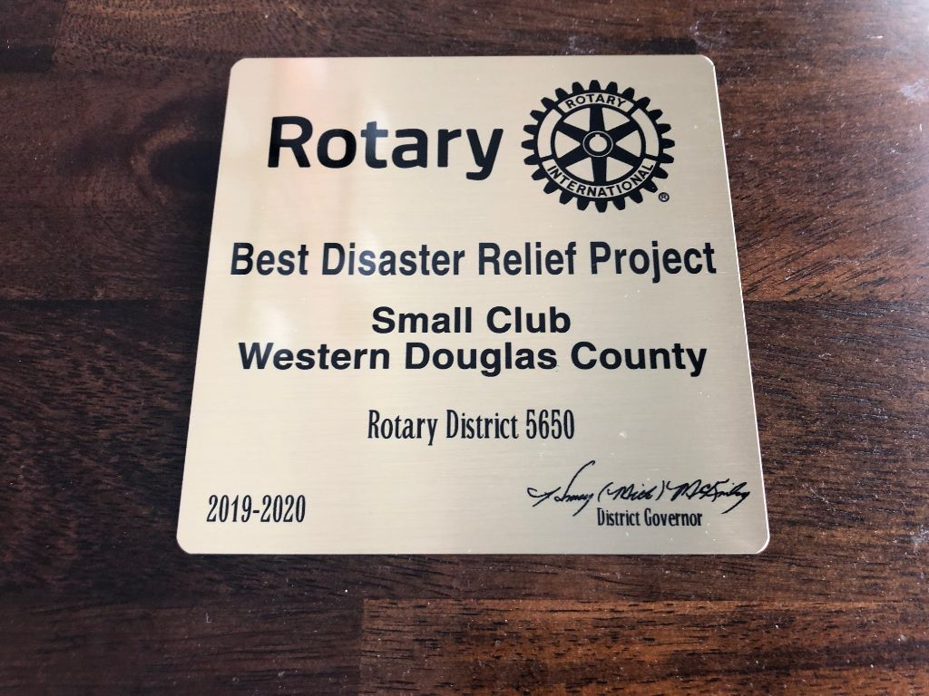
2019 - 2020
District Disaster Relief Award (Flood of 2019)

Slide 17
WDC Rotary’s
25th Annual Golf Outing
at “The Pines”
July 17, 2023
Raised ~ $8,000 for area
High School scholarships
$100 per player
$100 hole sponsor
Corporate Sponsorships

Slide 18
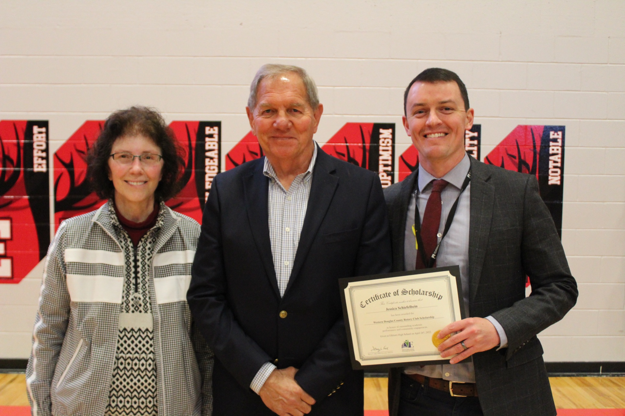
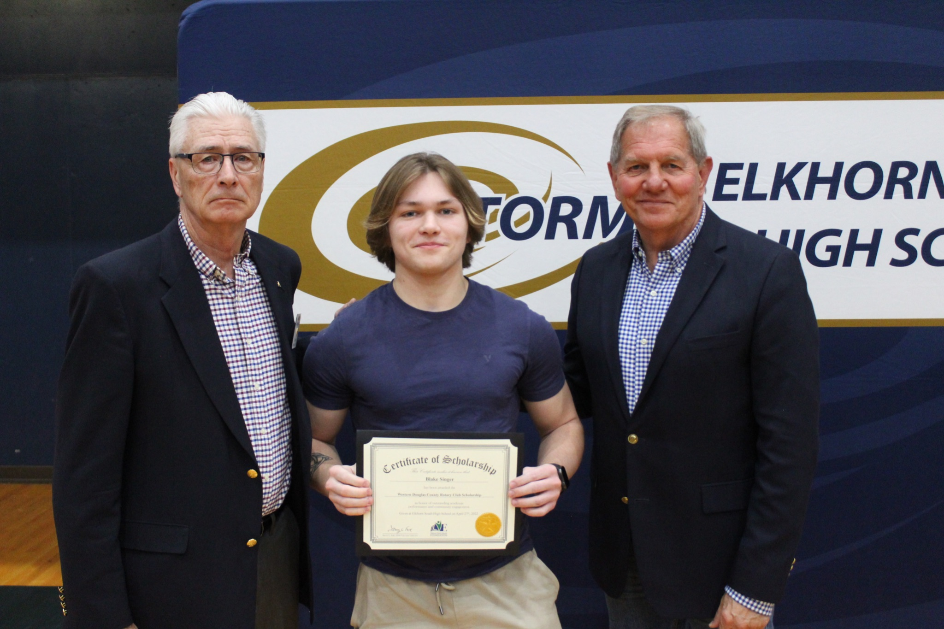
Annual Scholarships ($1,500 ea.)
DC West
Elkhorn High
Elkhorn South
Elkhorn
“Academics, Activities, Leadership, Community Service and Need”

Slide 19
Western Douglas County Rotary Membership
Rotary “Year” … July 1 2023 to June 30 2024
Membership Dues … $220 per year
Rotary International Dues
District 5650 Dues
Western Douglas County Rotary Dues
“ClubRunner” Website
Weekly Meetings …
12:00 - 1:00 PM
Elkhorn Public Schools Foundation
Monthly DC West Food Pantry
(2nd Wednesday of the Month, 4:00-5:00 PM) at DC West School

Slide 20
Thanks for Joining Us!
Questions?
Contact: Tod Ringenberg
tringenberg@cox.net

