Slide 1
Youth Service 2019-2020

Slide 2
Youth Service 2019-2020
INTRODUCTIONS YOUTHS SERVICE OFFICERS
SIGN IN SHEETS

Slide 3
QUESTIONS
HAVE YOU CHAIRED YOUTH SERVICE BEFORE?
HOW MANY MEMBERS DOES YOUR INTERACT CLUB HAVE?
HOW MUCH INVOLVEMENT DOES YOUR INTERACT CLUB HAVE WITH ROTARY AND COMMUNITY?

Slide 4
Mission and Commitment
Mission:
Youth Service is Rotary's commitment to the future. By encouraging, mentoring, and empowering our youth today, we are creating a legacy that will allow Rotary to continue its mission to see that all men and women of this world are given the opportunity to lead their lives in health, safety and prosperity.
Commitment:
Interact, Rotaract, Rotary Youth Leadership Awards (RYLA), and Rotary Youth Exchange (RYE) are Rotary sponsored programs that allow each club within the District to structure their own unique approach to Youth Service. Rotary also sponsors Global Scholars and Peace Fellows with the aim of empowering and educating young people to give back to their communities and the world.
District 5240 has a team of very dedicated Rotarians who have all found their "Rotary Moments" in working with our youth. We are here to help, encourage, offer information, advice, all to help pave the way for new youth service clubs and help older clubs thrive.

Slide 5
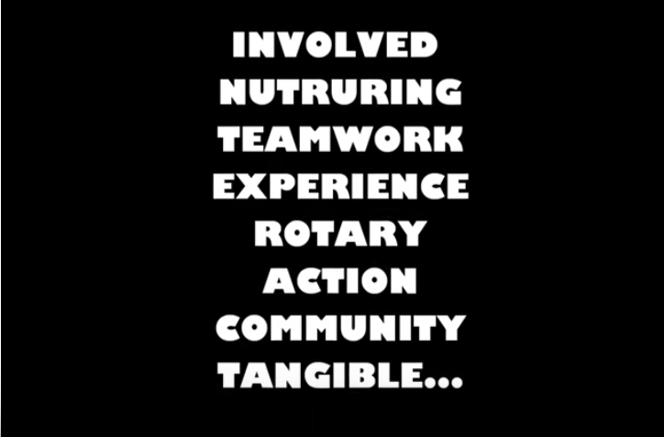
I
N
T
E
R
A
C
T

Slide 7
Present New Board with Rotary Calendar to plan year
Post your events on website, so students can get ideas and get involved with your club
fundraiser activities
Advisors and Interact Board members to Report end of year accomplishments. Facilitate continuity for next board
Provide Incoming Interact Board with Interact Handbook
Marketing/Branding Rotary /Recruiting Members RUSH WEEK
Wear T-Shirts, decorate with balloons, your Rotary Masscott, Canopies, snacks, marketing material, etc.
Provide Brochures of all Rotary Youth Services Programs
Interact
Rotaract
RYLA
YES
Exchange Programs
PRLS
Scholarships

Slide 8
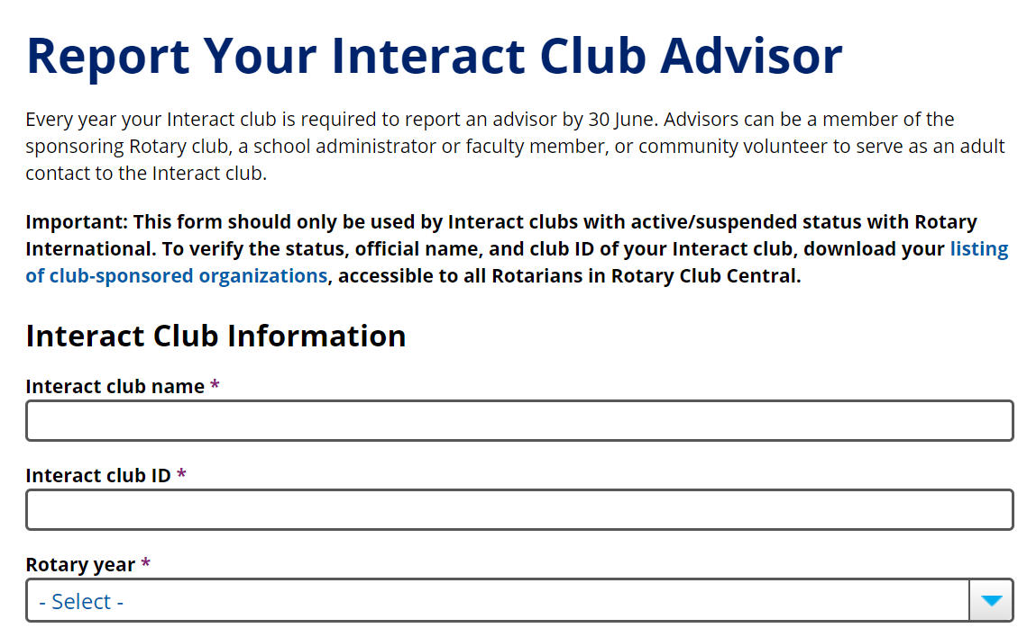
Update Youth Service Roster On Website

Slide 9
Share stories, so we can submit to District5240 website

Slide 10
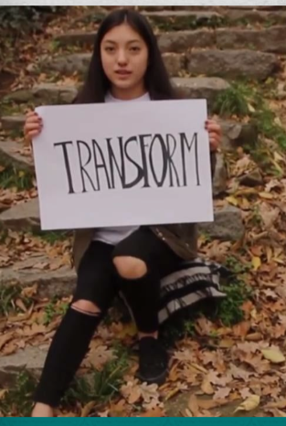
INTERACT IMPACT – Saturday Oct 26th (tentative)
Invite Community – Middle School - Recruit future
Interact Members
Educate Youth: What is Rotary?
https://www.youtube.com/watch?v=Ubqc7_MnBeE
Show our Interact Members inspiring videos Interact
Interact Impact Program Ideas:
Icebreaker, Team building, Break Out Sessions:
Peace Building
Fundraising
Community Outreach
Promoting/Branding Rotary Ideas
Accountability/Continuity
Community Leadership
Find Resources

Slide 11
YOUTH SERVICE Links on Website www.rotarydistrict5240.org
Interact Clubs
Rotaract
Rotary Youth Leadership Awards (RYLA)
YES! Brochure
Rotary Youth Exchange (RYE)
Student Protection Officer
Youth Service Regional Seminars
Files
Youth Service - New Generations "Career Path"
Photo Albums

Slide 12
2019-2020 Youth Events posted on website

Slide 14
ANY QUESTIONS?
WHAT TOOLS DO YOU NEED TO HAVE A
SUCCESFUL YEAR?
3. SUMMARY

