Slide 1
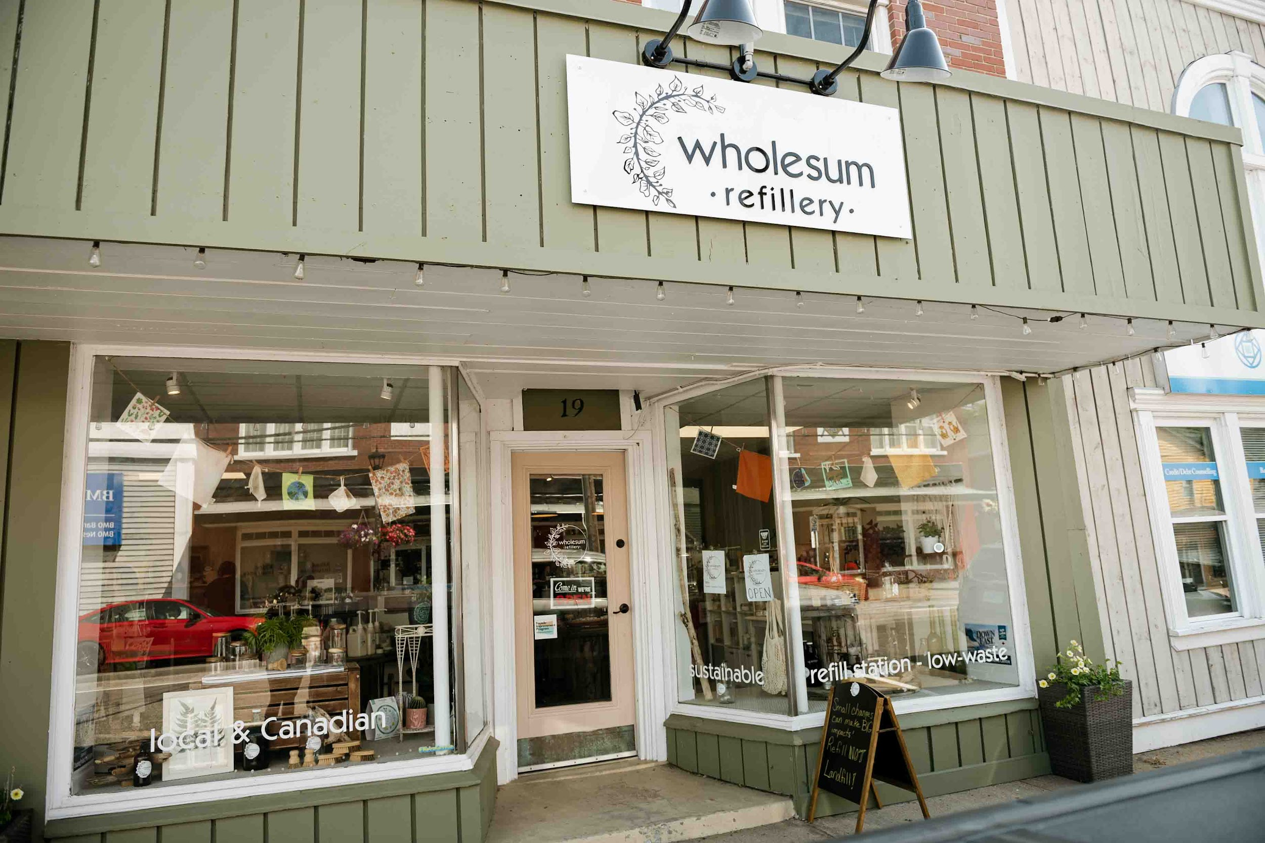
Wholesum Refillery: Reducing Waste, One Refill at a Time
A Presentation to Rotary Club

Slide 2
Introduction
Who We Are: A local low-waste shop in Kentville dedicated to sustainability
Our Mission: Reducing single-use plastics & making eco-friendly living accessible to our broader community

Slide 3
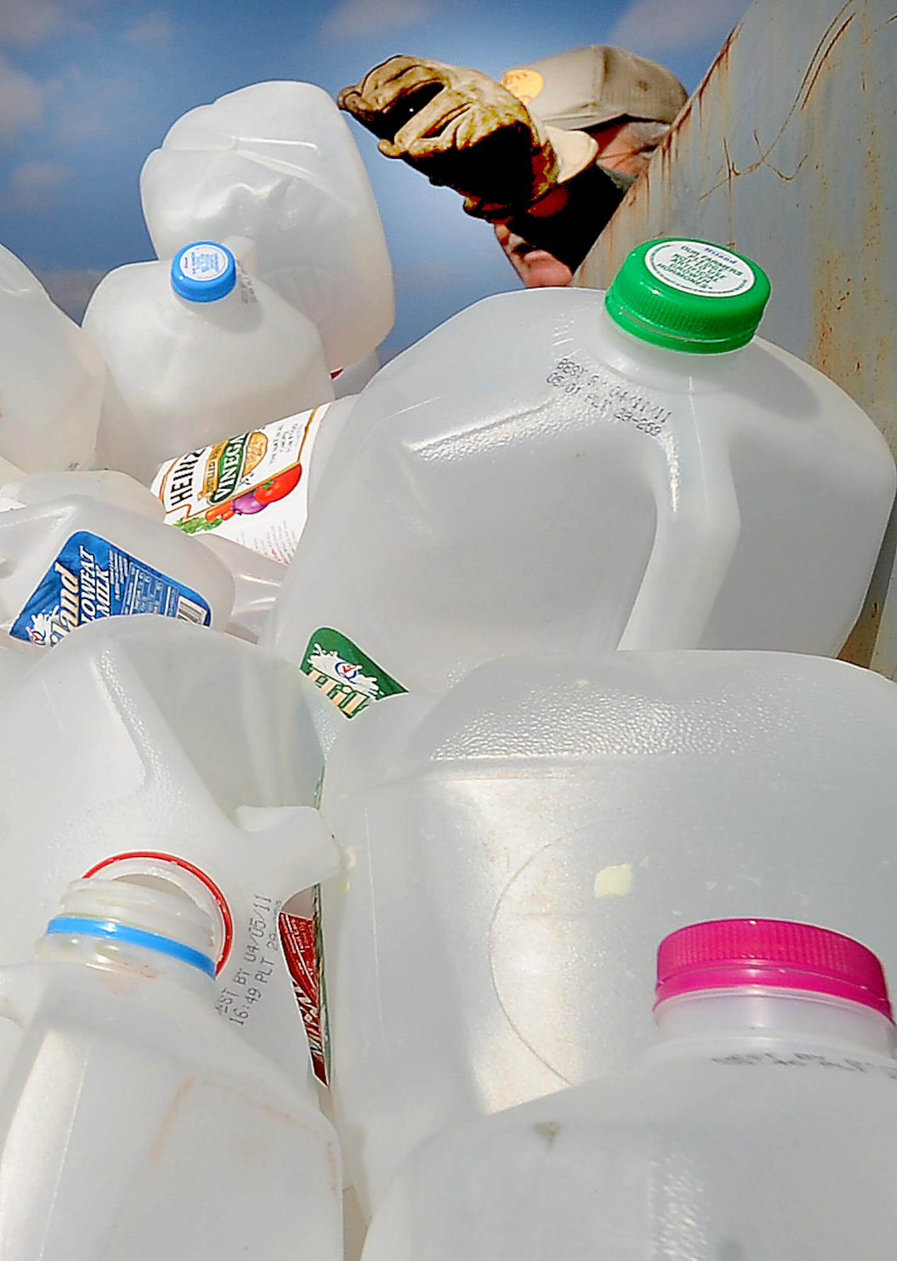
What is a Refillery?
A store where customers bring their own containers to refill household and personal care products
Why It Matters: Cuts down on
packaging waste,
promotes mindful consumption

Slide 4
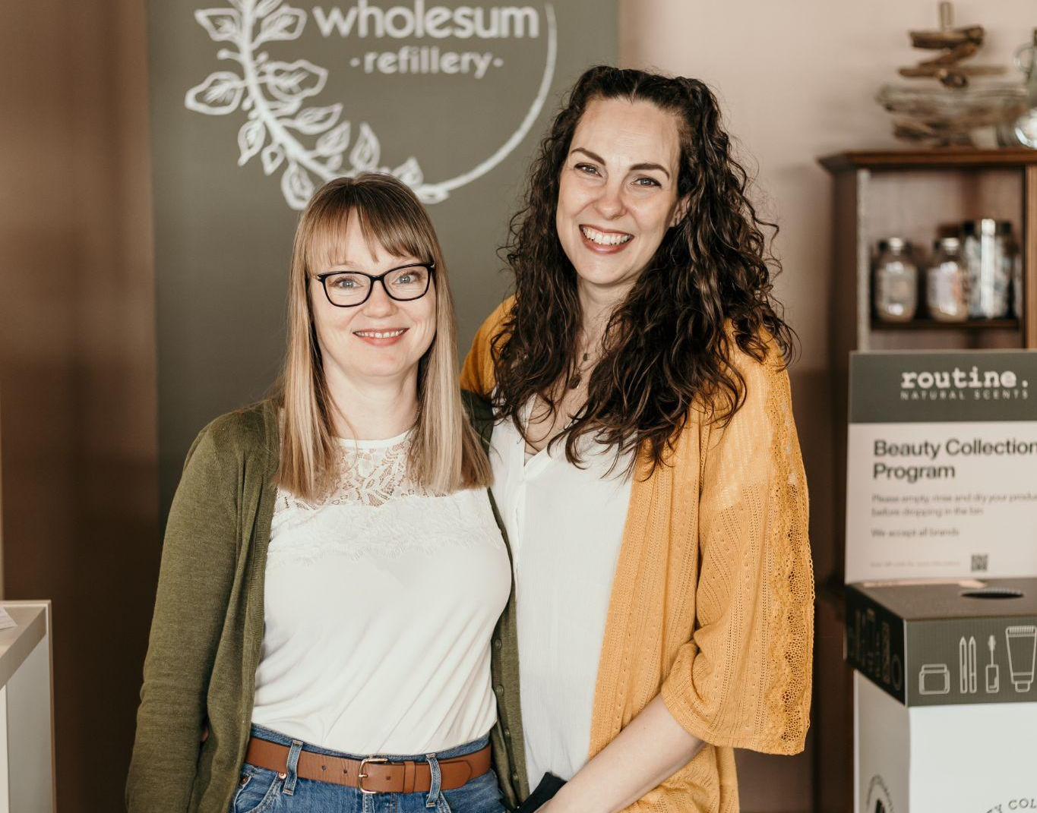
About Wholesum Refillery
Founded By: Rachael & Krista, childhood friends passionate about sustainability
Our Offerings: Household cleaners, personal care, reusable goods, and more

Slide 5

Products We Offer
Bulk Refills: Soaps, shampoos, detergents, and more
Sustainable Goods: Bamboo toothbrushes, reusable bags, compostable sponges
Locally Sourced: Partnerships with ethical brands like Cheeks Ahoy & Nova Scotia Soap Co

Slide 6
Why Low-Waste Shopping Matters
The Problem: 91% of plastic waste isn’t recycled
The Solution: Reduce, reuse, refill! We have filled & refilled almost 14,000 containers since we opened our doors in November 2021
Impact: Less landfill waste, lower carbon footprint, and a healthier planet

Slide 7
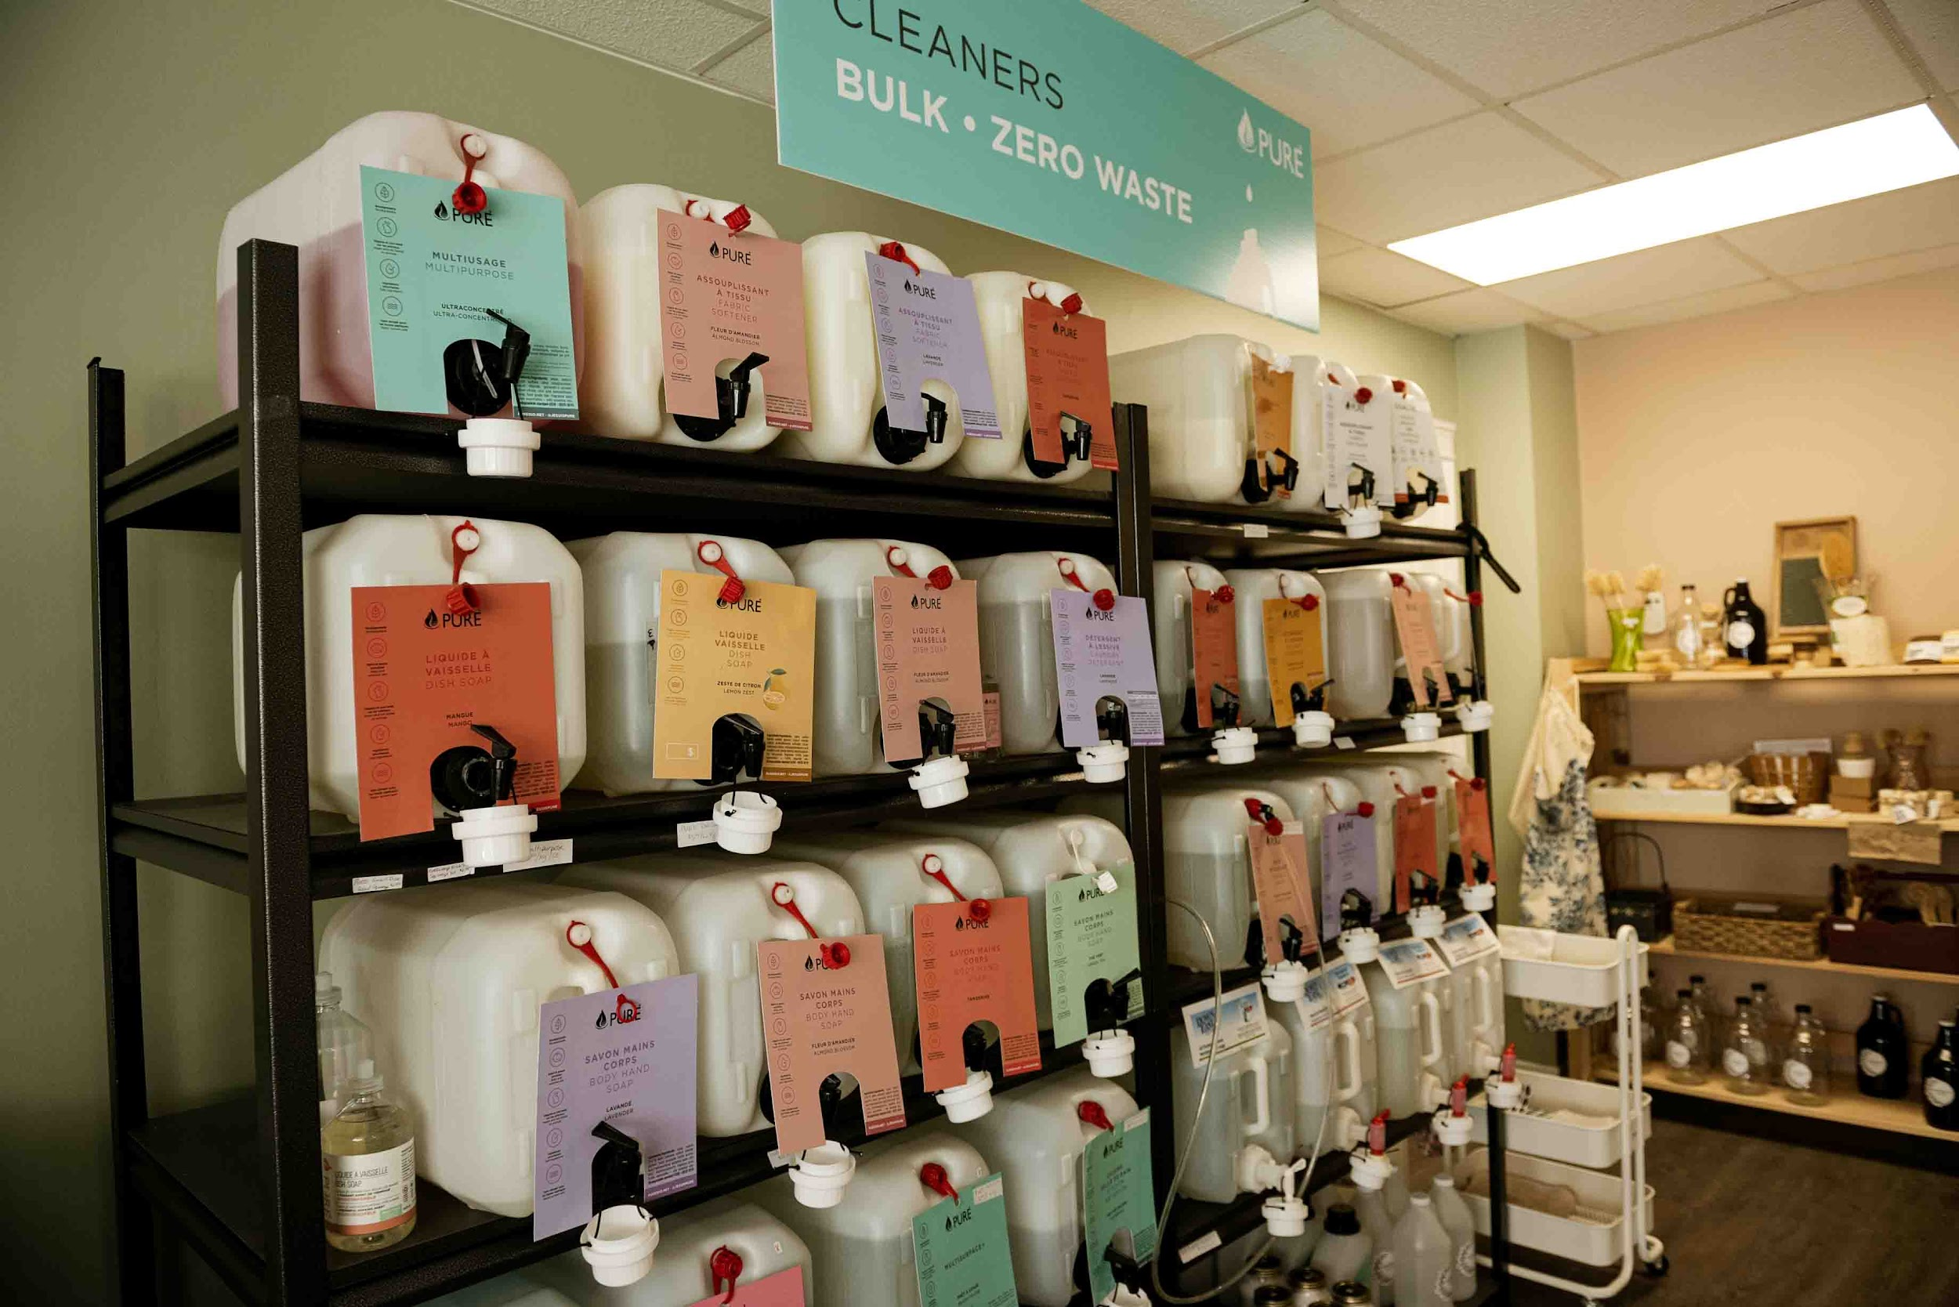
How You Can Get Involved
Shop Mindfully: Bring your own containers & choose sustainable products
Spread the Word: Share with family & friends
Education: Learn about the plastic problem and educate others

Slide 8
Call to Action
Visit Us! 19 Aberdeen Street, Kentville
Learn More: www.wholesumrefillery.com
Follow Us on Social Media: Facebook & Instagram

Slide 9

Thank you!!
"We don't need a handful of people doing zero waste perfectly. We need millions of people doing it imperfectly."
-Anne Marie Bonneau

