Slide 1
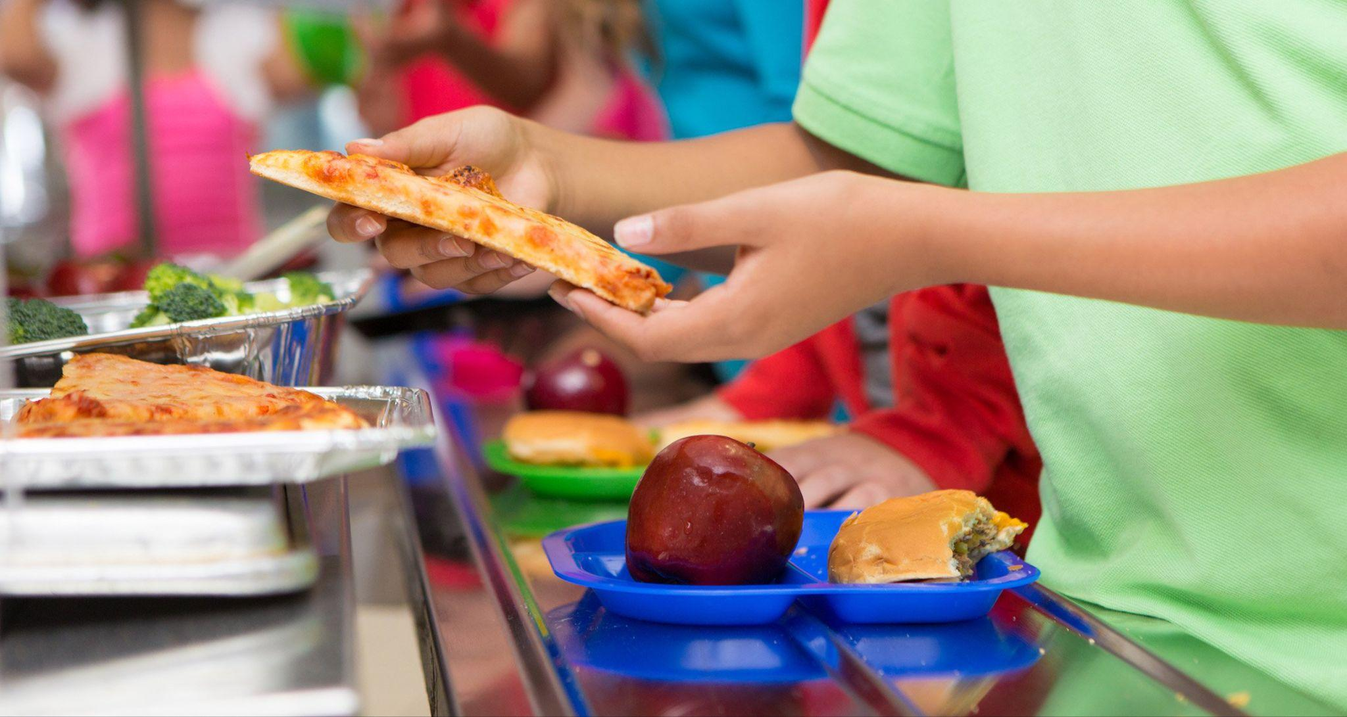
NORTHEAST KINGS EDUCATION CENTRE BREAKFAST PROGRAM
ROTARY PRESENTATION

Slide 2
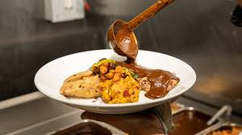
HOT LUNCH PROGRAM (Initially)
Initially started from additional COVID funds
Average hot lunch costs $6.25/student/day.
Offered a hot lunch to 15 students, 3 times/week for two month (May/June). Total cost: $2000

Slide 3

HOT LUNCH PROGRAM Update
This year, Rotary matched $10,000 funds raised which provided $20,000 with fundraising campaign.
Funds raised beyond $10,000 were also matched by a generous supporter which to date amounts to: $8500 (to be matched)
Cost to feed 1 student every day is = $1,200

Slide 4

HOT LUNCH PROGRAM Update
Currently we have 48 students on our hot lunch program ($57,600 annual cost)
School Board Funds = $6400
County Support funds = $5700
Total Donations with Rotary = $20,000
Other Donations with matching = $17,000
Total = $49,100

Slide 5

Breakfast Grab-n-Go
Approximately 100 students/day
Milk, fruit, cereal, toast
Estimated Cost = $8000 annually

Slide 6

Total Costs to Date
$45, 031 for hot lunch meal cards
$6, 554 for grab and go breakfast
Total to date:
$51, 585

Slide 7
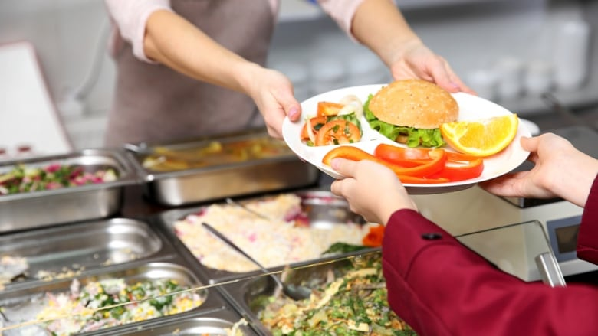
Next Steps
Provincial Meal Program - starting next year for P-5
Expected 2026 at NKEC
More to learn but positive steps.

