Slide 1
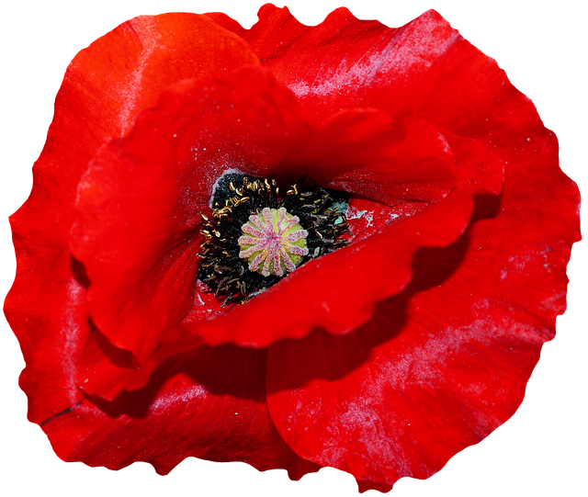
Remembrance – The action of remembering something…

Slide 2
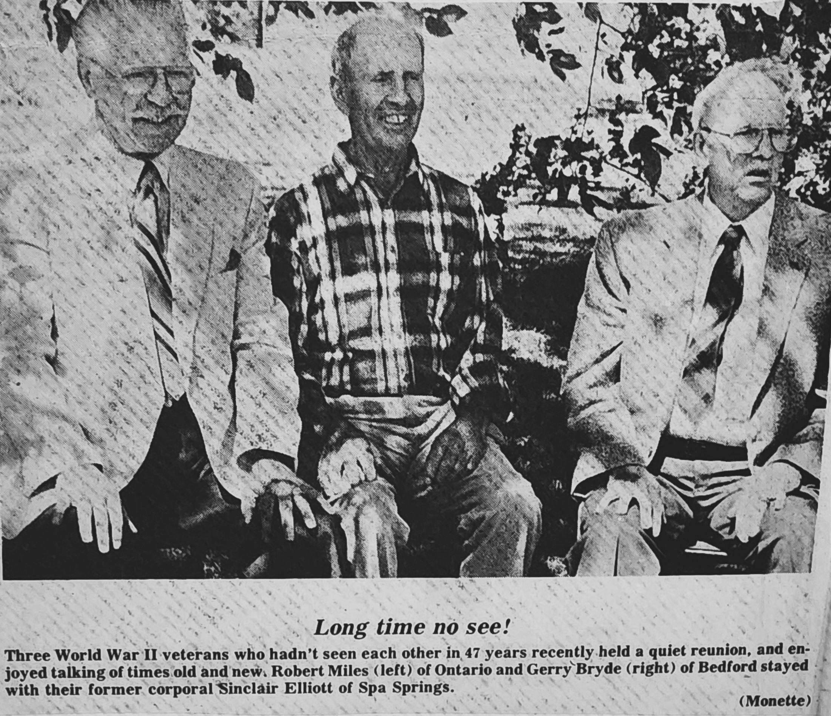
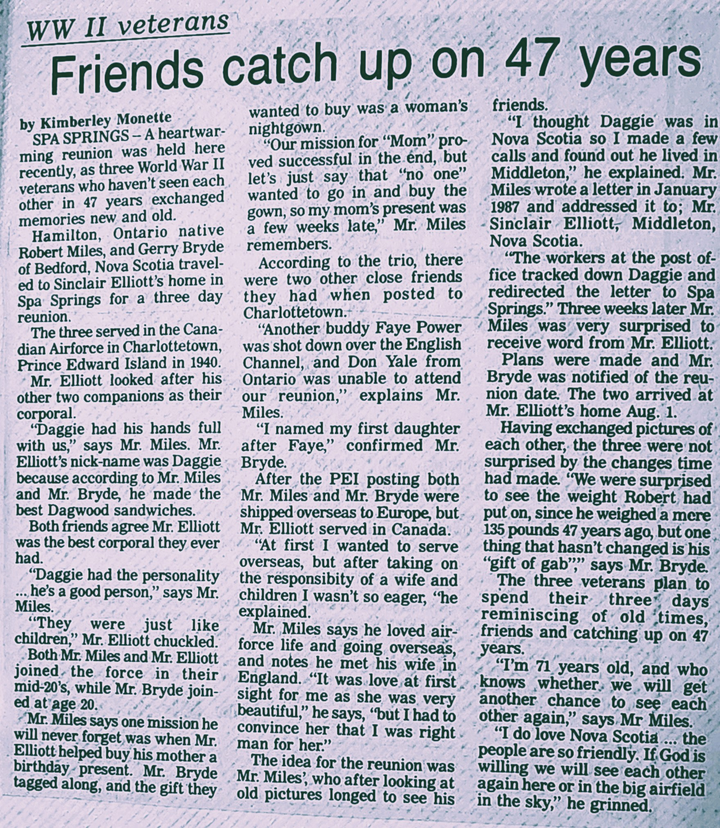

Slide 3
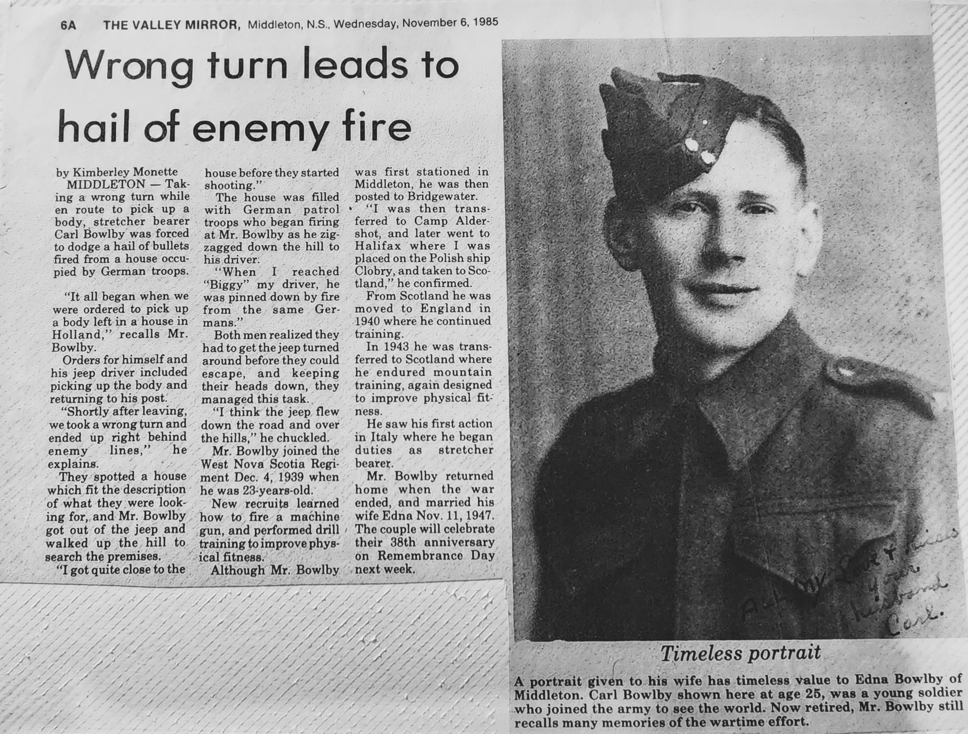
Published November 1985 Middleton, NS

Slide 4
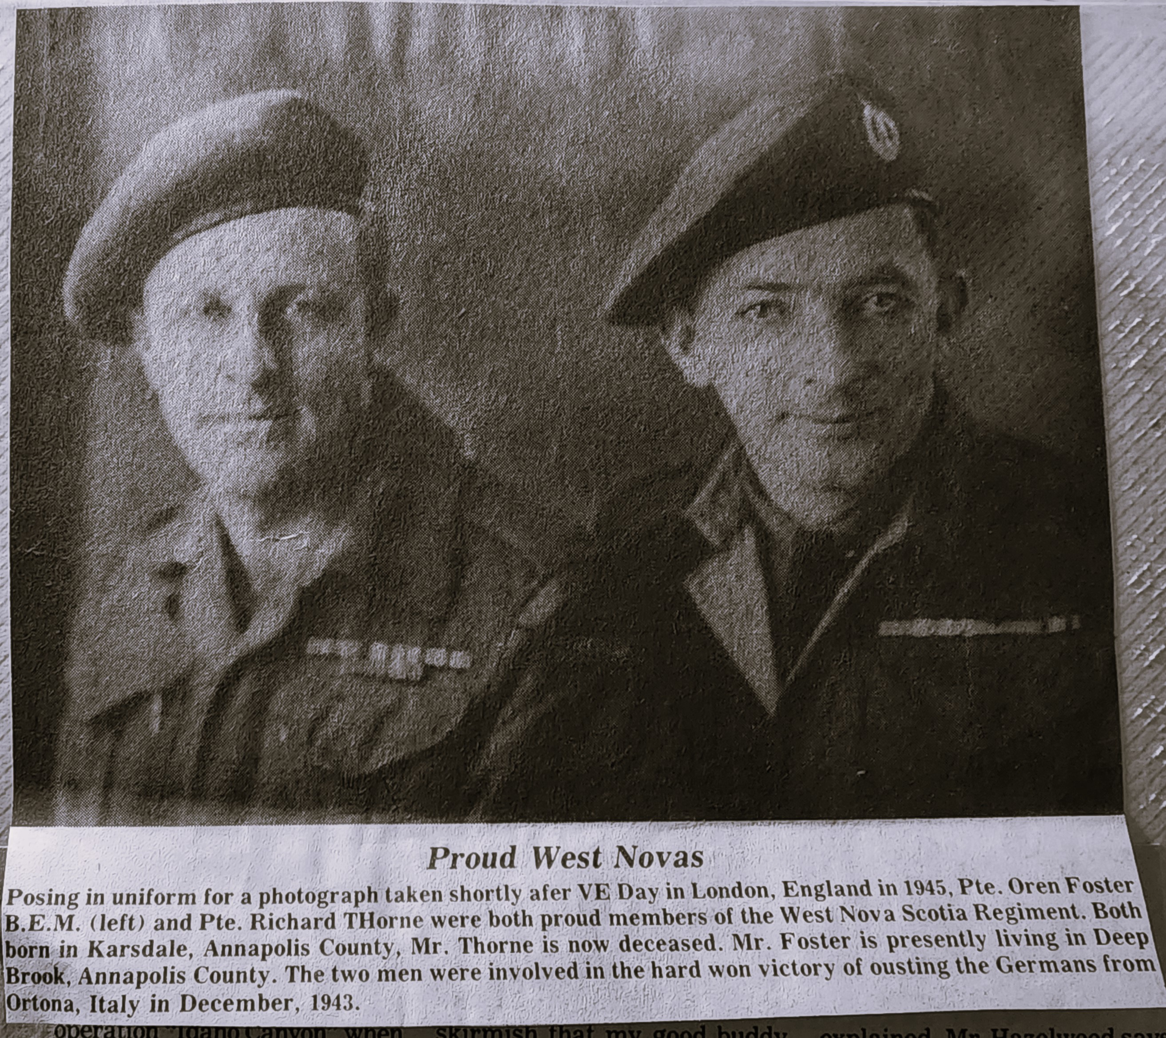
Published November 1985 Middleton, NS

Slide 5
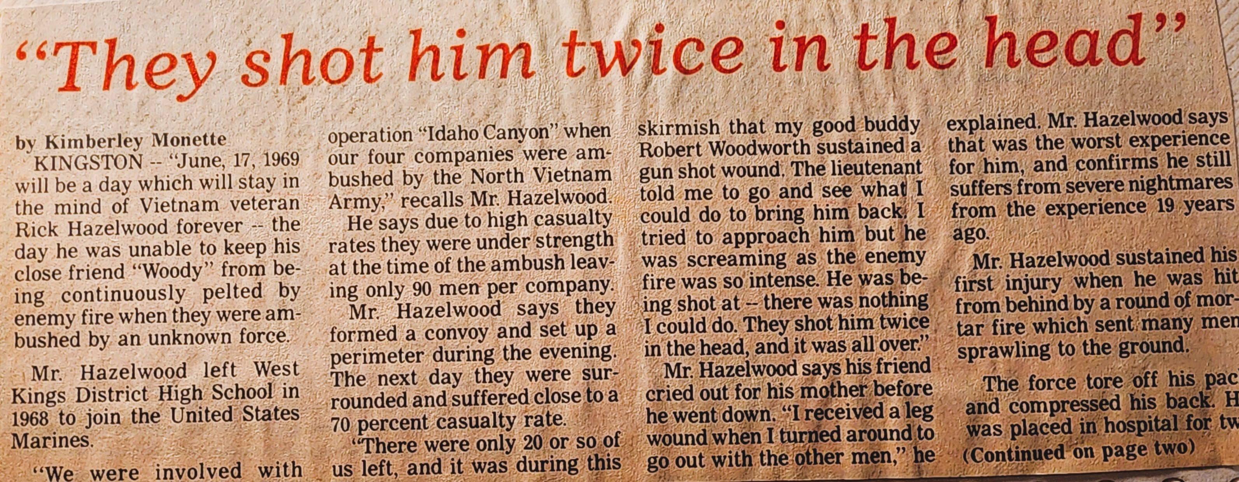

The terror and reality of Vietnam war!

Slide 6
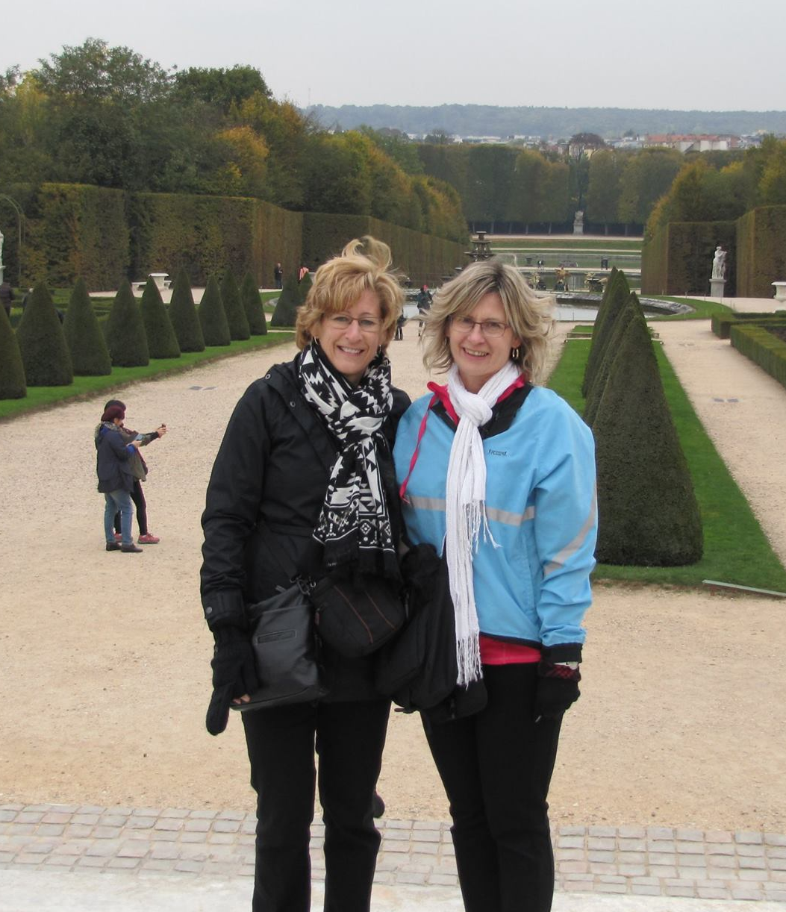
A 2015 River Boat Cruise with former Rotarian Marian Cameron-Sampson included Paris but offered us excursion opportunities to visit the historic Normandy Landing Beaches, including Omaha Beach, the Juno Centre and the Bény-sur-Mer Canadian Cemetery.

Slide 7
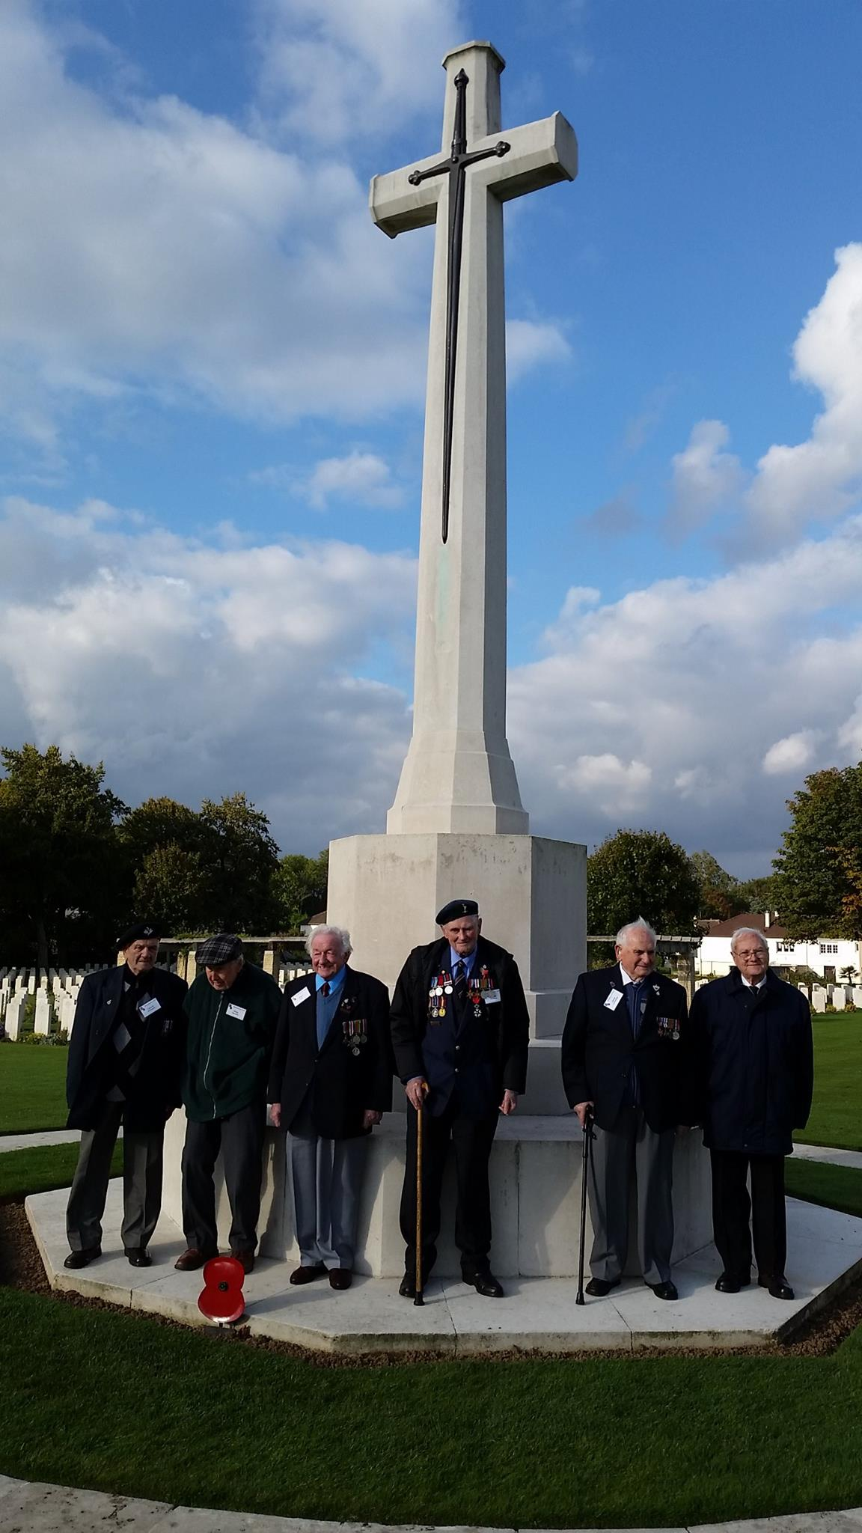
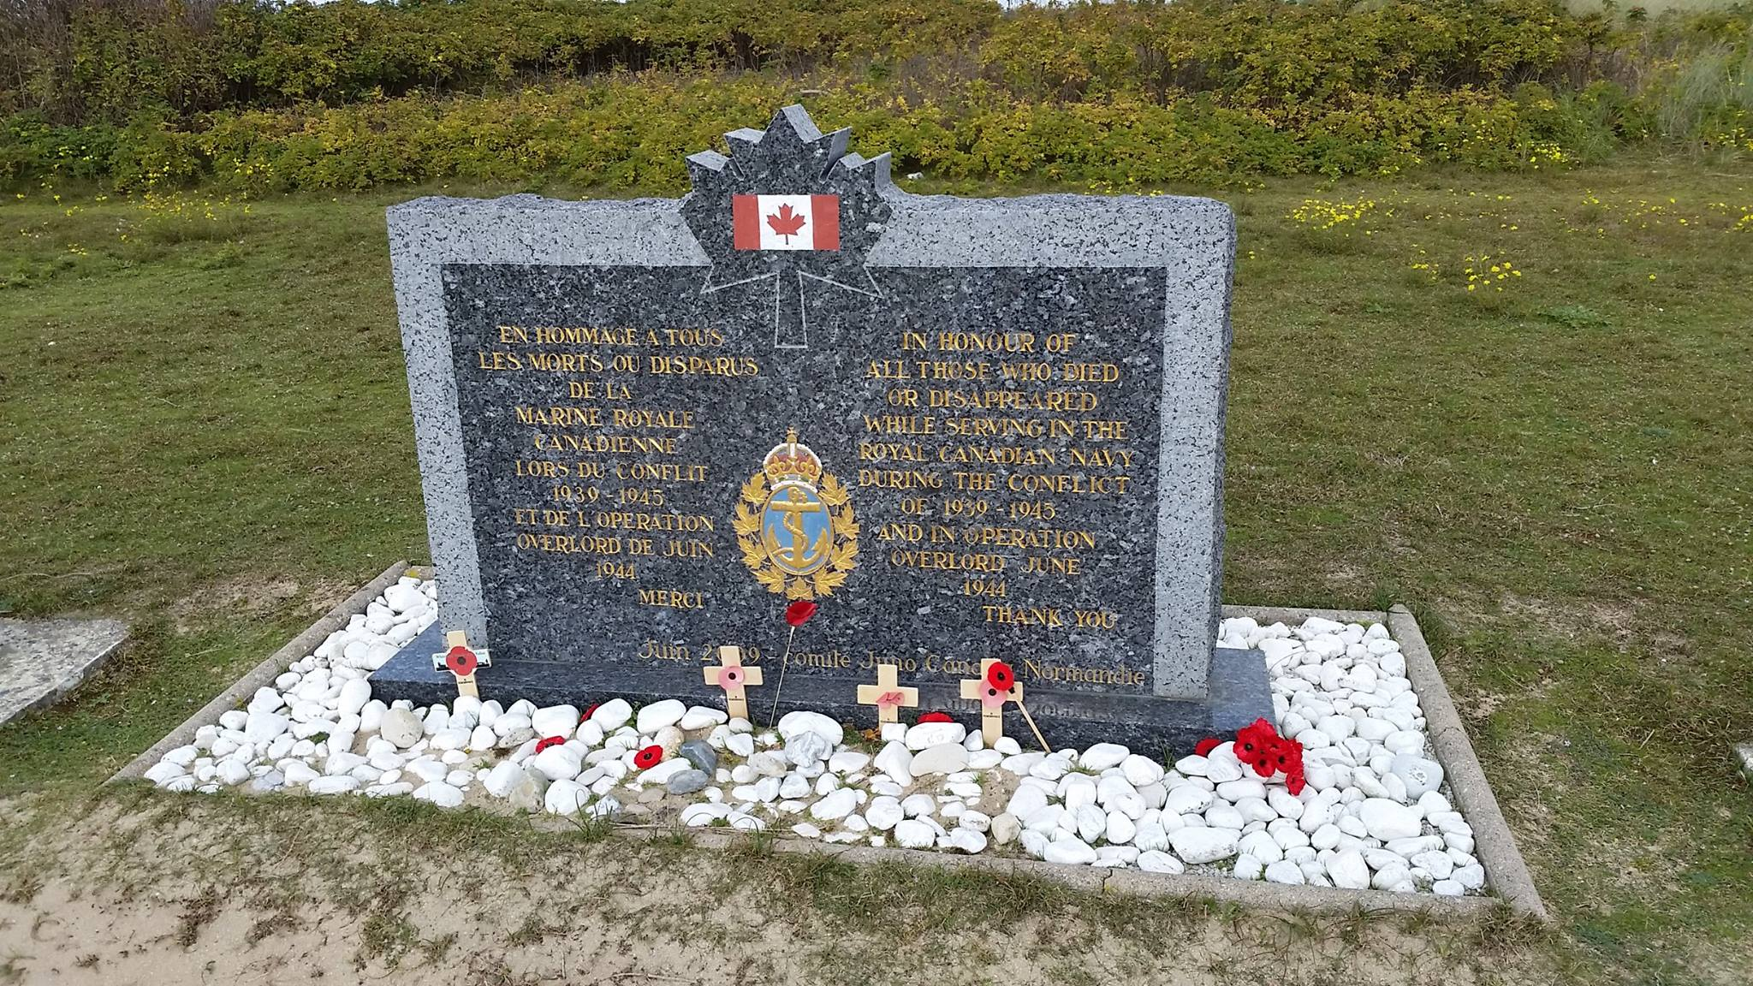
Canadian War Cemetery
Bény-sur-Mer was created as a permanent resting place for Canadian soldiers who had been temporarily interred in smaller plots close to where they fell. As is usual for war cemeteries or monuments, France granted Canada a perpetual concession to the land occupied by the cemetery. The graves contain soldiers from the Canadian 3rd Division and 15 Airmen killed in the Battle of Normandy. The cemetery also includes four British graves and one French grave, for a total of 2049 markers.
Due to deterioration from the weather the Commonwealth War Grave Commission are going to replace all the gravestones.
(Monette 2015)

Slide 8
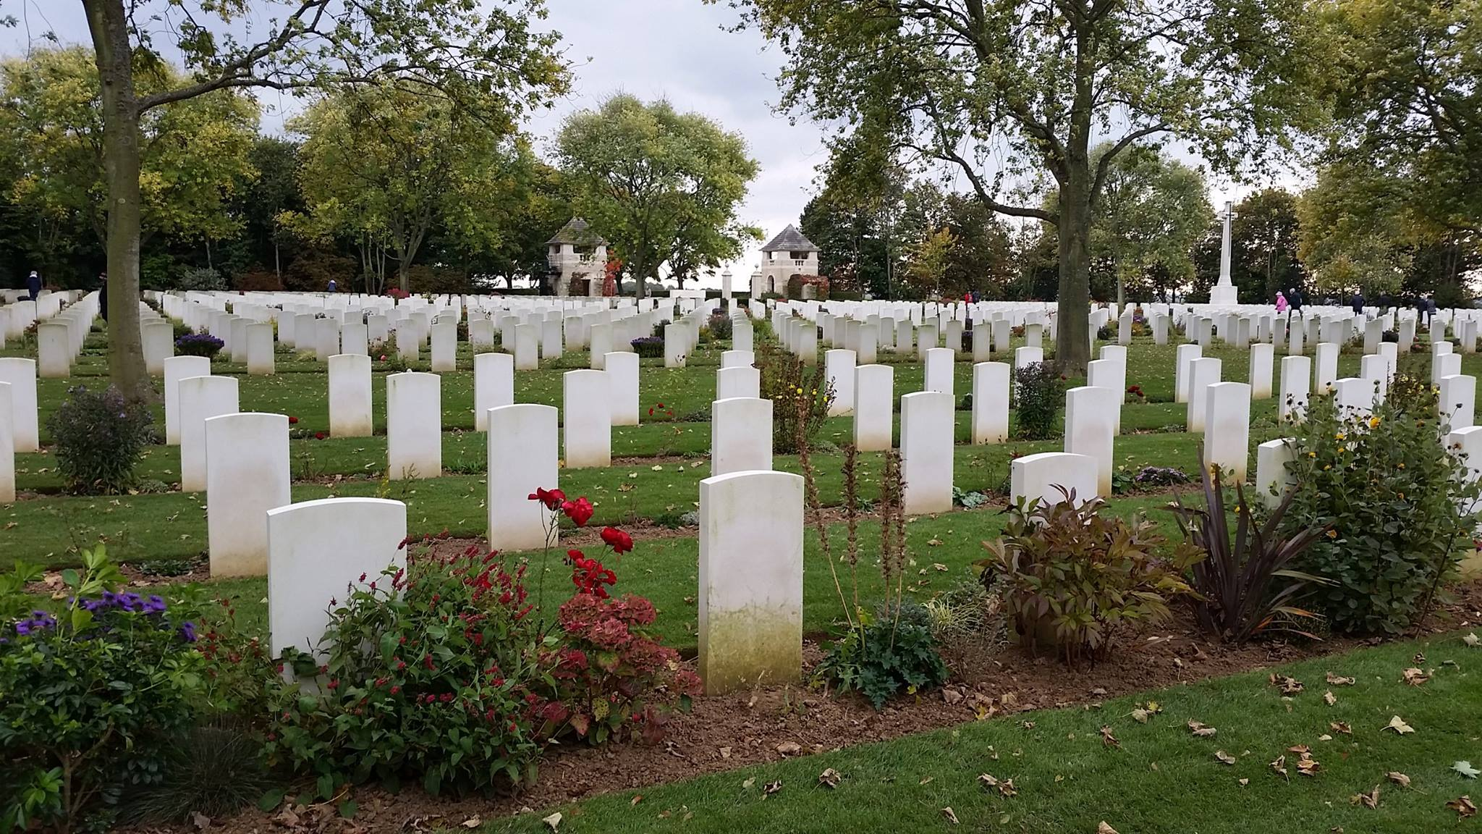

Slide 9
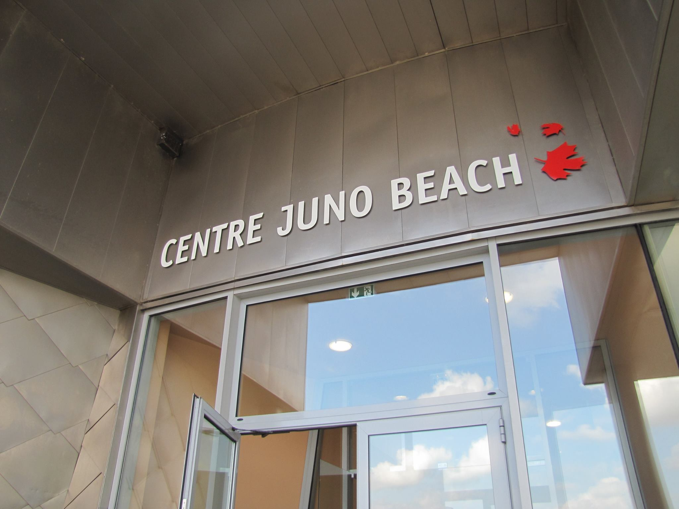

Slide 10
Juno Beach was one of five beaches of the Allied invasion of German occupied France in the Normandy landings during the Second World War.
It was assaulted on June 6, 1944 (D-Day of the invasion), by units of the Canadian 3rd Infantry Division, who took heavy casualties in the first wave but by the end of the day succeeded in wresting control of the area from defending German troops.
961 casualties:
340 dead
574 wounded
47 captured

Slide 11
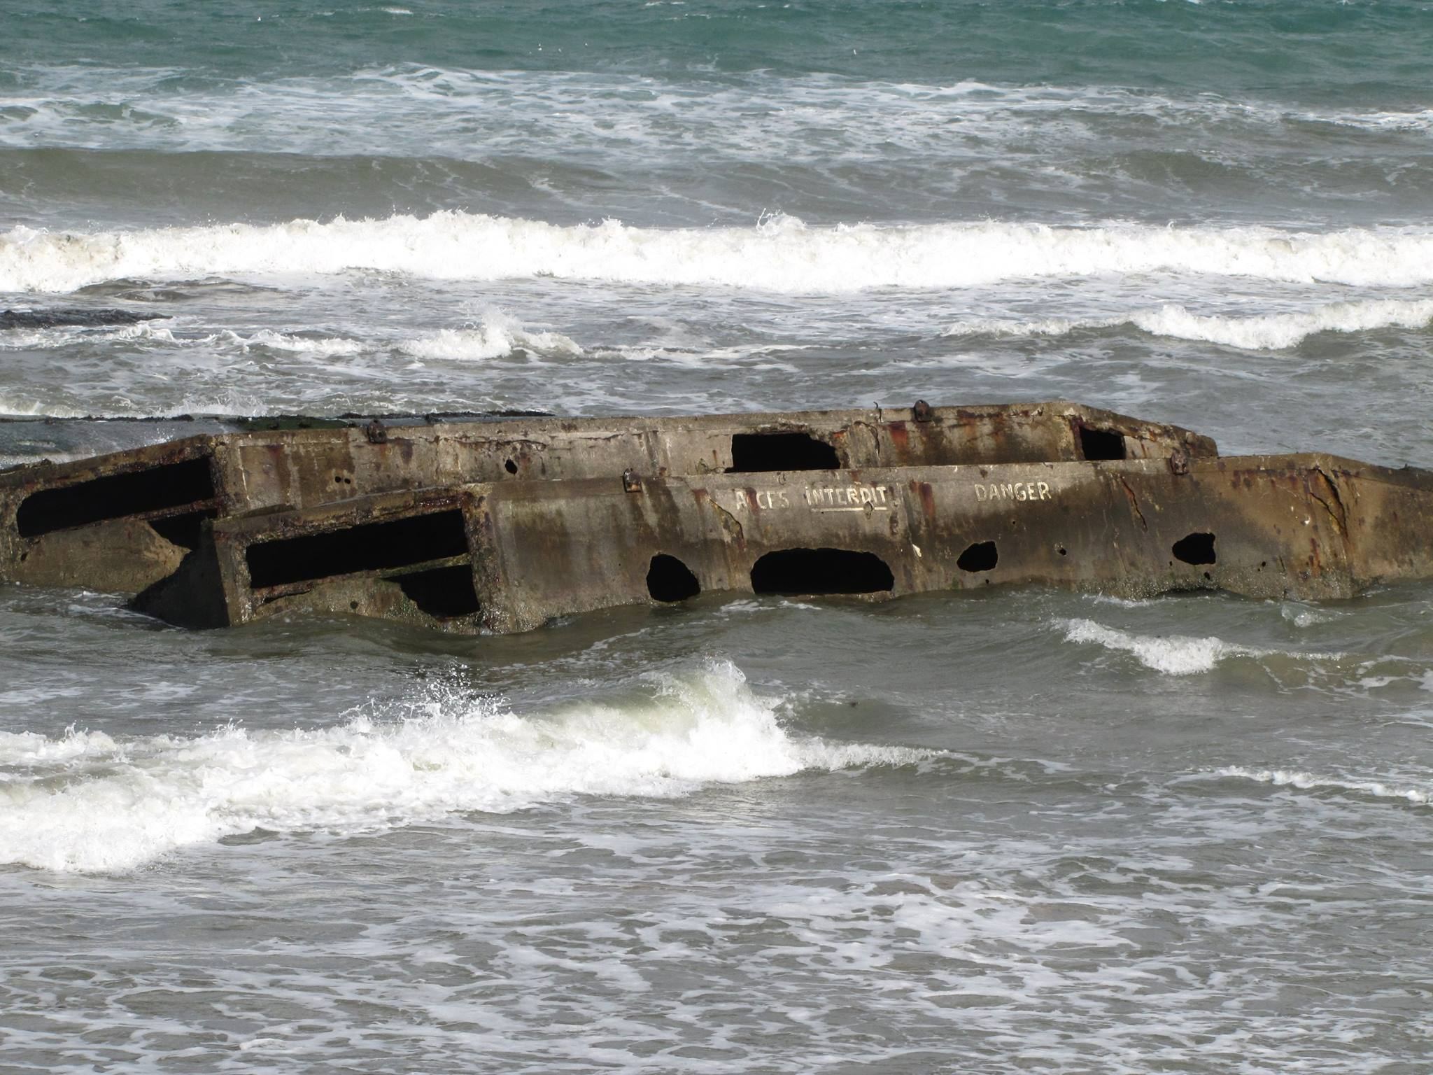
Some of the remains of the Mulberry Harbour constructed for the D-Day landings in the Second World War in France. This photo was taken at the westerly edge of "Gold" beach and was one of the "British" beaches during the landings.
(Monette 2015)

Slide 12
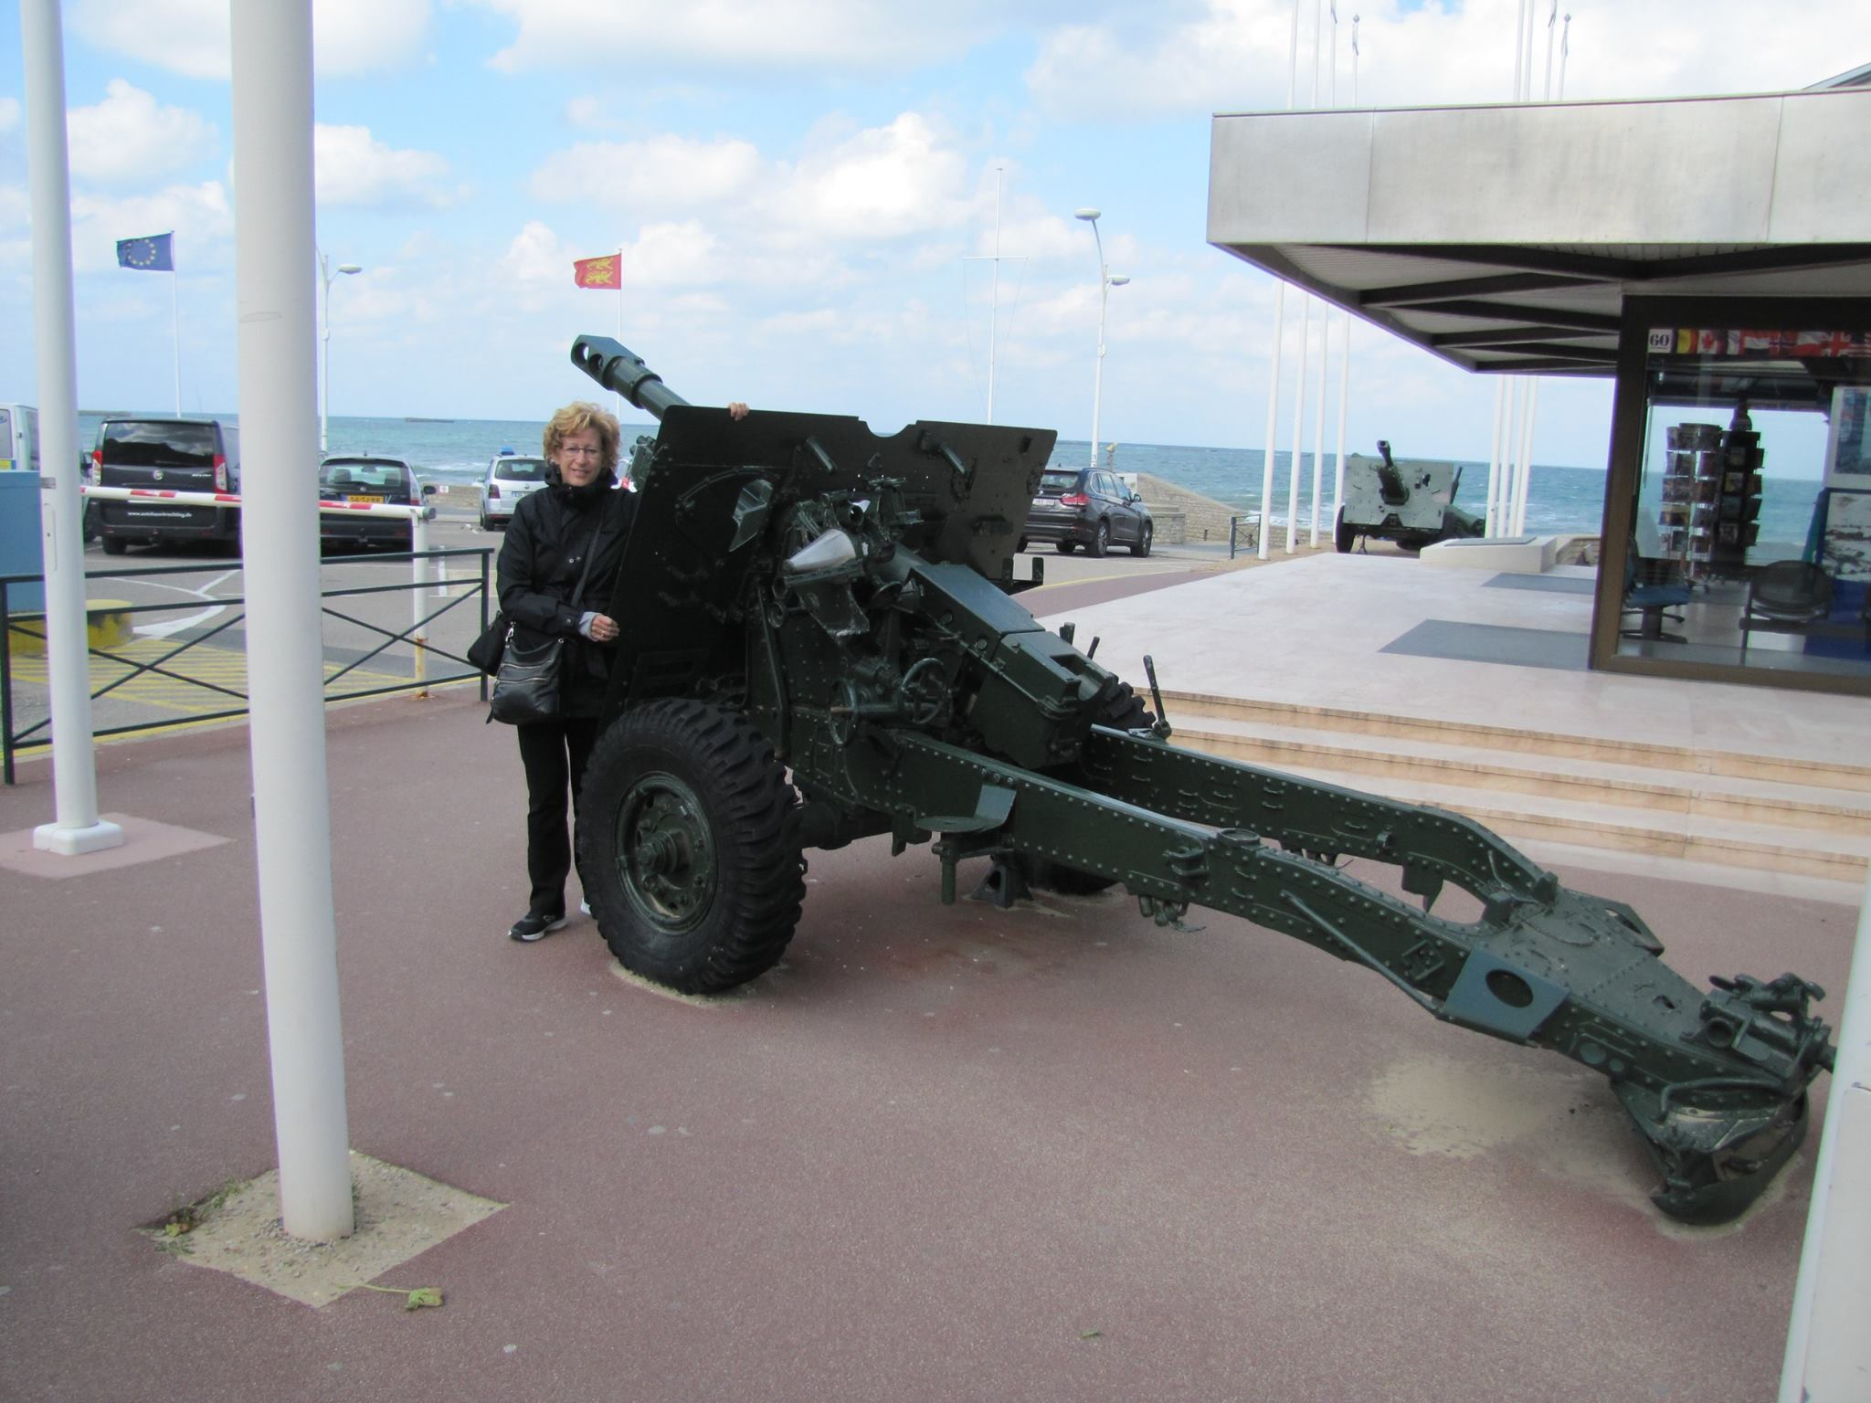

Slide 13
