Slide 1
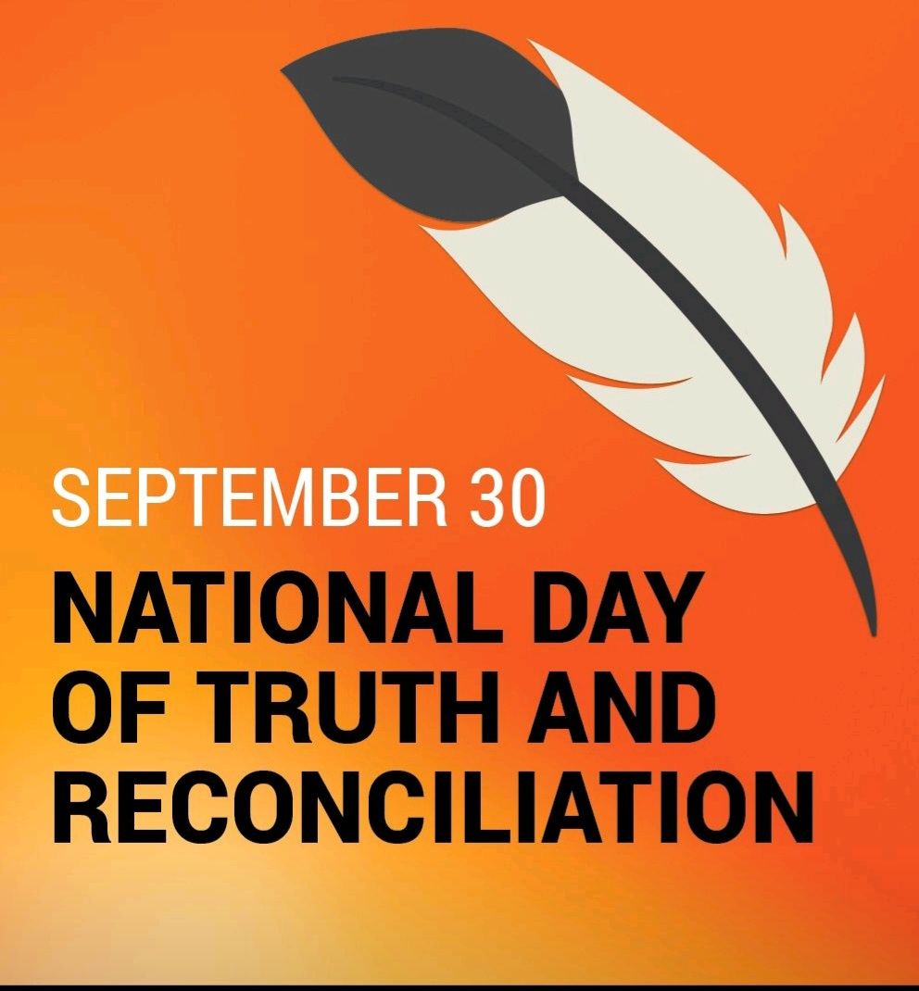
P jila”si Welcome

Slide 2
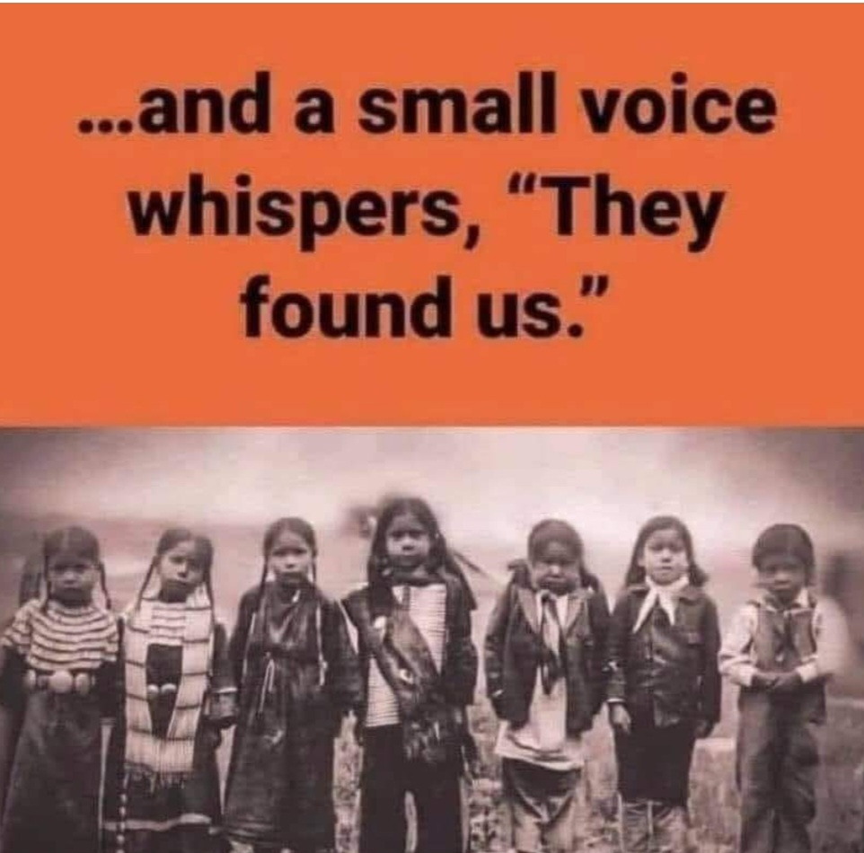

Slide 3
Oh my , What a topic! Truth And Reconciliation
Truth and Reconciliation has always been a deeply personal and sensitive topic for myself both in my personal and professional life. As an Aboriginal Veteran I am faced with many challenging and difficult decisions around highly sensitive and complex topics that have real impacts on Indigenous and non-Indigenous Peoples alike. It’s never simple. Understanding and coming to terms with centuries of violence and oppression is never going to be a simple task. And I am grateful to be surrounded by an amazing group of people who have poured their hearts and minds into bringing to the world such a unique and creative educational opportunity that can have a serious impact in colonial Canada. We just need more people to have the courage to step into it.

Slide 4
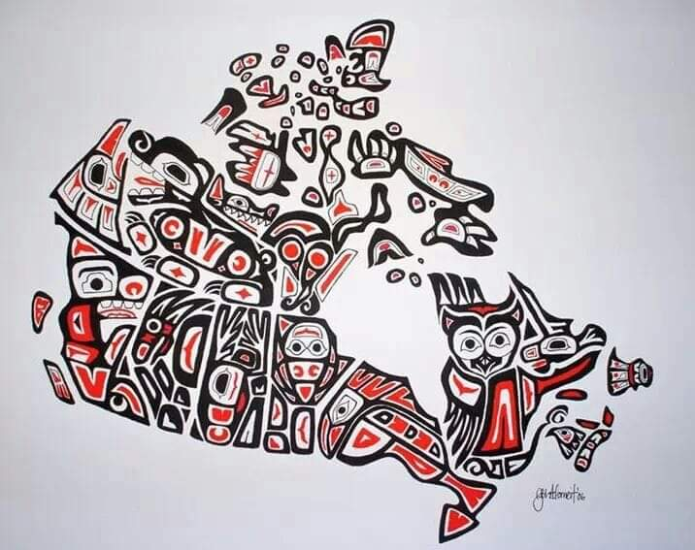
And I am proud of what we have accomplished, while also continuing to be grounded in our values.
When I was asked to speak up and not out, I was very nervous and hesitant. I didn’t know how this topic could be placed on a speaking platform in the company of friends and colleges especially when the Calls to Action after the Truth and Reconciliation Commission came to light.

Slide 5
Through the speaking up process we have maintained sensitivity, while sourcing the truth without targeting those who made mistakes, had intense discussions around status and non-status, treaties, people’s behavior, and the role of the Church and Crown in the last 160+ years of colonization in Canada. I have come to realize that with the help of our Elders and Teachers Council, the wisdom of survivors we have created an accessible way for everyone to engage the important topic of Truth and Reconciliation.

Slide 6
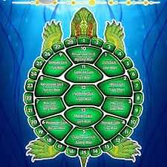
I am asking those around me, who have come to know me and who have seen and heard my approach, to have the courage to step into a learning environment with this unique, challenging and truly a feeling experience.
With this in mind I will talk about the Reconciliation component .

Slide 7
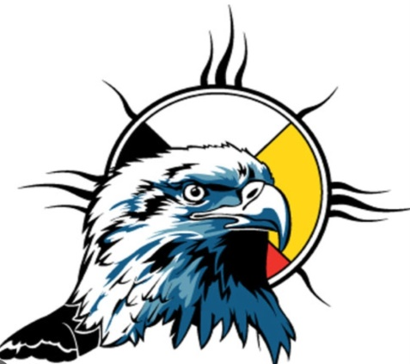
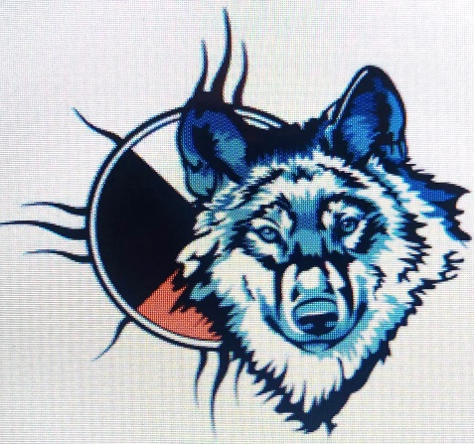
With
Love & Humility
8 ways to engage in truth and reconciliation
“Together, Canadians must do more than just talk about reconciliation; we must learn how to practice reconciliation in our everyday lives – within ourselves and our families, and in our communities, governments, places of worship, schools and workplaces. To do so constructively, Canadians must remain committed to the ongoing work of establishing and maintaining respectful relationships.”

Slide 8
1. Recognize the word Indigenous refers to diverse and distinct nations
Indigenous is a collective name for First Nations, Inuit and Métis peoples, which includes hundreds of distinct and independent nations across the country (and even the world), each with unique histories, traditions and languages.
You should ask those you interact with how they identify and learn the names of the nations on whose land you live and work. Avoid using terms that can be derogatory and offensive that homogenize and denigrate Indigenous peoples.
When engaging with the process of reconciliation, it is important to remember the diversity among First Nations, Inuit and Métis peoples.

Slide 9
2. Learn the history between Indigenous and non-Indigenous peoples
Before we act, we must first learn. The stories and voices of Indigenous peoples must be highlighted in our educational systems and are integral in dismantling the colonial point of view traditionally taught in the Canadian school system. The relationship between Indigenous and non-Indigenous people has been one of imbalance and injustice. It can be uncomfortable to learn about this history and to acknowledge how much of Canadian history minimizes and erases Indigenous peoples and how current policies continue to reinforce a colonial world view.
There is no Canadian history before Indigenous peoples but there is Indigenous history before Canada. It is important to remain mindful of this when engaging with the process of reconciliation.

Slide 10
3. Understand the history and legacy of residential schools
Indian Residential Schools* sought to “destroy Indigenous cultures and languages and to assimilate Indigenous peoples so they no longer existed as distinct peoples” (Truth and Reconciliation Commission, 2015). For over 150 years, Indigenous children were forcibly removed from their families and sent to these schools, with the last school not closing until 1996. It is both a long and recent history.
To engage with the process of reconciliation, we must acknowledge residential school experiences, impacts and consequences, including the intergenerational trauma experienced by Indigenous peoples.

Slide 11
4. Explore the unique intersections we have between treaty, constitutional, Indigenous and human rights in Canada
Indigenous and non-Indigenous peoples have different relationships with the Canadian government. The legal rights of Indigenous peoples have changed since Europeans first arrived on Turtle Island, from the Doctrine of Discovery to Confederation and the subsequent Indian Act* – these legal “rights” were based on the needs of the colonizers, not the intrinsic rights of Indigenous peoples.
The Canadian Constitution and, to a much greater extent, the United Nations Declaration on the Rights of Indigenous Peoples have sought to assert the inherent rights of Indigenous peoples. To fully engage with the process of reconciliation, time and attention must be given to the power and agency that Indigenous nations are reclaiming, what that looks like and why it is important.

Slide 12
5. Recognize the rich contributions that Indigenous peoples have made to Canada
Canada is indebted to the diverse cultures and nations of Indigenous peoples and the rich history and knowledge they have contributed to Canada, including the country’s name (which likely comes from the Huron-Iroquois word “kanata,” meaning village or settlement) and our collective identity as a country.
According to the Calls to Action, supporting Indigenous peoples’ “cultural revitalization and integrating Indigenous knowledge systems, oral histories, laws, protocols and connections to the land are essential to the process of reconciliation.”

Slide 13
6. Take action to address historical injustices and present-day wrongs
Before taking action, it is important to engage with anti-racism training. Anti-racism training teaches how to address unconscious biases about Indigenous peoples and unlearn harmful stereotypes. This type of education also provides the necessary tools to act in a culturally sensitive and well-informed way.
Before acting, it is important to reflect on why you are taking action, the affects you hope to achieve with these actions and how you will include Indigenous peoples in your actions.

Slide 14
7. Teach others
Teaching others what we have learnt is a crucial step in engaging with reconciliation, as it deepens our own learnings and understanding and helps create a community of culturally safe people. When teaching others, it is important to refer and guide individuals to Indigenous sources of knowledge and information. While we can begin to teach people about the importance of reconciliation, and all that we have learnt, we must ensure it is grounded in the voices and knowledge of Indigenous peoples.

Slide 15
8. Create a culturally safe environment
To better understand the systemic structures of oppression and the importance of dismantling them, non-Indigenous people must learn about the treatment of Indigenous peoples within institutional environments, like schools and hospitals, and how anti-Indigenous racism has been embedded into policy and practice. With cultural safety training***, people can carefully and critically learn about the oppressive social structures within these institutions and how they impact the health and education of Indigenous peoples. Individuals and institutions can then begin to create and support equitable environments that are culturally safe and Indigenous-informed.
Creating a culturally safe environment is an important step in creating a culturally safe Canada, wherein Indigenous peoples are included in all spaces, without barrier and with access to traditional knowledge and practices.
This compilation of ways to engage in truth and reconciliation was extracted from the Indigenous Health Learning Lodge (IHLL) and using insights drawn from the following sources:

Slide 16
6 Actions of ReconciliACTION
Atlohsa Family Healing Services
Calls to Action**
National Centre for Truth and Reconciliation
Reconciliation Education
Truth and Reconciliation Commission of Canada
United Nations Declaration On The Rights Of Indigenous Peoples
Whose Land

Slide 17
Hope for Wellness Help Line
Indian Residential Schools Resolution Health Support Program*

Slide 18
The National Day for Truth and Reconciliation is a time for non-Indigenous people to pause and acknowledge the history and ongoing effects of the residential school system in Canada and reflect on individual responsibility and action. It is also a day to look at the ways in which settler colonialism, a particular form of colonization where the people who settle in a place remain there indefinitely, continues to impact the lives of Indigenous peoples in Canada. Reconciliation is an ongoing process that needs to be incorporated into every day of the year, not just September 30.

Slide 19
WELA ‘LIOG
THANK YOU ALL FOR YOUR FRIENDSHIP AND COUNCIL.
As a L’nu and a member of first nations I extend our welcome to the ancestral lands of the
Mi kma’ki where we all share the resources of mother earth, the land air and water.
Speaking Wolf
Matthew Connolly

