Slide 1

PROJECT LIFESAVER
“Bringing Loved Ones Home”

Slide 2


Slide 3
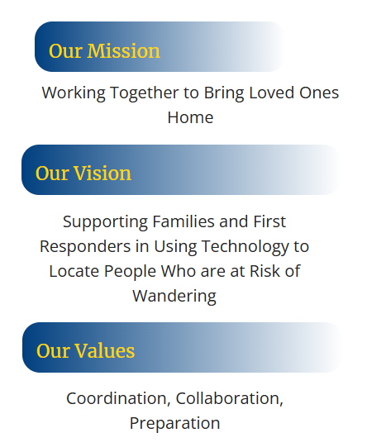
Project Lifesaver Association of Nova Scotia

Slide 4
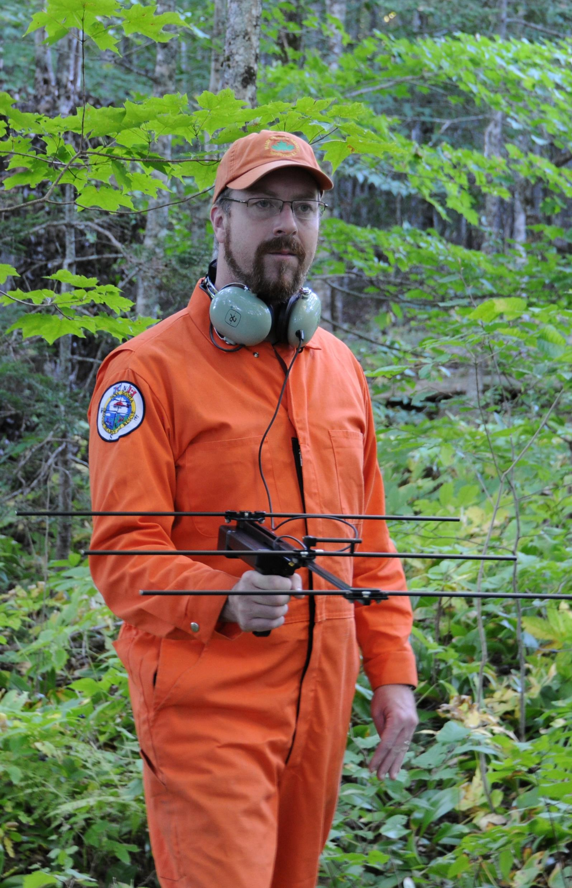
About Us
Project Lifesaver is a non-profit organization dedicated to assisting and responding to the challenge to caregivers of finding wandering or bolting loved ones who may suffer from Alzheimer's Disease, Autism or any other special needs requirements.

Slide 5
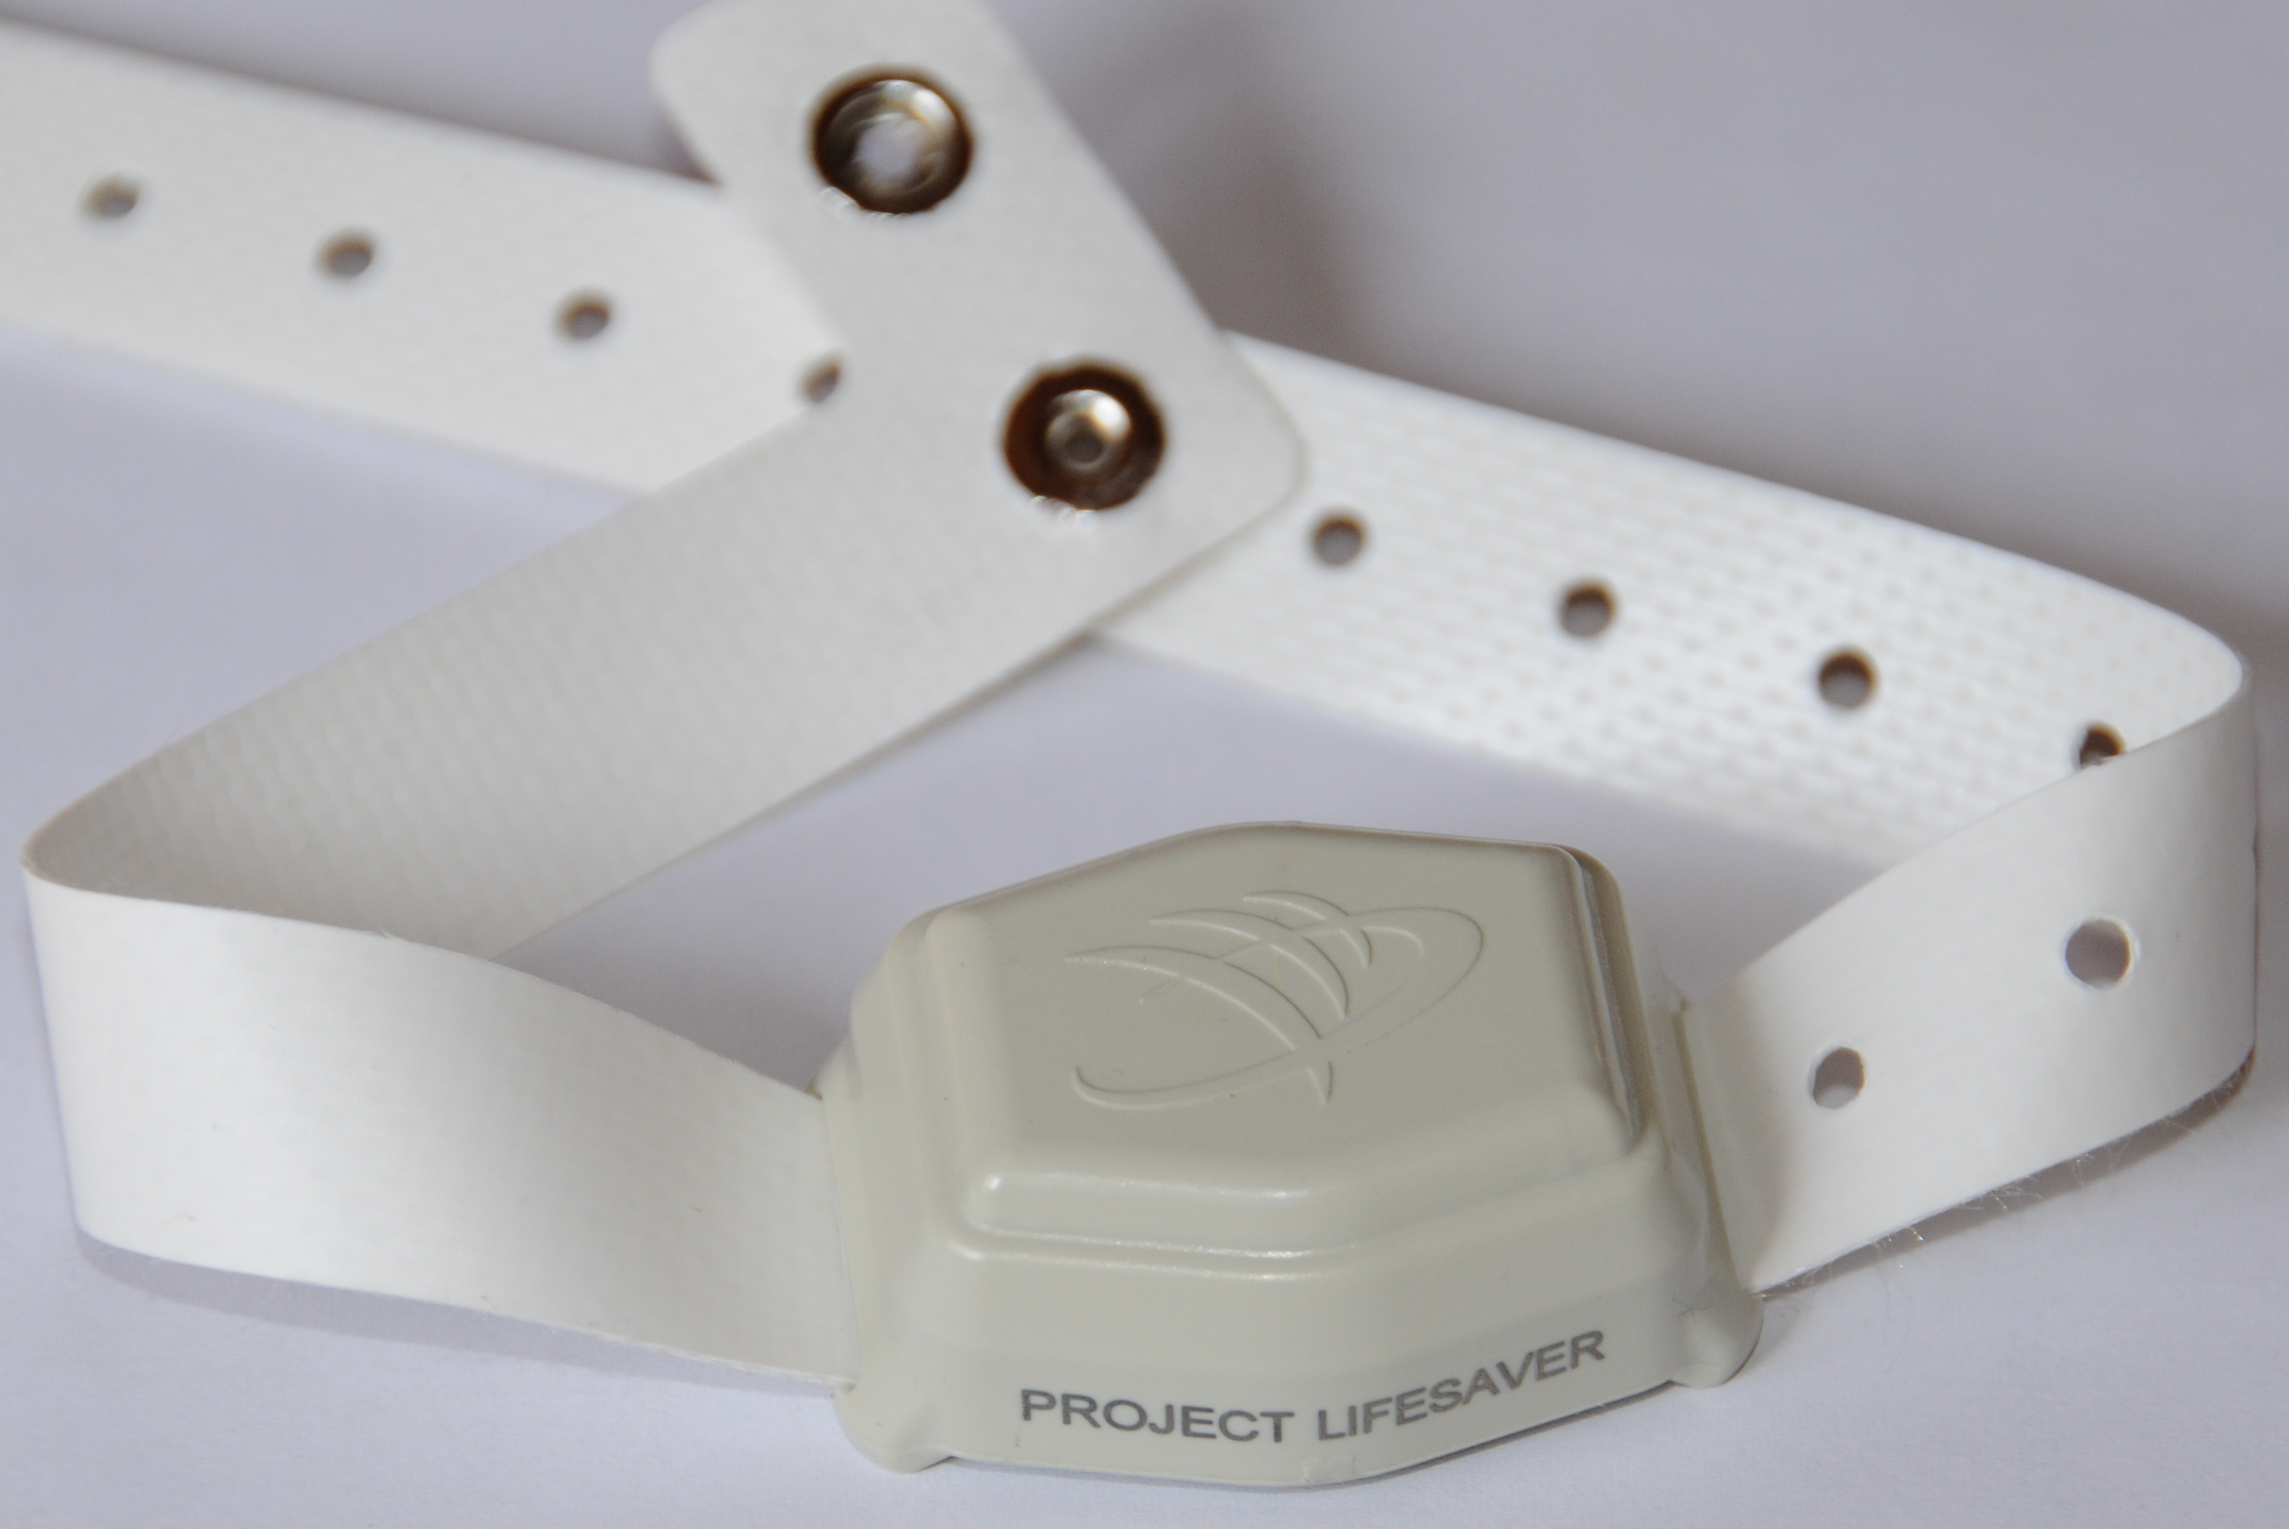
The Equipment
Clients registered with Project Lifesaver wear a personalized bracelet. It is a one-ounce battery operated radio wrist transmitter that emits a unique automatic tracking signal every second, 24 hours a day.

Slide 6
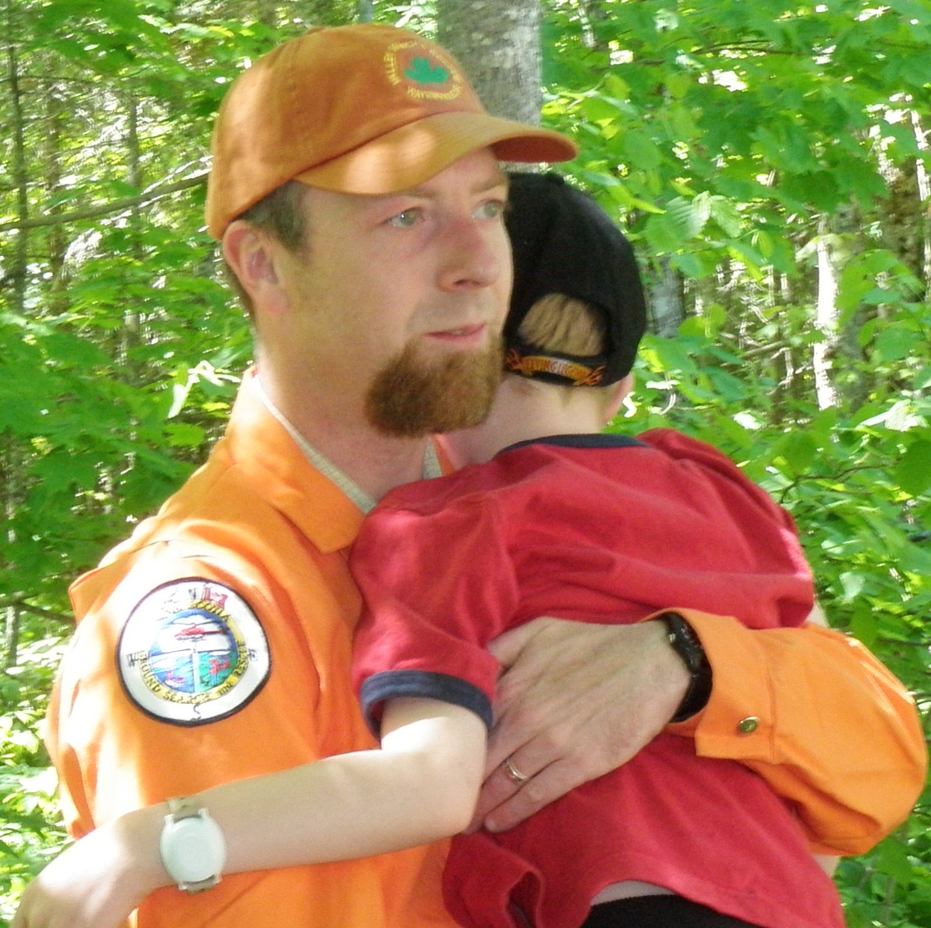
Response Teams
Project Lifesaver equips and trains search & rescue agencies in an active response system to help with the increasing problem of locating wandering patients before they fall victim to the elements, accidents or predators.

Slide 7
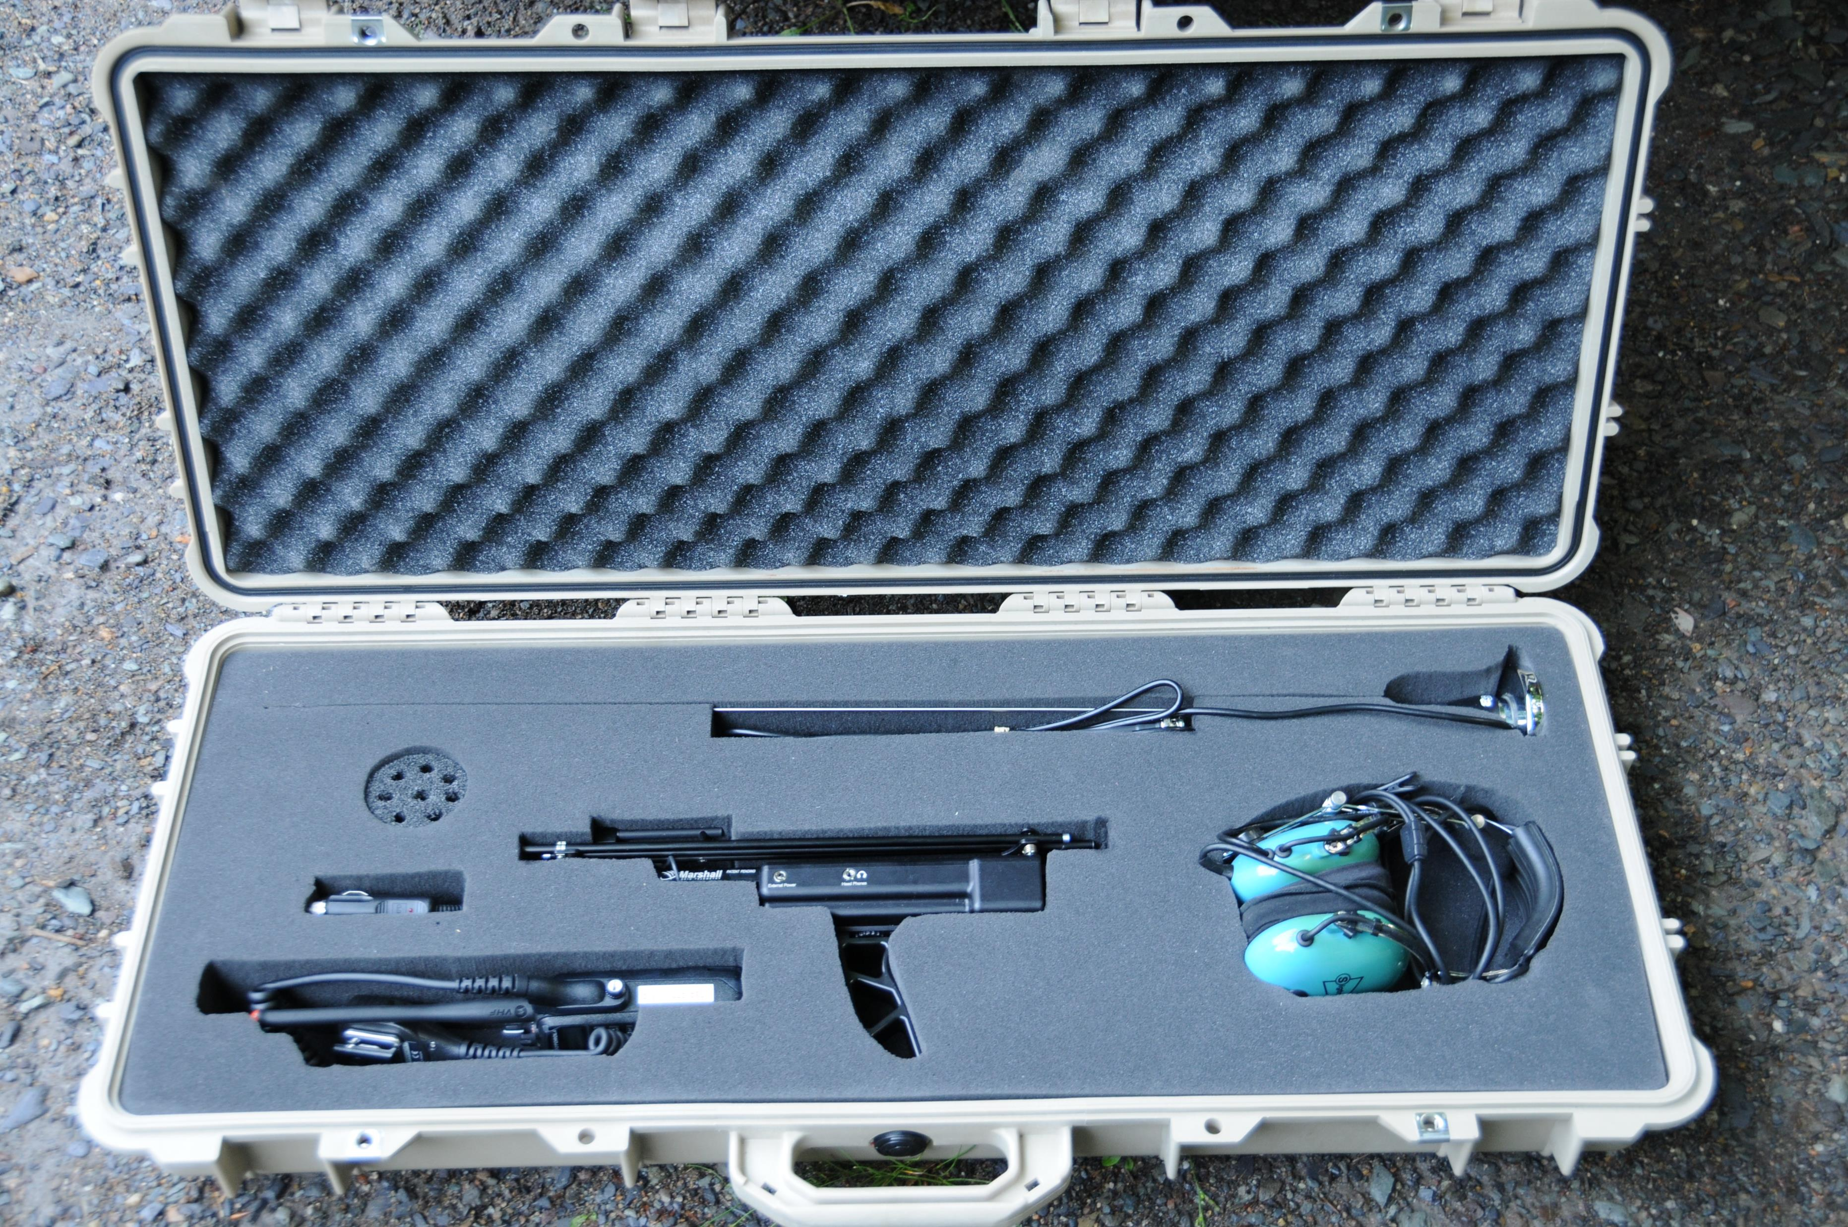
Why Radio Frequency?
It is the opinion of Project Lifesaver that radio frequency tracking equipment, in the hands of trained public safety personnel, represents the most reliable and effective technology available to locate wandering loved ones.

Slide 8
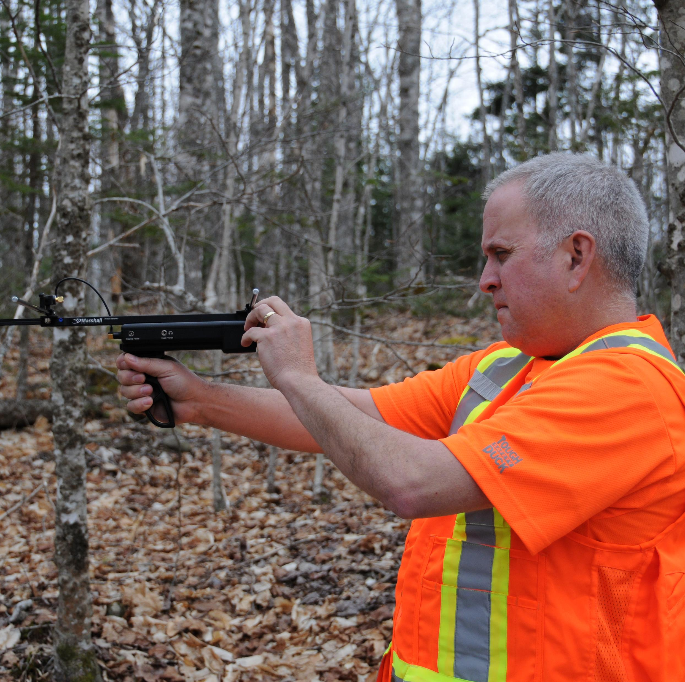
Project Lifesaver Saves Lives
Project Lifesaver saves lives and further serves the community by significantly reducing the need for extensive search and rescue operations that are often extremely costly in human and financial terms.

Slide 9
Since 2010
PLANS Clients have been safely located in less than 30 minutes
28

Slide 10
How Does It Work?
The caregiver enrolls their loved one in the program
Once the client is enrolled the client profile is created
The client is assigned a 1 ounce battery operated transmitter which has a unique radio frequency.
Batteries are tested daily by the caregiver and replaced monthly by Project Lifesaver GSAR volunteers / caregivers.
The transmitter emits a signal every second, 24 hrs a day

Slide 11
Call Out Procedure
Care giver calls 911 and provides client detail including info that the missing person is a Project Lifesaver Client
RCMP or local Police Agencies dispatch calls Valley Communications to obtain client profile and frequency number.
Under direction of police on scene commander, Valley Communications activates local GSAR Electronic Search Specialist (ESS) team and places the full GSAR team on Standby

Slide 12
Call Out Procedure
GSAR ESS will use vehicle mounted receiver while on route to scene
Once on scene GSAR ESS will use handheld receiver to locate client.
Once 30 minutes elapses or no signal, full GSAR team is activated.

Slide 13
Questions?

