Slide 1

Regional Emergency Management
Emergency Preparedness
& You
Dan Stovel
Regional Emergency Management Coordinator

Slide 2
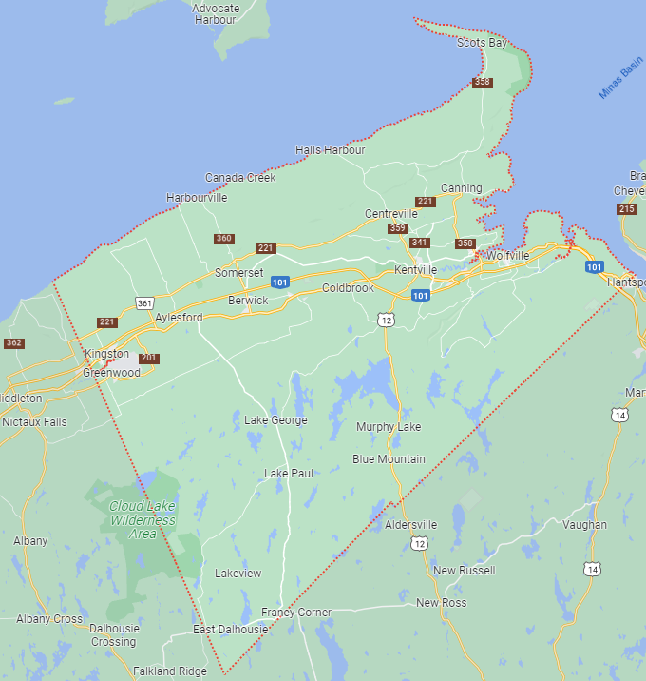
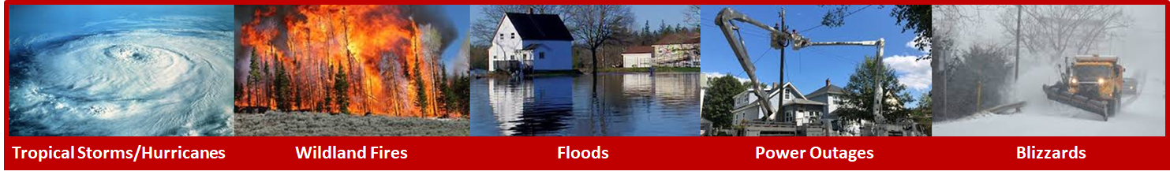
Aim
To increase Community Awareness about Emergency Preparedness in order to be better prepared for emergencies in Kings County.

Slide 3
Kings REMO Programs
Kings REMO Website
MOU/Agreements
Comfort Centres
Emergency Email Notification System
Brochures
Alert Ready
Vulnerable Persons Registry
Kings REMO Social Media
Community Outreach
Website
MOUs
Agreements
Comfort
Centres
Emergency
Emails
Brochures
Alert Ready
VPR
Social Media
Community
Outreach

Slide 4
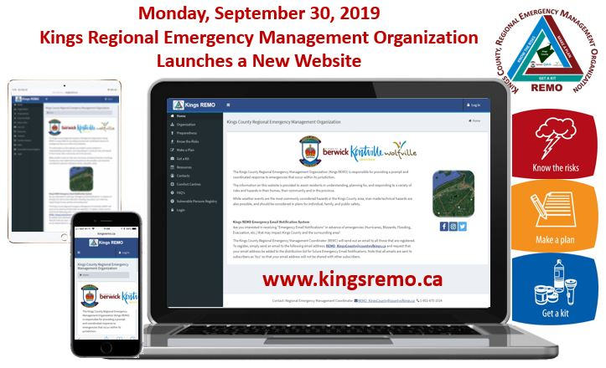
Kings REMO Website
Home
Committees
Preparedness
Know the Risks
Make a Plan
Get a Kit
Resources
Contacts
Comfort Centres
FAQs
Vulnerable Persons Registry
Website
MOUs
Agreements
Comfort
Centres
Emergency
Emails
Brochures
Alert Ready
VPR
Social Media
Community
Outreach

Slide 5
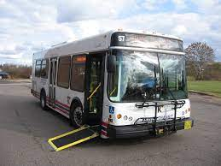

Emergency Preparedness
MOUs / Agreements
Transportation
Kings REMO – Kings Transit Authority, 2019-10-23
Regional Emergency Management Mutual Aid
Kings County – Annapolis County 2022-05-19
Kings County – West Hants 2022-12-13
Kings County – Lunenburg County 2023-01-10
Website
MOUs
Agreements
Comfort
Centres
Emergency
Emails
Brochures
Alert Ready
VPR
Social Media
Community
Outreach

Slide 6

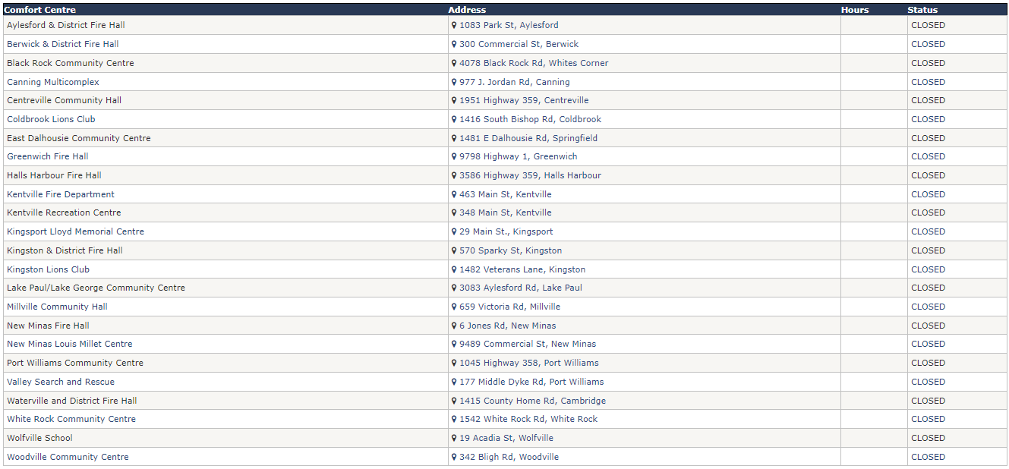
MOU / Agreements
Comfort Centres
Kings REMO – 25 Comfort Centres in Kings County
  Community Groups support activation of Centres
Website
MOUs
Agreements
Comfort
Centres
Emergency
Emails
Brochures
Alert Ready
VPR
Social Media
Community
Outreach
2022-09-27
Kings REMO – Town of Wolfville Council & Staff
6

Slide 7
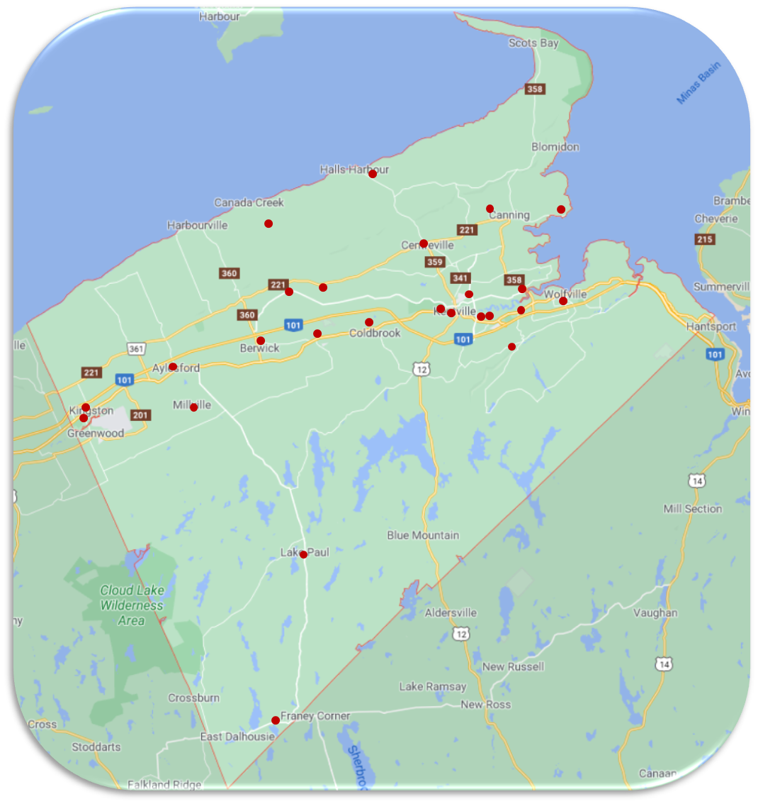
Comfort Centres - Locations
Not Overnight Shelters
Website
MOUs
Agreements
Comfort
Centres
Emergency
Emails
Brochures
Alert Ready
VPR
Social Media
Community
Outreach

Slide 8
Comfort Centres - Services
Place to get Warm
Re-Charge devices
Use Washroom
Get a Warm Drink
Check on each other – share information
Get updates on weather & Power resumption
Not Overnight Shelters
Website
MOUs
Agreements
Comfort
Centres
Emergency
Emails
Brochures
Alert Ready
VPR
Social Media
Community
Outreach

Slide 9

Comfort Centres - Communications
The opening of a Comfort Centre will be announced by Kings REMO through:
  News Releases
  Local News media, commercial TV & radio
  Local Municipal Websites
  Social Media
  NS EMO & NS 211
  Kings REMO Website
  Emergency Email Notification System
Website
MOUs
Agreements
Comfort
Centres
Emergency
Emails
Brochures
Alert Ready
VPR
Social Media
Community
Outreach

Slide 10

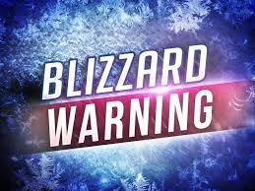


Emergency Email
Notification System
Subscription based service
Emails sent to all subscribers ‘bcc’
Advance notification of significant weather conditions and Alerts that may impact Kings County
General Emergency Preparedness information
Website
MOUs
Agreements
Comfort
Centres
Emergency
Emails
Brochures
Alert Ready
VPR
Social Media
Community
Outreach

Slide 11
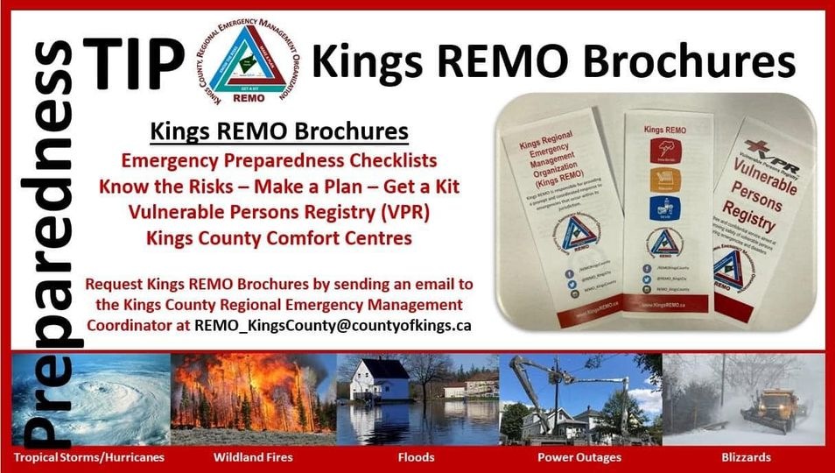
Kings REMO Brochures
Emergency Preparedness Checklists
Know the Risks
Make a Plan
Get a Kit
Vulnerable Persons Registry (VPR)
Comfort Centres
Website
MOUs
Agreements
Comfort
Centres
Emergency
Emails
Brochures
Alert Ready
VPR
Social Media
Community
Outreach

Slide 12
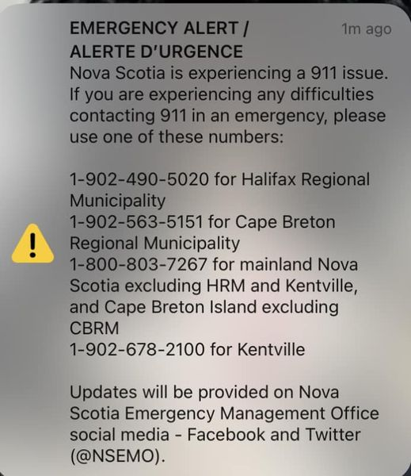
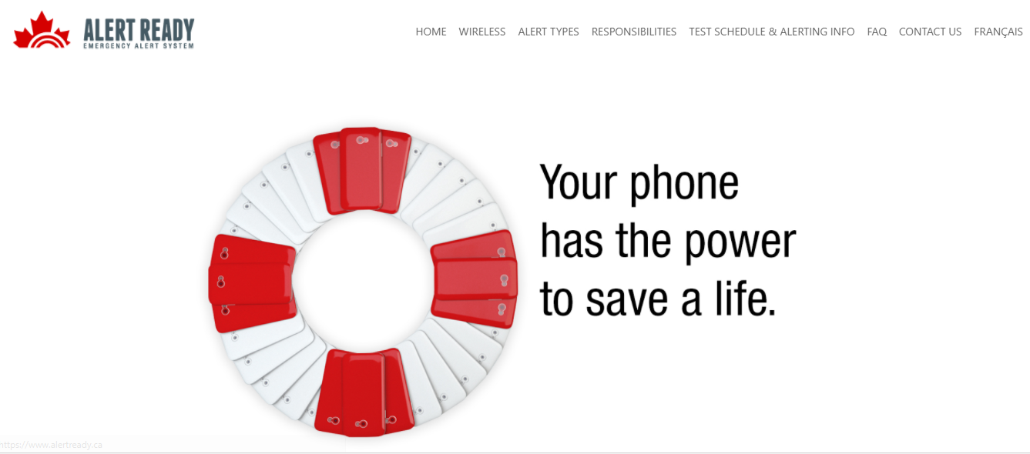

Alert Ready www.alertready.ca
Testing in NS:
2 mandatory tests
per year
  May
  Nov
Website
MOUs
Agreements
Comfort
Centres
Emergency
Emails
Brochures
Alert Ready
VPR
Social Media
Community
Outreach

Slide 13

Vulnerable Persons Registry
“To increase the safety of residents living within their own homes who would be at greater risk during an emergency or disaster. To offer a beneficial public service that will continue our community’s commitment to increasing the safety of residents”
Website
MOUs
Agreements
Comfort
Centres
Emergency
Emails
Brochures
Alert Ready
VPR
Social Media
Community
Outreach

Slide 14
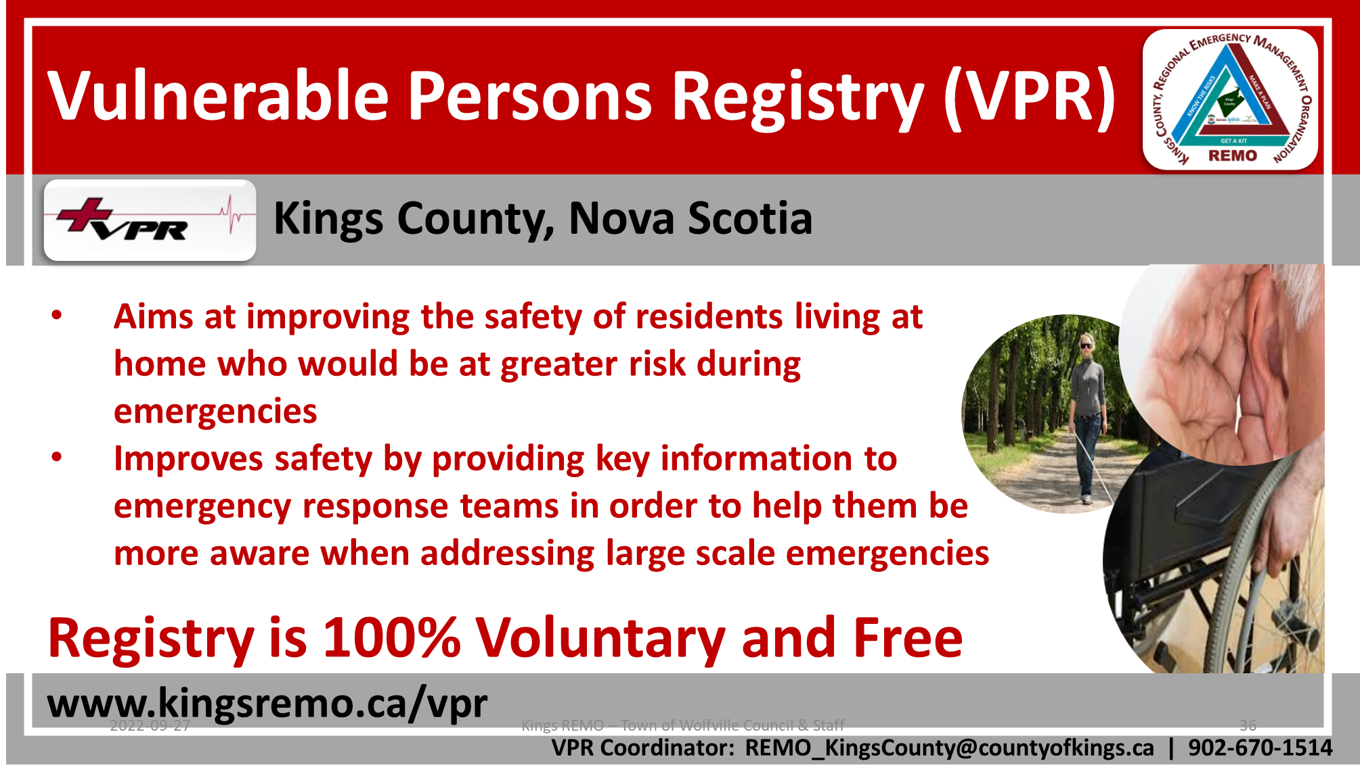
Vulnerable Persons Registry
Website
MOUs
Agreements
Comfort
Centres
Emergency
Emails
Brochures
Alert Ready
VPR
Social Media
Community
Outreach

Slide 15
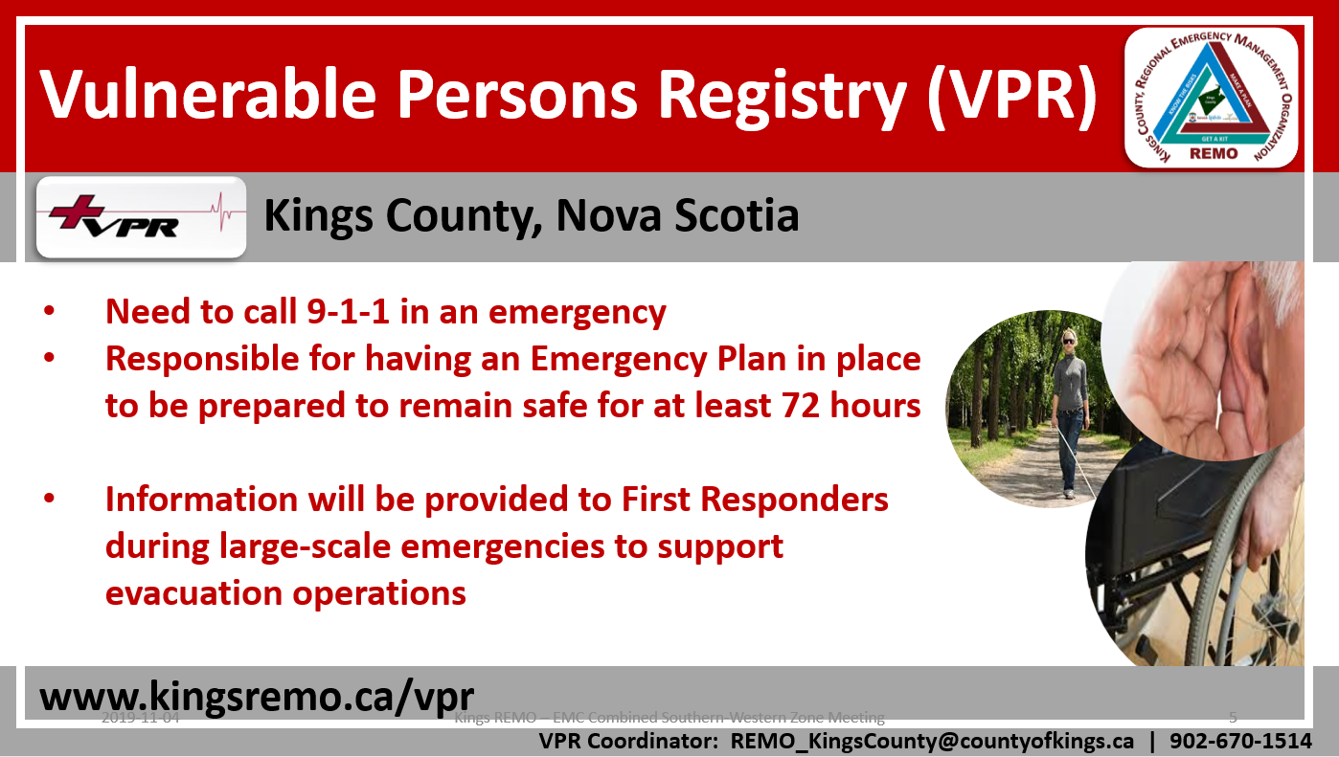
Vulnerable Persons Registry
Website
MOUs
Agreements
Comfort
Centres
Emergency
Emails
Brochures
Alert Ready
VPR
Social Media
Community
Outreach

Slide 16
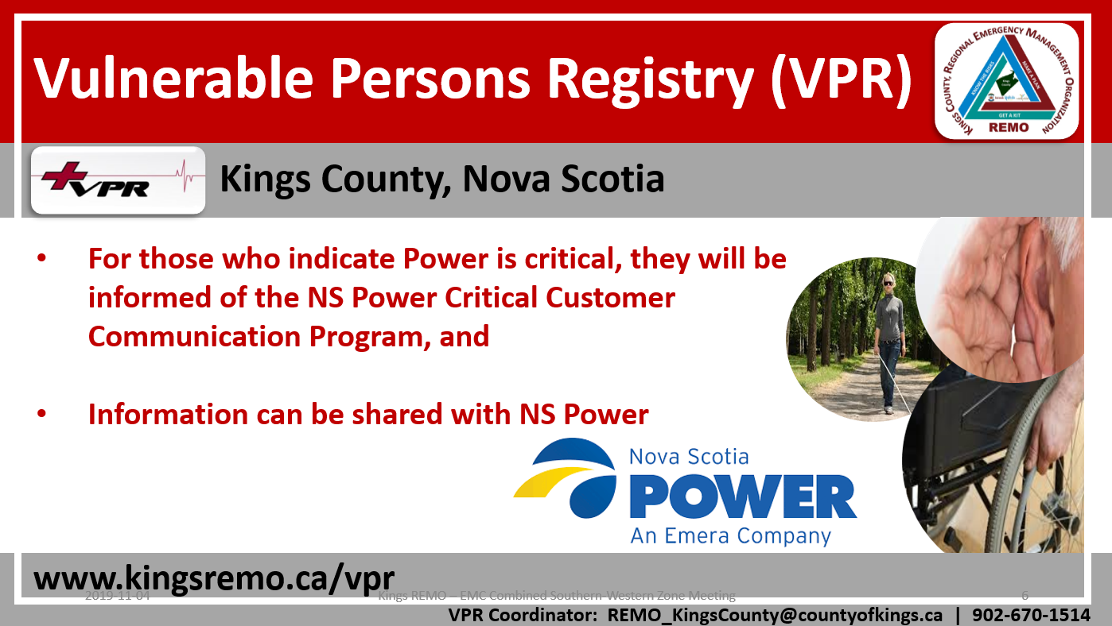
Vulnerable Persons Registry
Website
MOUs
Agreements
Comfort
Centres
Emergency
Emails
Brochures
Alert Ready
VPR
Social Media
Community
Outreach

Slide 17



REMO Social Media
“Social media offer the opportunity to connect and cooperate with the networked public, take advantage of the capabilities and innovations of virtual volunteers, and to reach people quickly with alerts, warnings and preparedness messages” ⁽¹⁾
(1) Social Media in Emergency Management, Defence Research and Development Canada, May 2014
Website
MOUs
Agreements
Comfort
Centres
Emergency
Emails
Brochures
Alert Ready
VPR
Social Media
Community
Outreach

Slide 18
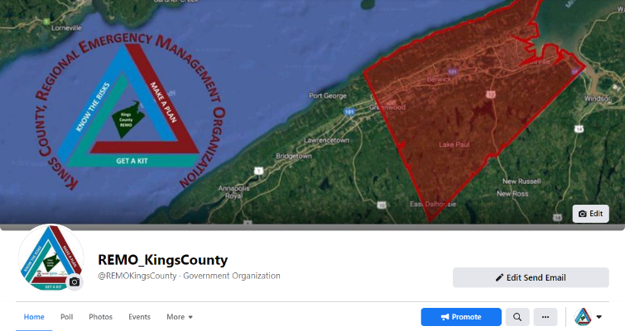
REMO Social Media
Facebook Followers
4,413 (+ 342) 2023-01-16
5,014 (+ 601) 2023-05-29
Website
MOUs
Agreements
Comfort
Centres
Emergency
Emails
Brochures
Alert Ready
VPR
Social Media
Community
Outreach

Slide 19
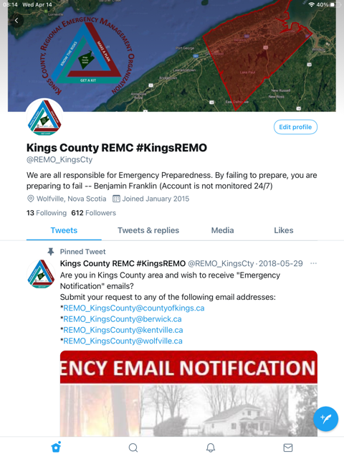
REMO Social Media
Twitter Followers
826 (+ 12) 2023-01-16
833 (+ 7) 2023-05-29
Website
MOUs
Agreements
Comfort
Centres
Emergency
Emails
Brochures
Alert Ready
VPR
Social Media
Community
Outreach

Slide 20
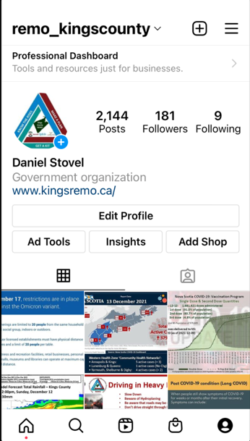
REMO Social Media
Instagram followers
244 (+ 8) 2023-01-16
257 (+ 13) 2023-05-29
Website
MOUs
Agreements
Comfort
Centres
Emergency
Emails
Brochures
Alert Ready
VPR
Social Media
Community
Outreach

Slide 21

Kings REMO Community Outreach
Emergency Preparedness & You
Website
MOUs
Agreements
Comfort
Centres
Emergency
Emails
Brochures
Alert Ready
VPR
Social Media
Community
Outreach

Slide 22



Kings REMO Community Outreach
Emergency Preparedness Presentations
2018 16
2019 31
2020 10
2021 1 (COVID-19 impacts)
2022 9
2023 12 as of 2023-05-29
Website
MOUs
Agreements
Comfort
Centres
Emergency
Emails
Brochures
Alert Ready
VPR
Social Media
Community
Outreach

Slide 23
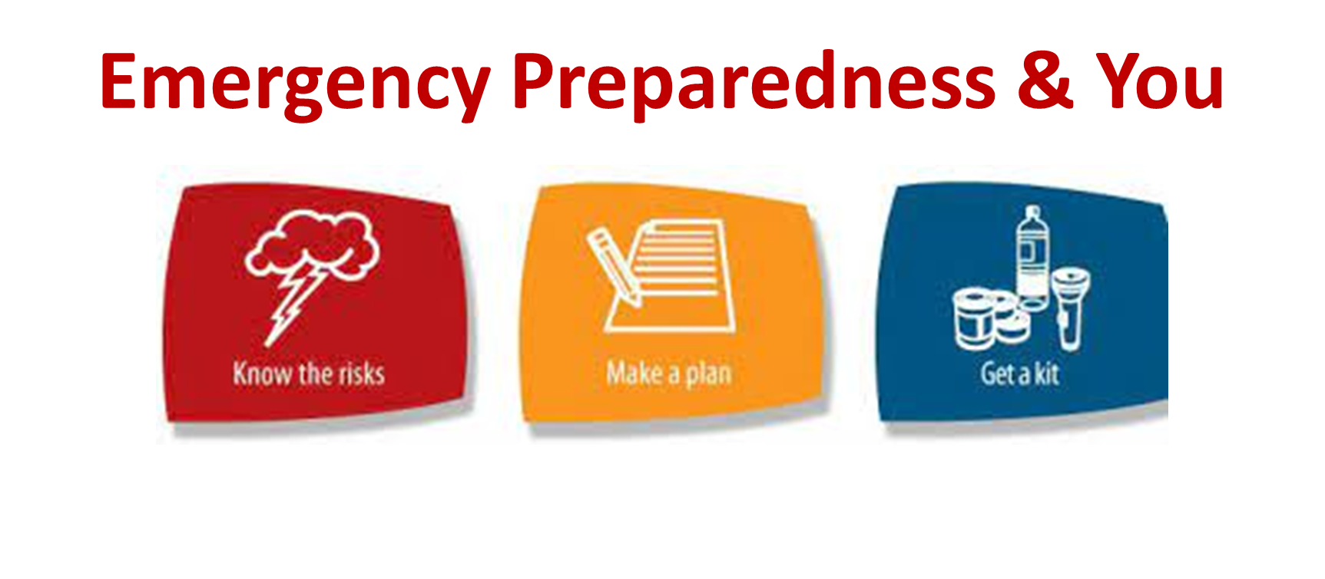
Kings REMO &
Emergency Preparedness
??? Questions ???
Dan Stovel, REMC – Kings County
REMO_KingsCounty@countyofkings.ca

