Slide 1

Investing in Nova Scotian Food
FarmWorks
TM
Investment
Co-operative Limited
Video

Slide 2


Slide 3
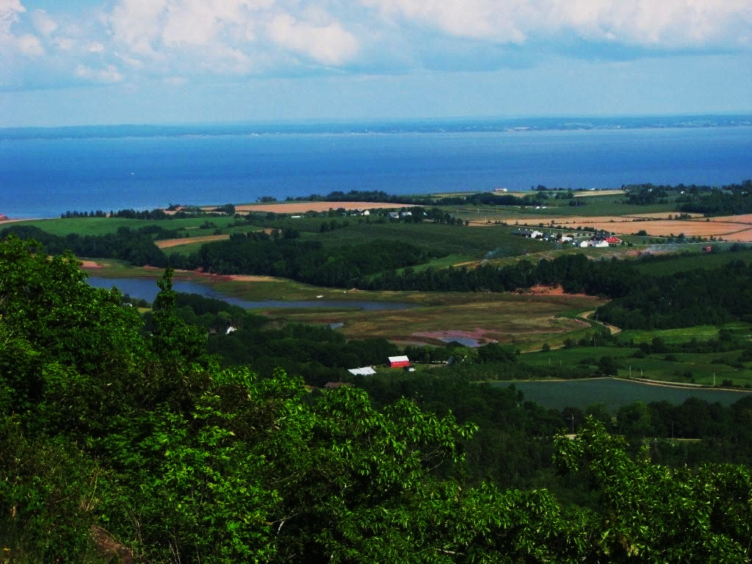
FarmWorks
Community Economic Development Investment Fund
Helping to Grow
Nova Scotian
Farms and Food

Slide 4
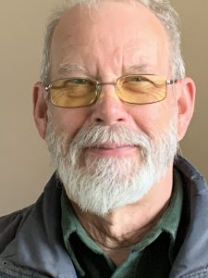
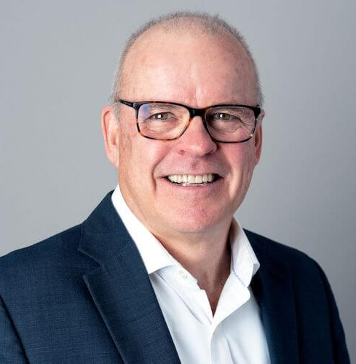
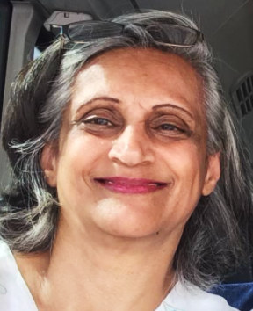
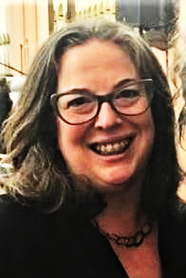
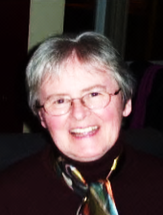
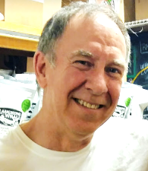

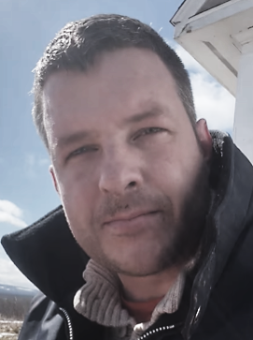
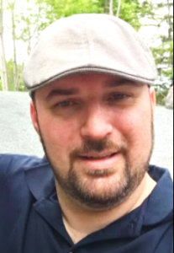
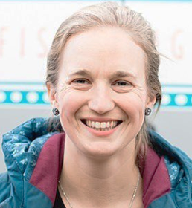

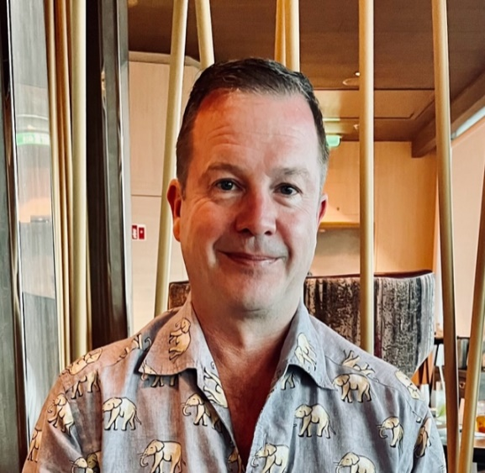

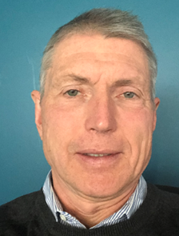
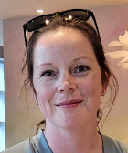
Charles MacLean – Chair
Food Procurement Administration
Barb Boates-Sweet – Vice Chair
Restauranteur, Management
Avila Coutinho – Treasurer
Business Development and Analysis
Robin MacAdam - Secretary
Energy Consultant
Linda Best – Managing Director
Microbiologist, Friends of Agriculture Society
Murray Coolican – Director
Business, Government Relations
Danny Martin - Director
Military, Musician, Food Entrepreneur
Robert MacEachern – Director
Business and Indigenous Consultant
Hana Nelson – Director
Management, Value-added fishery production
Hélène Branch – Director
Business Consultant, Mentor
Lindsay Reid – Director
Restauranteur, Business analysis
Stephen Rear – Director
Entrepreneur, Business Consultant
Chris Payne- Director
CPA, Developed CEDIF program
John Wray – Director
Ordained Minister, Media, Farmer
Nadia Gerrits – Administrative Assistant
Business, Finance, Sales
FarmWorks Directors 2025

Slide 5
FarmWorks
Field to Fork to Future
  People – quality of life for all Nova Scotians
  Community – farms and SMEs contribute
  Health – increasing the availability of healthy food
  Economy – keeping more money and jobs in NS
  Environment – ecologically sound local production
  Preservation – of built and natural amenities of NS

Slide 6
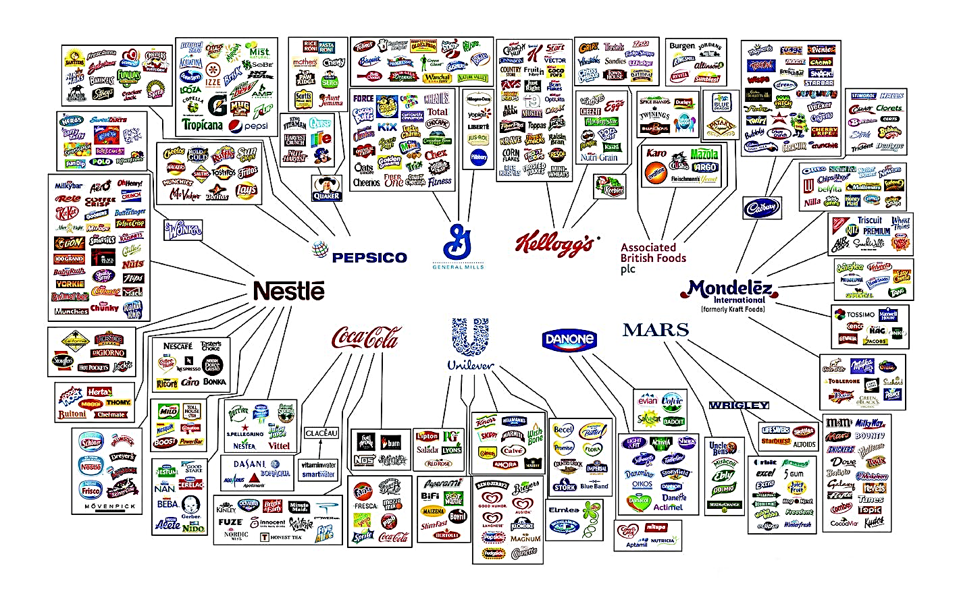
Challenge

Slide 7
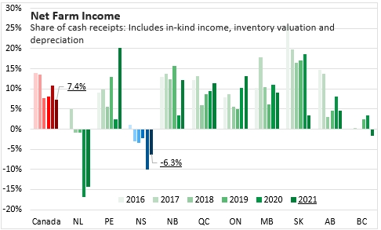
Challenges - Opportunities

Slide 8
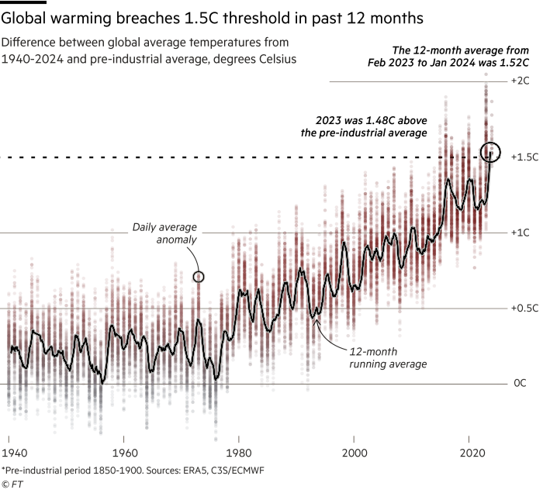
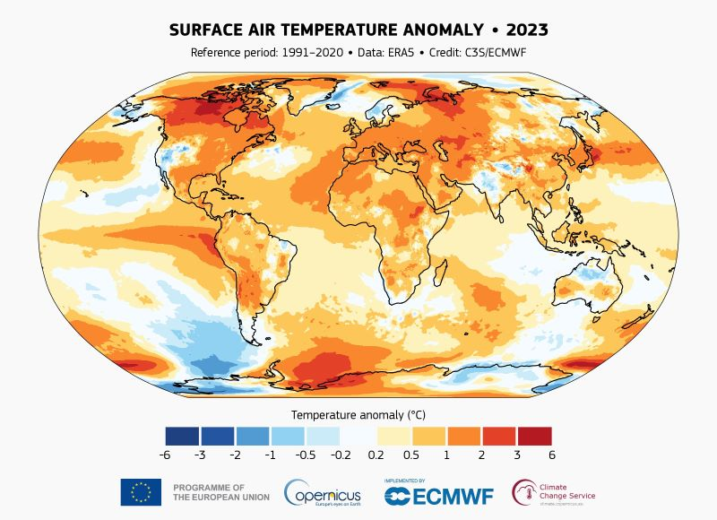

Slide 9
  Community Economic Development Investment Funds (CEDIF)
In 2021 RRSP investments by 133,420 Nova Scotians totaled $1,030,000 and almost all left NS
FarmWorks CEDIF 14 years to date:
$5,983,300 invested by 575 Shareholders
Currently > $90,000 repaid monthly
$10,840,000 has been loaned to 172 clients
CEDIF impact – significant socioeconomic gains
(Report by Dr. George Karaphillis for CECNB)

Slide 10
CEDIF Tax Credits & Deferral
FarmWorks CEDIF Shares support a range of Farms and Food businesses, investor capital is preserved
FarmWorks $100 Shares 5-year terms – up to $30,000 annually
35% NS Tax Credit for prior tax year (or back 3 or forward 7 years)
20% and 10% credits at the beginning of subsequent 5-year terms
RRSP – Provincial Tax Credit and Federal Tax Deferral
Existing RRSPs – transfer for 35%, 20% and 10% Tax Credit
Planning for Fifteenth Offer is underway

Slide 11
FarmWorks Lending
No application or legal fees or other charges
Application, Business plan, Financials, Projections, Personal Worth, Credit Score, Visits, Discussions
No payments first three months
CEDIF Loans are unsecured
Mentoring and Advisory assistance if requested
After two years no charges for prepayments

Slide 12
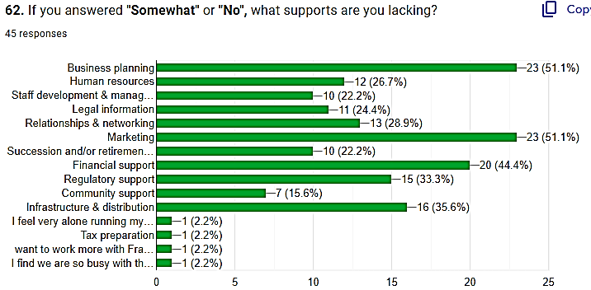
FarmWorks Lending
What supports are you lacking?

Slide 13
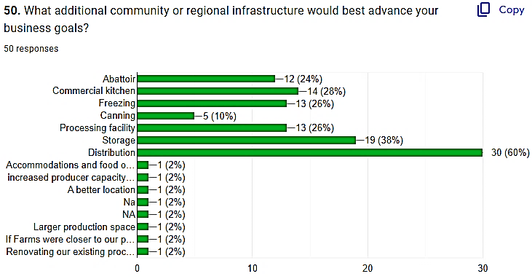
FarmWorks Lending
What community or regional infrastructure would help your business?

Slide 14
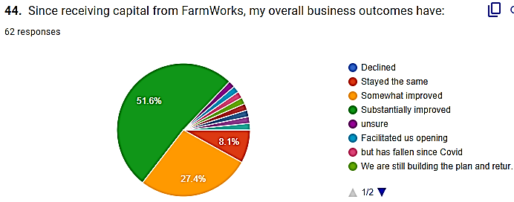
FarmWorks Lending
Since receiving capital from FarmWorks my
overall business outcomes have:

Slide 15
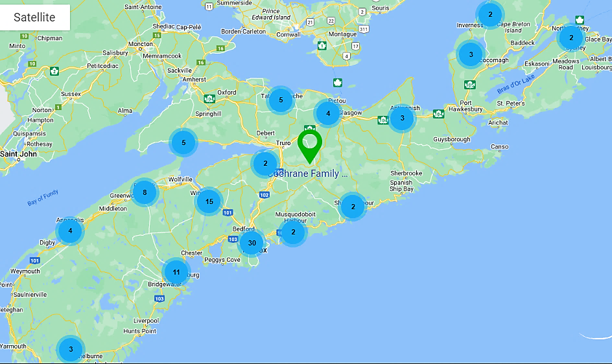
Over 100 Food Related Businesses

Slide 16
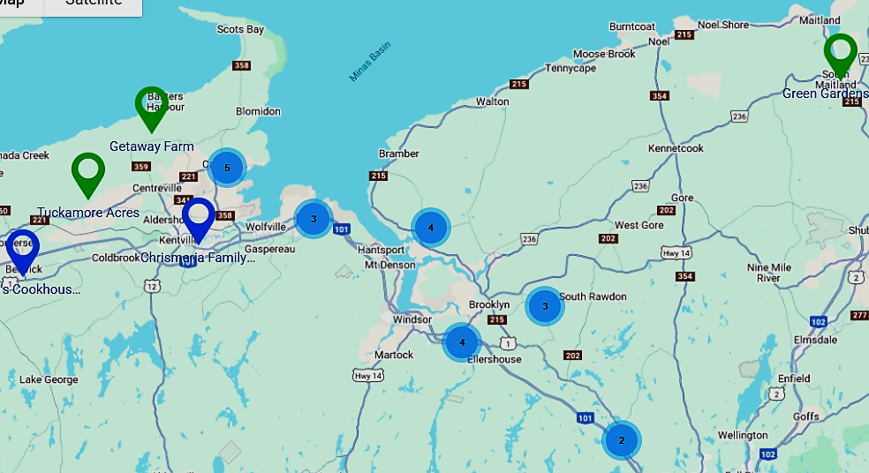

Slide 17


