Slide 1



ROTARY ATLANTIC
ENVIRONMENT
COMMITTEE

Slide 2

District 7815 Enviroclubs Awards Program

Slide 3
Reference to Rotary Clubs and Rotarians by default includes Rotaractors and Interactors

Slide 4

June 26, 2020
The Rotary Foundation Trustees and Rotary International Board of Directors adds a new area of focus:
The Environment
(effective July 1, 2021)
Notes:
The impetus for the creation of District environment committees came at least in part from the announcement from RI that “the environment” would be the 7th area of focus effective July 1st, 2021.

Slide 5
There is no ‘Planet B’
Notes:
The recognition of ‘The Environment’ as an area of focus is long overdue. Our environment is our home and there is a long list of issues that threaten the health of our environment. We need to take care of our home because we don’t have another. Supporting a healthy environment supports the other 6 areas of focus. For example, you can’t have clean water and sanitation without a healthy environment, and vice versa.

Slide 6
“The Earth is what we all have in common”
Wendell Berry
Notes:
The wish for a healthy environment unites people from around the world and it should unite Rotarians from around the world as well. Care for the environment can bring us together globally as an organization but it can also bring us together locally – not just with other Rotarians but with our communities as well.

Slide 7
“
You cannot get through a single day without having an impact on the world around you. What you do makes a difference and you have to decide what kind of a difference you want to make.”
—Jane Goodall
Notes:
Environmental issues sometimes seem so complex and vast, but we all have a part to play in solving them.

Slide 8

“
Notes:
Rotarians like to tout themselves as being people of action. As individuals, Rotarians can make lifestyle and consumer decisions that impact our environment. As an organization and as clubs, we can use our influence to make positive impacts beyond the sum of our individual impacts.

Slide 9

Purpose
The district environment committee will foster environmental awareness and engagement while promoting actions throughout the district that lead to more responsible environmental stewardship.
Notes:
Our role is not to tell clubs what they should do but rather, to support them as they work to improve environmental awareness of their members and their community and to implement environmentally responsible practices and projects.

Slide 10
July 2022
7815 DG Harvey Bass announces the creation of a District EnviroClub Awards program in St. John’s during RIP J Jones’ visit to St. John’s

Slide 11

Purpose; is to recognize clubs that undertake environmental initiatives and encourage clubs to expand on and implement their own environmental initiatives

Slide 12

Modelled after an awards program launched in the UK. Ours has considerable input from programs from Districts 7040 and 7620

Slide 13

Benefits of being an EnviroClub
Environmental sustainability is an important and current issue worldwide and locally, affecting everyone. Being a recipient of an EnviroClub Award may help to make your club more relevant to your members and in better engaging and retaining them.

Slide 14
Benefits of being an EnviroClub
Recognition of your environmental initiatives through receipt of the EnviroClub Award may also attract new members (younger members?) to your club and lead to new partnerships with other Rotary clubs, businesses, and community groups in your local community.

Slide 15
Benefits of being an EnviroClub
“The Environment” is Rotary’s newest area of focus. Having clubs in our District who are EnviroClubs demonstrates that Rotarians are indeed ‘people of action’ and that they follow up words and promises with concrete actions.

Slide 16

The Awards Program is a progressive criteria-based system, where clubs must first work for a “Bronze” Award before progressing to a “Silver” Award and finally a “Gold” Award.

Slide 17
Bronze
This is the basic award, simply requiring a club to register its Environmental Sustainability Officer or Environment Committee Chair, document the club’s current and planned initiatives and devote some of the club’s time to the exploration of environmental sustainability.

Slide 18
Bronze checklist
Appointed a Club ES Officer or Environment Committee Chair or Environment contact (suggest that they join ESRAG https://www.esrag.org/)
Provided a statement of current environmental initiatives by the club or individuals e.g., tree planting, if any

Slide 19
Bronze checklist
Provided a description of at least one environmental project implemented in the current Rotary year OR a planned environmental initiative for this or the next Rotary year (can be a continuation of or improvement on an existing initiative) and explained how the initiative(s) benefits the environment (beyond beautification and aesthetics)

Slide 20
Bronze checklist
Devoted at least two meetings to an environmental topic (e.g., films, guest speakers, planning an environmental initiative, participation in an environmental service project, etc.)

Slide 21
Bronze checklist
A plus (+) citation to every Club for their Bronze EnviroClub Award if they reach 25% of their members reporting that they measured their ecological footprint using a calculator (here is one that we suggest: https://www.footprintcalculator.org/ ).

Slide 22

To qualify for a Silver Award; a club will need to demonstrate that it is continuing with and improving an existing initiative and launching at least one new one. The club should continue to explore environmental topics as part of their regular activity. Clubs should also be engaging with other Rotary Clubs and partner with other community organizations to take environmental action. They should also be promoting these actions throughout Rotary networks and in their community.
Notes:
A healthy environment is key to supporting the other 6 areas of focus. For example, you can’t have clean water and good sanitation without a healthy environment – and vice versa.

Slide 23
A Gold Award signifies a significant commitment to the environment. To qualify for a Gold Award, a club will need to demonstrate its continued efforts outlined in the criteria for the Bronze and Silver Award levels and involvement in a minimum of TWO major initiatives in the Rotary year.

Slide 24
Applications accepted on an ongoing basis. Due by April 30th so that award winners can be recognized at a District event before the end of the Rotary year.

Slide 25

For an application or if you have questions, email
RotaryAtlEnv@gmail.com and submit applications to the same

Slide 26

Facebook: Rotary Atlantic – Environment Initiative
Follow here
Instagram @RotaryAtlEnv

Slide 27
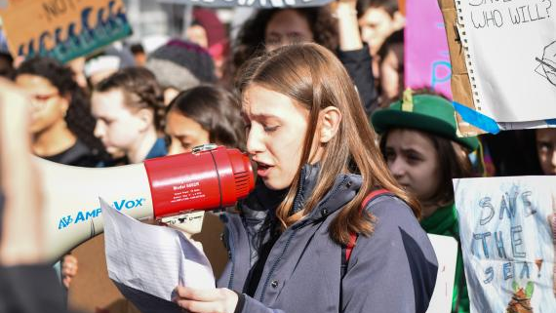
Participate in the Project Feature for @rotaryatlenv on Instagram
The Rotary Atlantic District Environment Committee has launched a Project Feature initiative on our instagram page. Submitting your projects allows us to curate our own Rotary Showcase of Environmental projects from District 7815 and help clubs without instagram accounts to share their projects.

Slide 28
Do you have a Previous or Upcoming project to submit? Follow the link and fill out the form: https://forms.gle/t8FAxDmF2E9VgCK5A
Important information to include in your submission;
- Up to 5 high quality photos taken during/after the project
- Club Name (and Instagram handle, if available)
- When and where the project happened
- Brief description of the project
- Any participating partners or other clubs who would appreciate the shoutout
- Name of photographer(s) (and Instagram handle, if available)

Slide 29

Welcome to the Environmental Sustainability Rotary Action Group (ESRAG)! https://www.esrag.org/welcome-esrag
ESRAG was formed to empower members of the Rotary Family worldwide to take actions to sustain our environment, particularly to stabilize our climate.
Notes:
Do you have an interest in the environment and in what Rotary is doing to support this area of focus. Sign on to ESRAG for regular newsletters. This Rotary Action Group is very active. Their website has many resources and the group holds excellent webinars regularly.

Slide 30
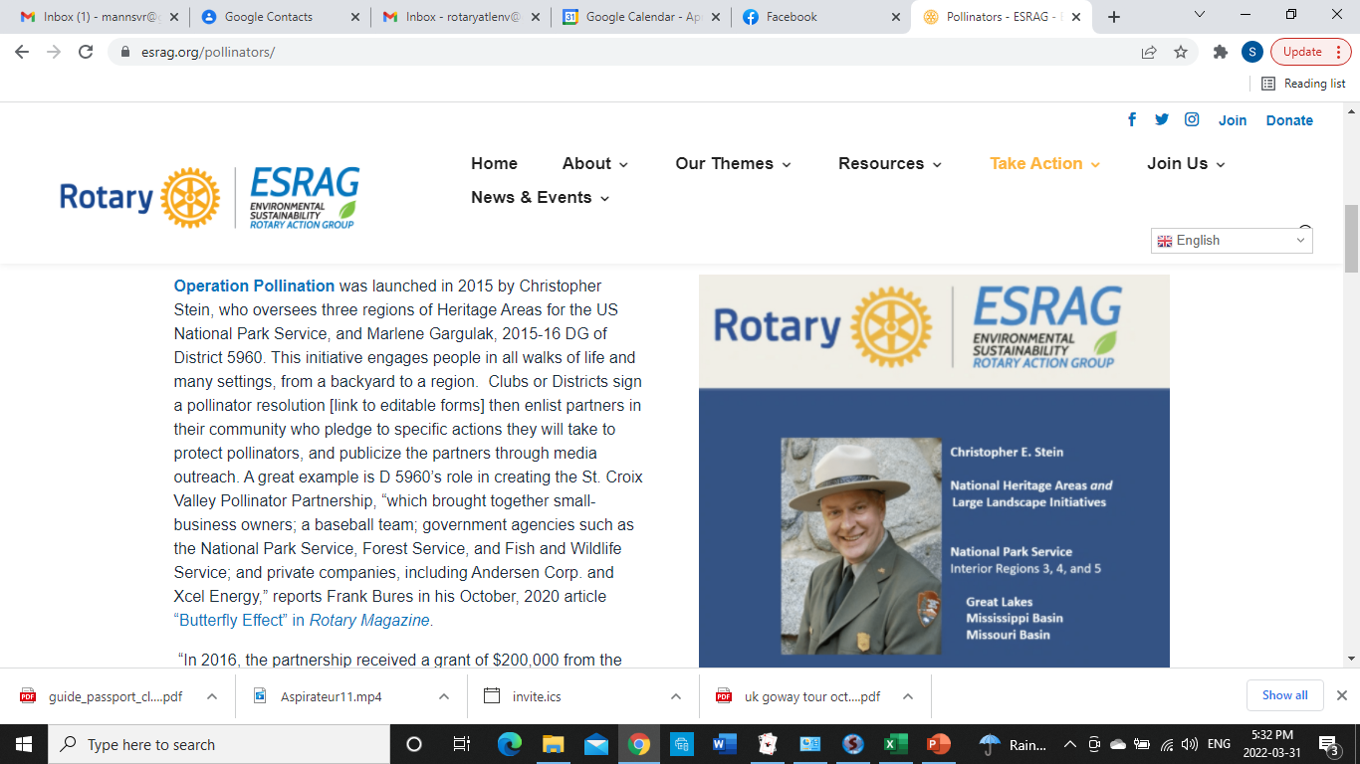

Slide 31
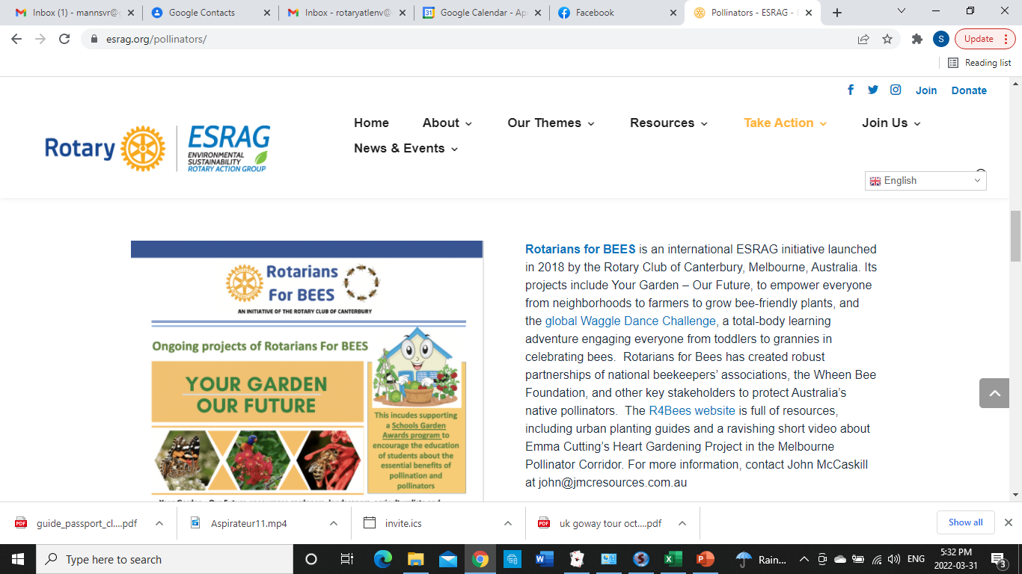

Slide 32
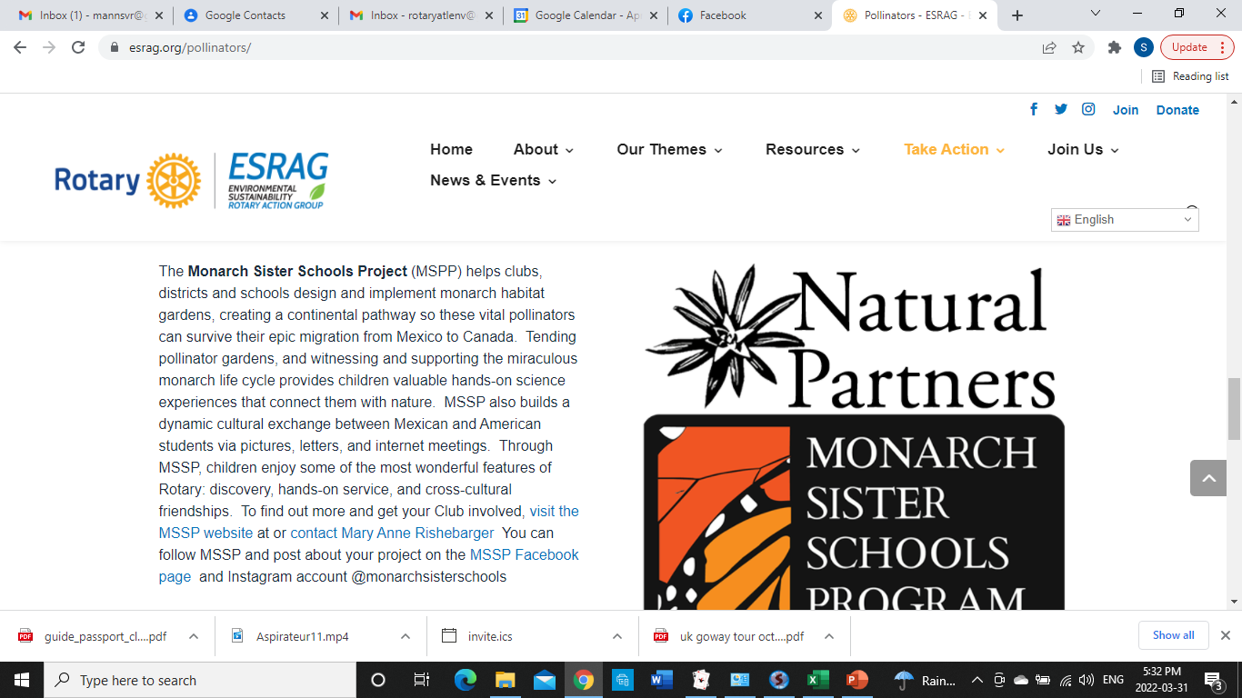

Slide 33
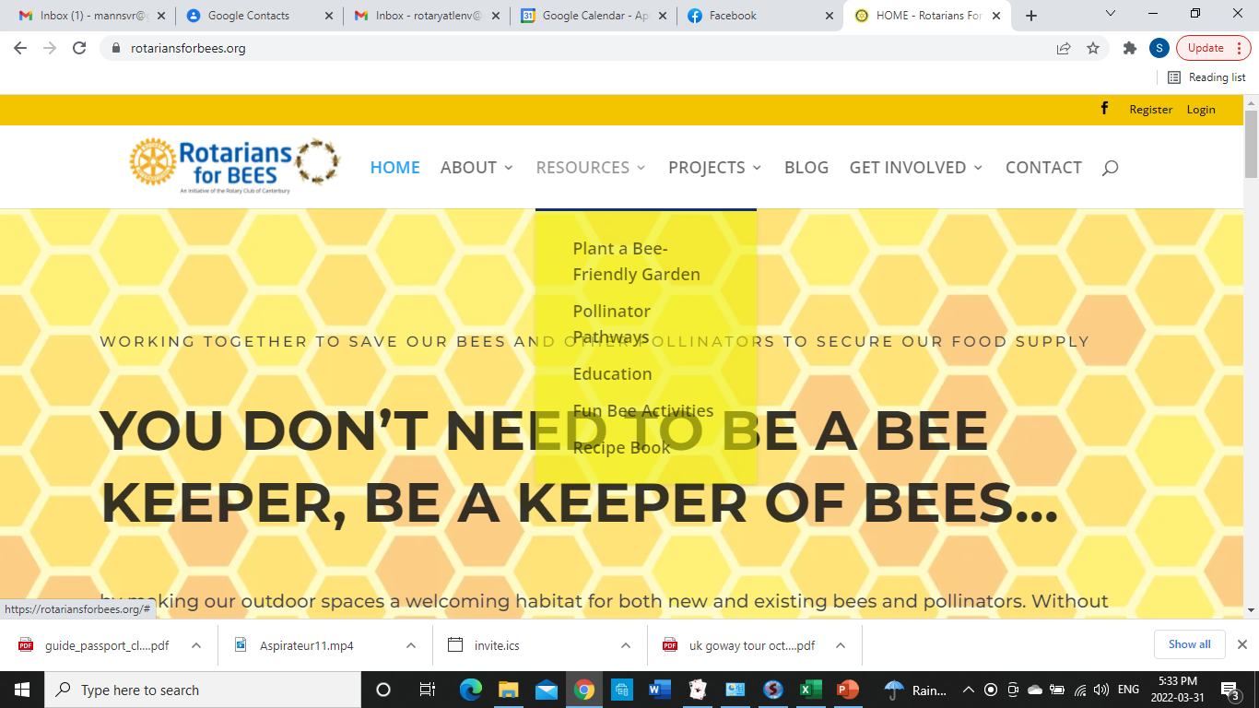

Slide 34
New committee members are always welcome!
Email RotaryAtlEnv@gmail.com
Notes:
The committee is always open to new members. We would love to have your involvement. If interested, email to rotaryatlenv@gmail.com or contact any committee member.

