Slide 1
Kentville Rotary
Environment Day
June 7th, 2025
ENDING PLASTIC POLLUTION

Slide 2
Opportunity for Club members engagement
Communications and Public Image Committee
Membership Committee
NKEC Interact Club
Community Service Committee
Ducks Unlimited
Town of Kentville – Parks and Rec.
Oakdene Community Garden Group
Three venues – Oakdene, Miners Marsh, Memorial Park

Slide 3
Exhibitors and Participants
Blomidon Naturalists - Pollinators
Clean Annapolis River Project
Canada Foundation Education EV
Canada Research Station
Ducks Unlimited*
Ecology Action Centre
Efficiency Nova Scotia*
Mersey Tobeatic Research Institute
NS Invasive species
NS Nature Trust
NSCC – Horticultural Dept.
Textile waste Research
Valley Waste Resource Management
JiiJuktukweijk Watershed Alliance
Valley Community Learning Assn
Wildlife Div. Lands/Forests
Wholesum Refillery
Scrubed Green Cleanin
Applied Geomatics NSCC Middleton
E bikes…….AND MORE!!

Slide 4
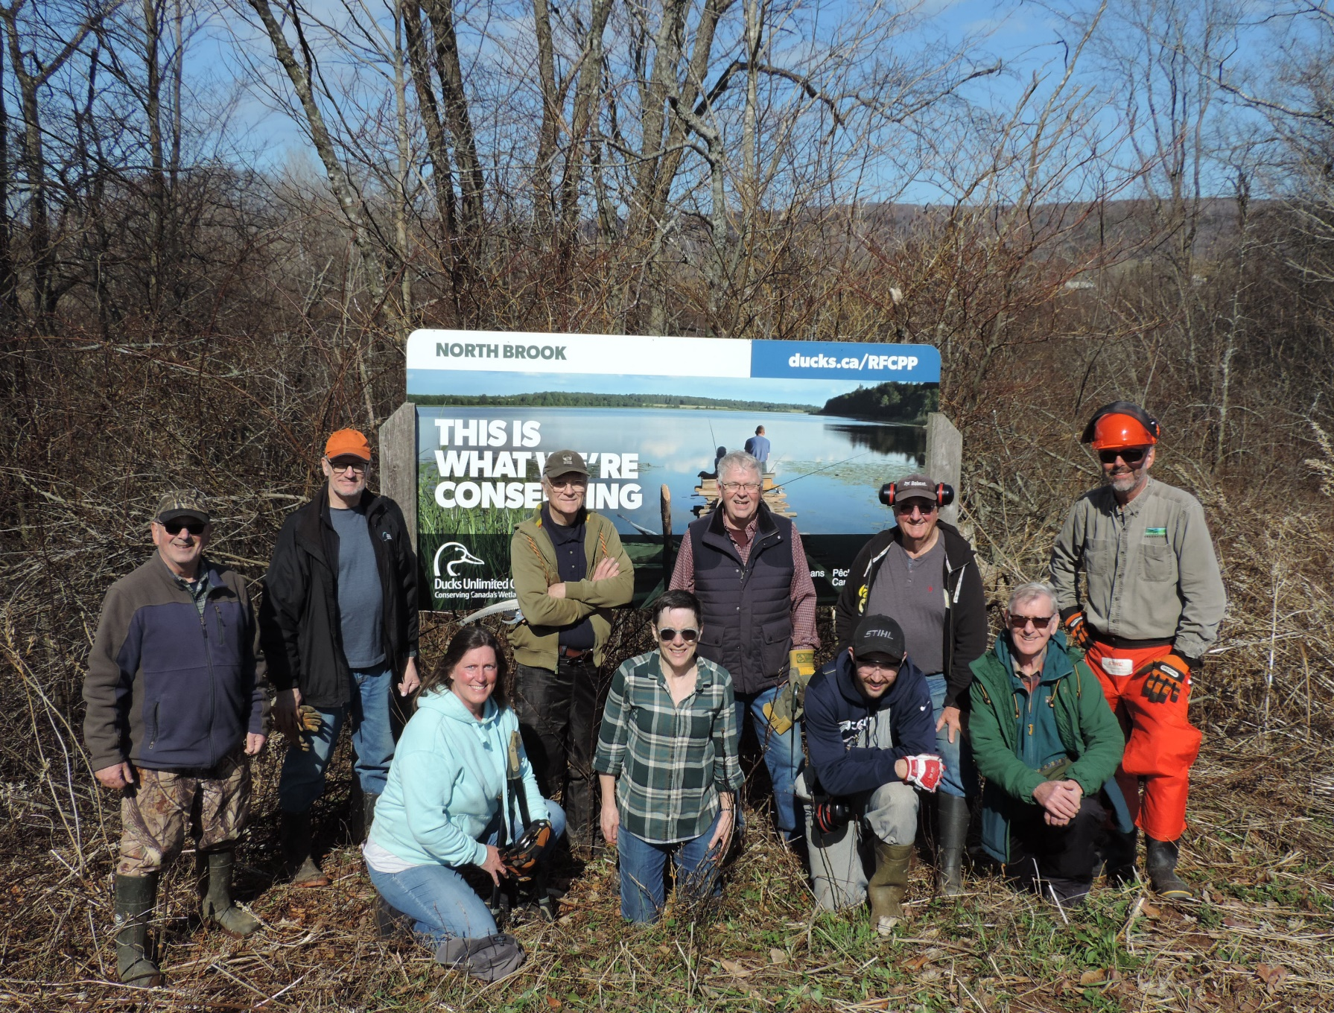


Slide 5
Promotion and Advertising
Social Media – TOK
Home show promo piece
Posters
Signage at Community Boards
Shared through Community Partners Network
Valley Events listing
Grapevine
Radio Ads
Rotary Facebook

Slide 6

Helping the Environment

Slide 7
Volunteers Environment Day
EV Coordinator – Miners Marsh 1
Membership/PR/VF 2 twice
Plant Tables – Gardens (May 30th 2) 3
Exhibitor Coordinator (Oakdene) 2
Tour Coordinator Miners Marsh 1
Exhibitor Coordinator (Miners Marsh 2
BBQ + Supplies – Water Jugs (Oakdene) 5
Setup/Take Down/Clean up Crew 4 twice

Slide 8


Slide 9


Slide 10
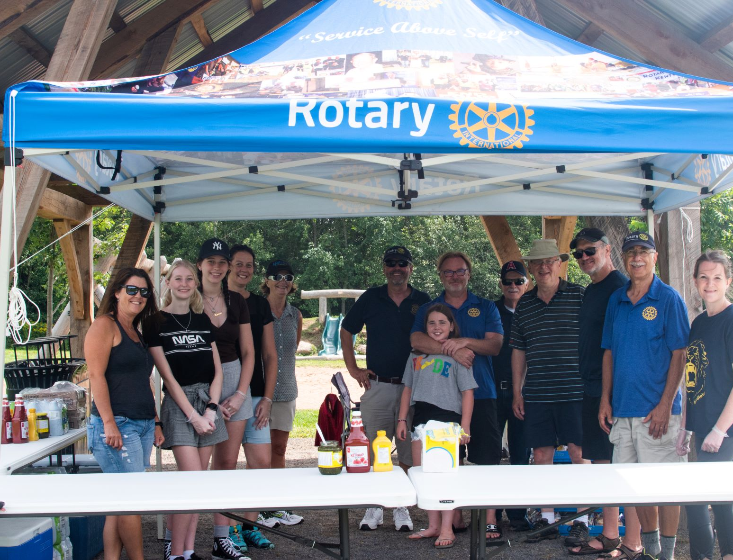
Service above Self
Rotary Helping the Environment
Kentville Rotary
Town Kentville
Ducks Unlimited
Indigenous Partner
Corporate Partner

