Slide 1
ROTARY INTERNATIONAL’S
COUNCIL ON LEGISLATION
APRIL 2016

Slide 2
Language translations:
English
Spanish
Korean
Japanese
French
Mandarin
Portuguese

Slide 3
KNOWLEDGE OF:
  R.I. Constitution
  R.I. By-laws
  R.I. Code of Policies
  Club Constitution
  Club By-laws
  Rotary Foundation Code of Policies

Slide 4
Attendees Training
Multi-choice answer questionnaire on line 80% pass required before proceeding.
2 hours training session at Zone Institute in Melbourne.
One hour webinar. (on line)
Two hours training on site in Council Chamber prior to commencement of Council on Legislation

Slide 5
Council on Legislation
Enactments:
Legislation that amends the constitutional documents: (RI bylaw 7.010)
Resolutions:
Legislation that does not amend the constitutional documents and makes recommendations to the R.I. Board

Slide 6
Legislation Groupings
Club Administration
Avenues of Service and Object of Rotary
Club Meetings
Attendance
Membership
RI Officers and Elections
Rotary International
R.I. Finances and per capita dues
Legislative Procedures
Regular Legislation - Resolutions

Slide 7
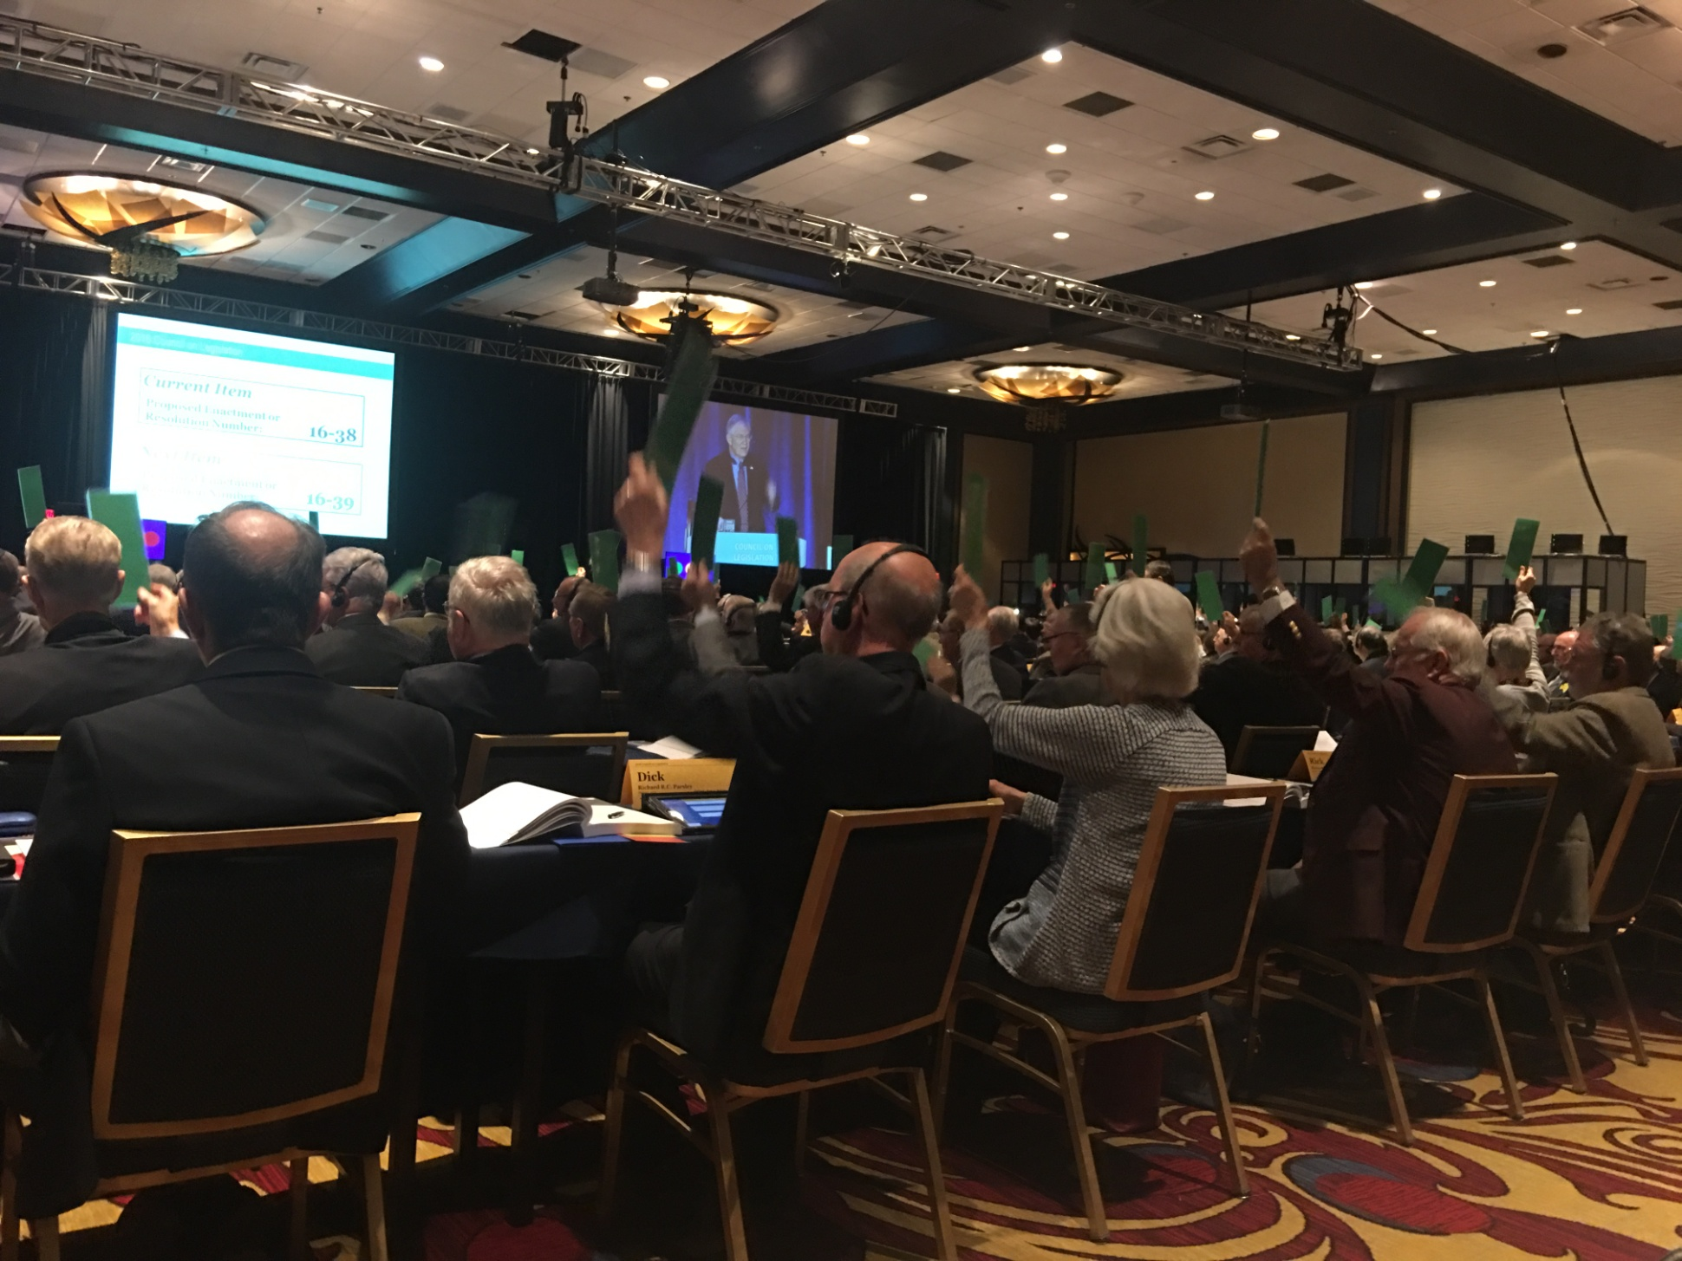
Voting on a piece of legislation – see translation booths on right

Slide 8
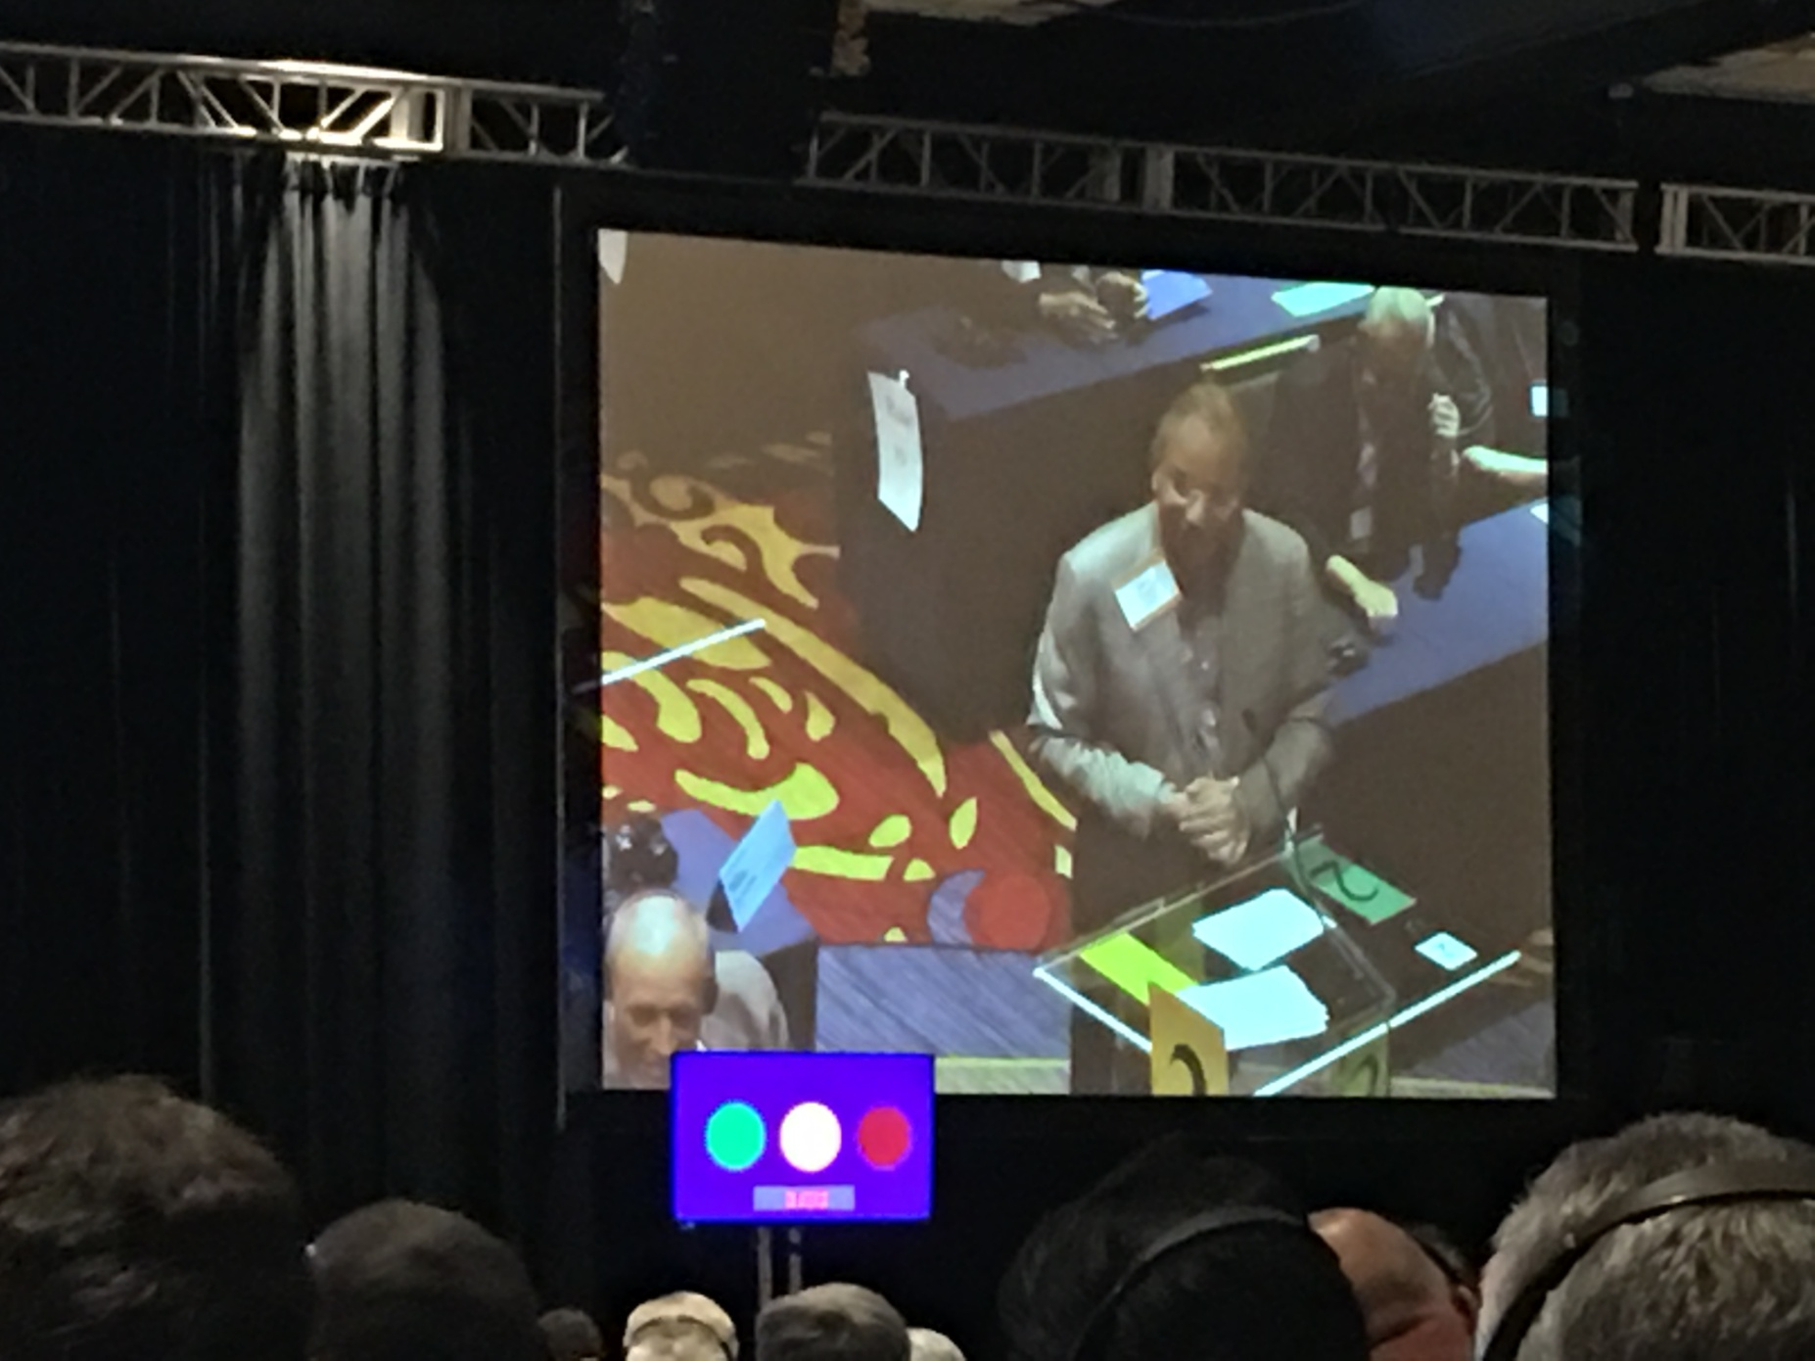
Debating an article of legislation from podium 2 – red light, time is up

Slide 9
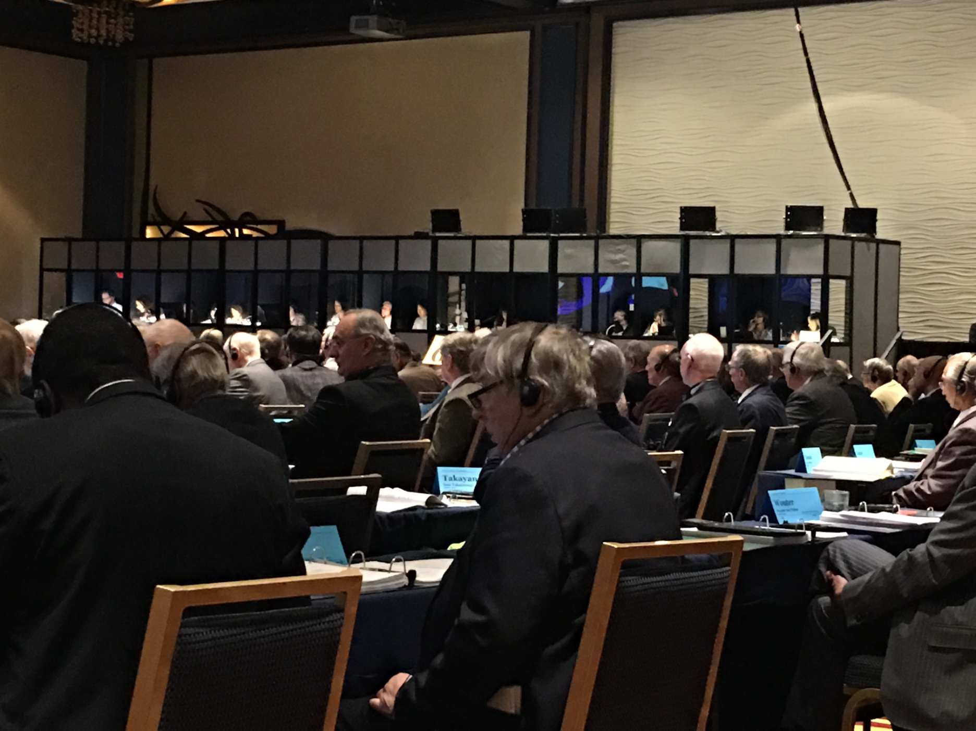
Translation booths for the Council

Slide 10
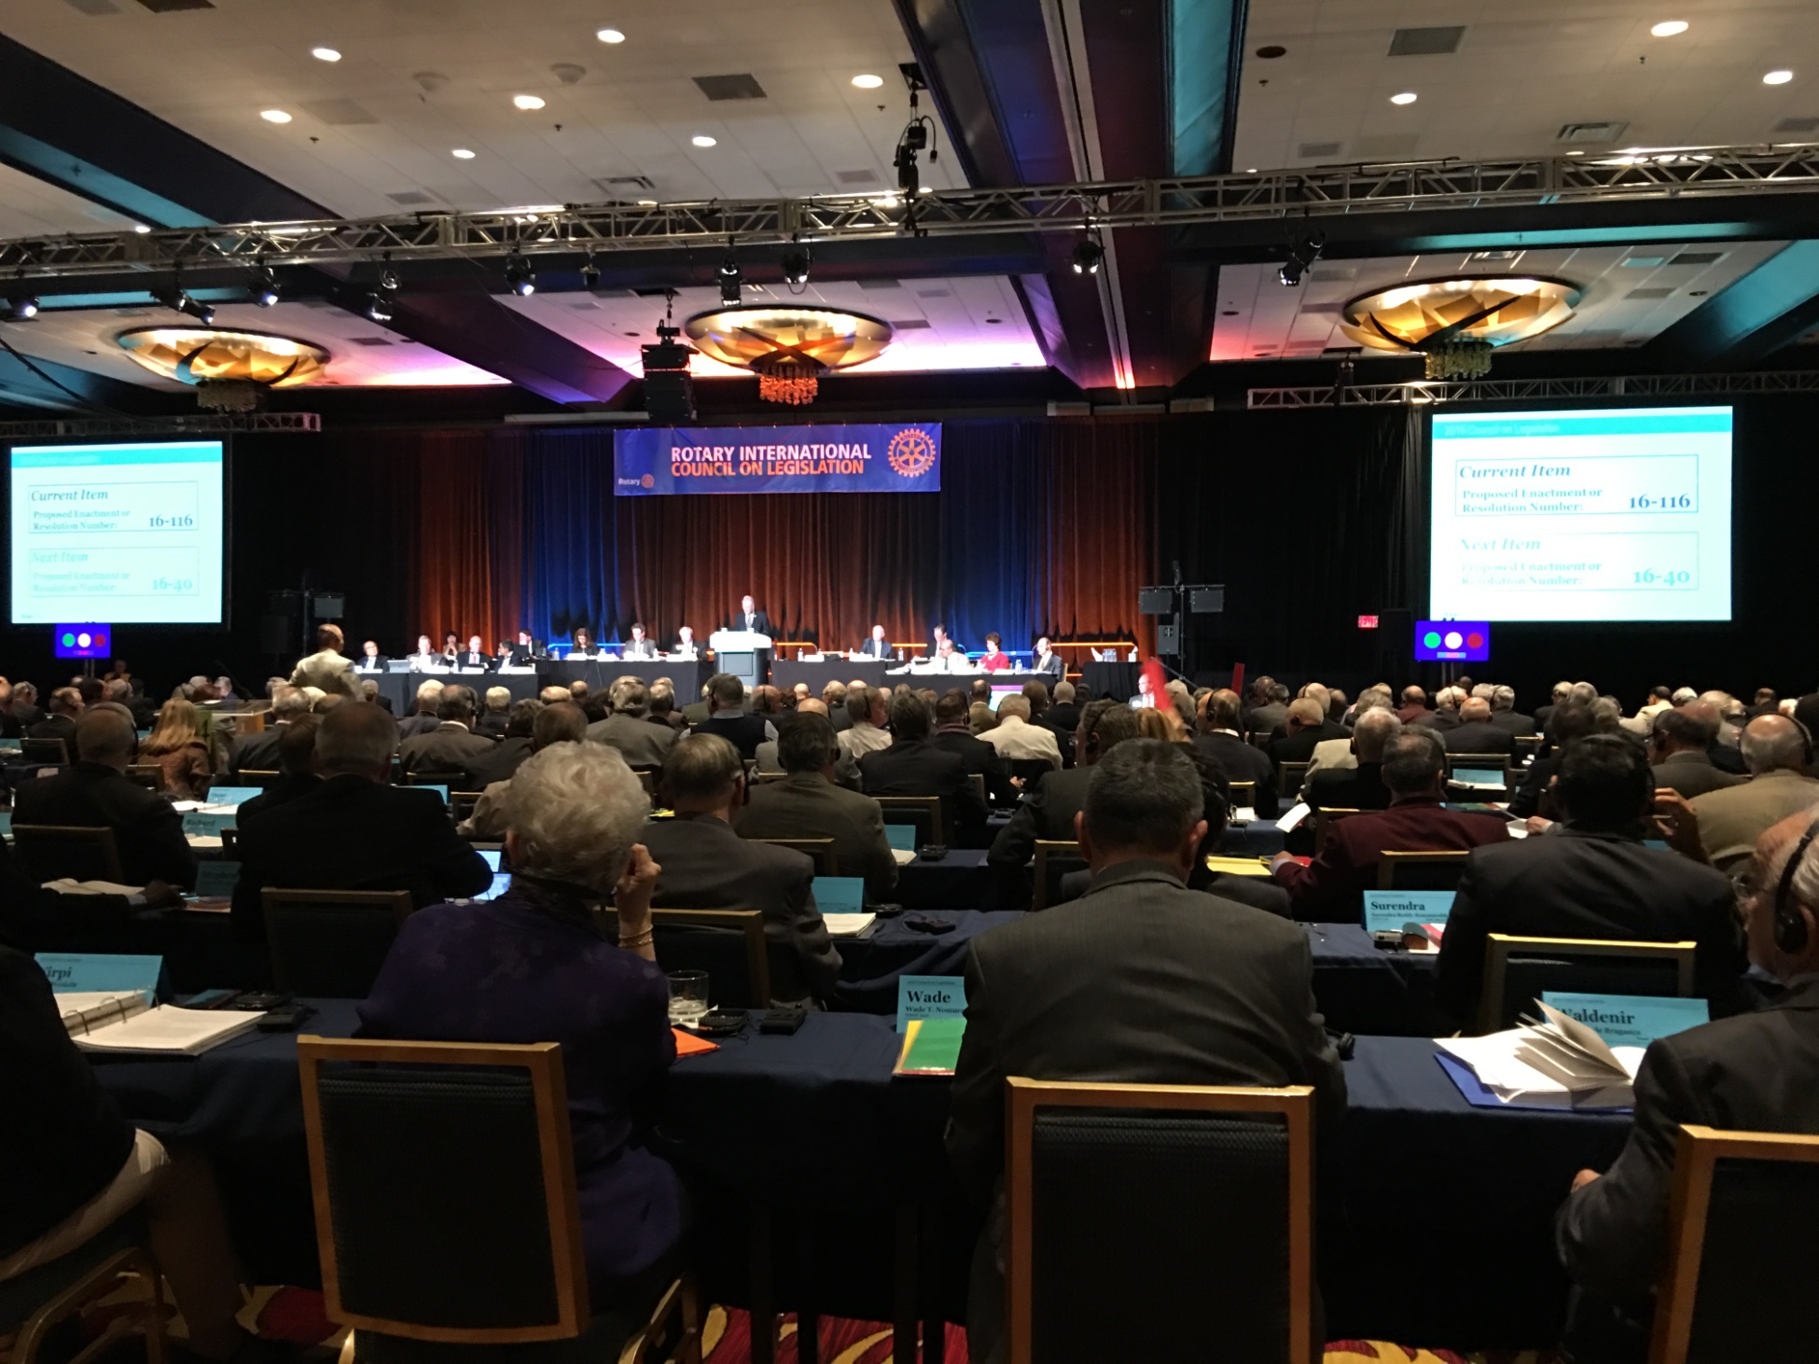
Council Chamber during debate

Slide 11
Council decisions
So what changed?

Slide 12
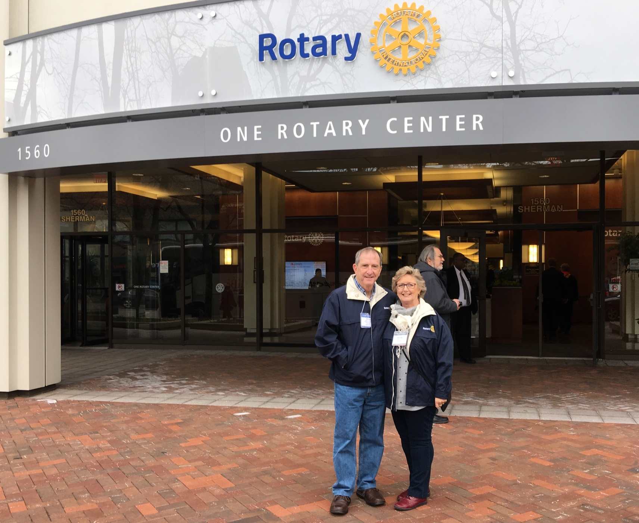
Not all hard work – a quick visit to Rotary International Headquarters at Evanston.

Slide 13
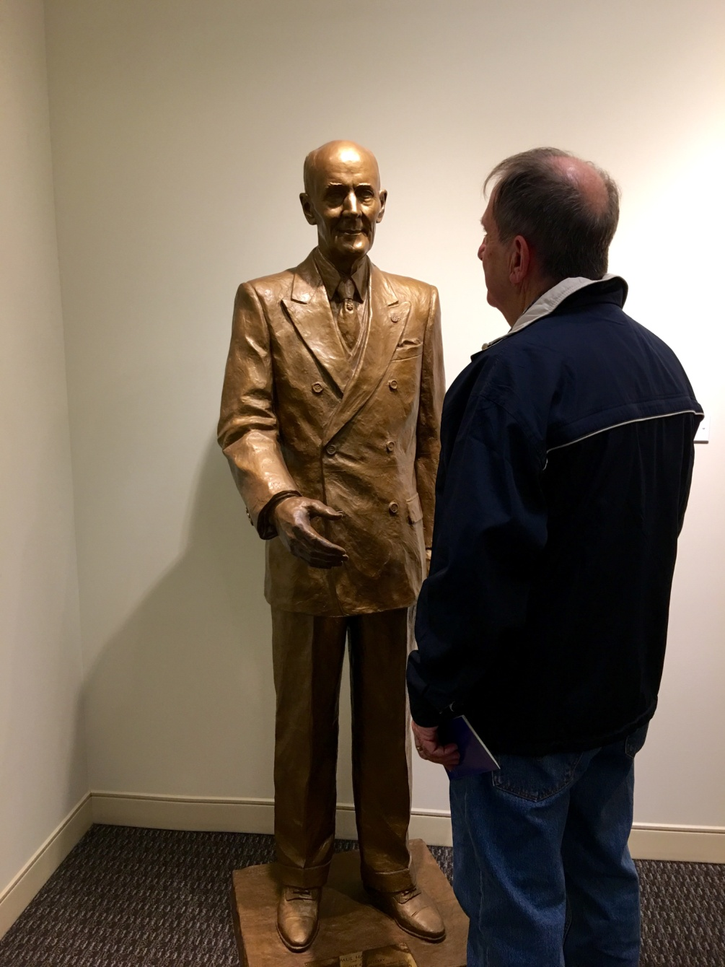
A quiet chat with Paul Harris – he was non committal on a number of things.

Slide 14
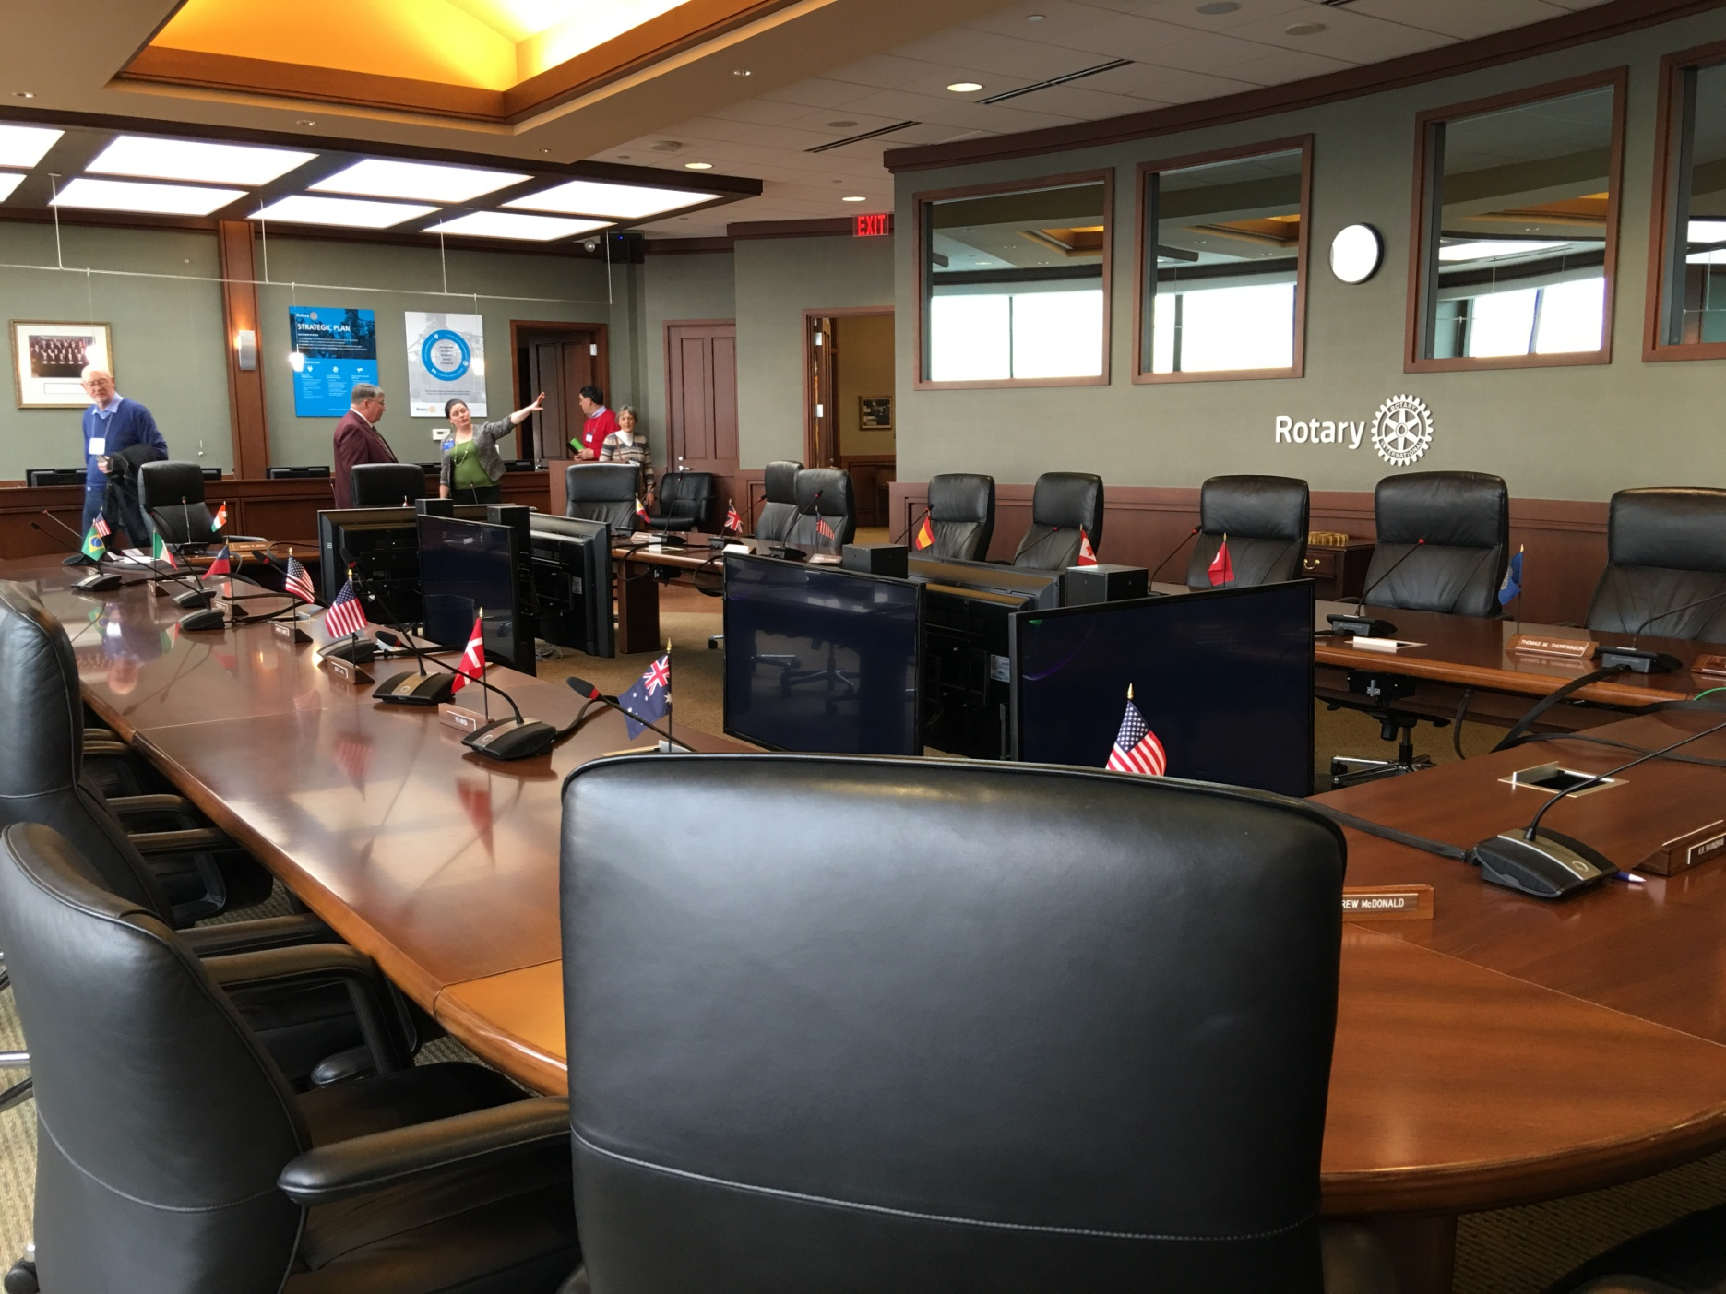
The Boardroom of Rotary International

Slide 15
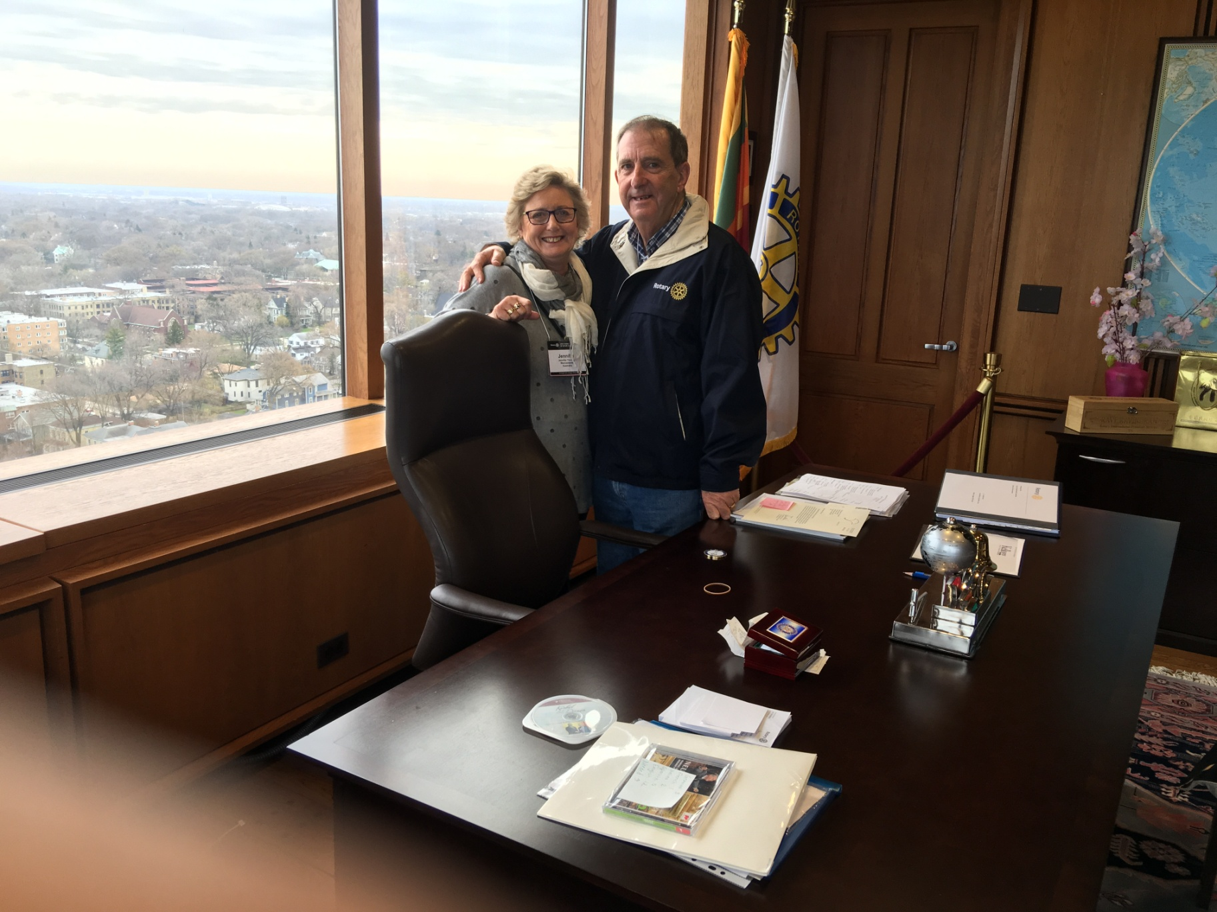
The office of the R.I. President.

