Slide 1
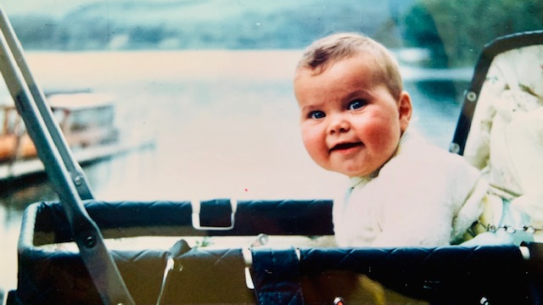
I WAS MEANT TO BE
A CHARTERED ACCOUNTANT
The Life Talk and Life Lessons
of Hugh Stowell

Slide 2


Slide 3


Slide 4
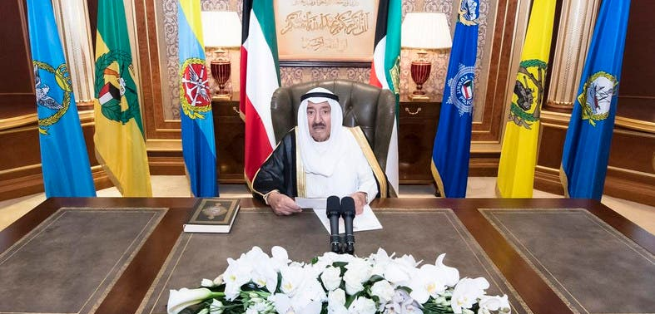

Slide 5
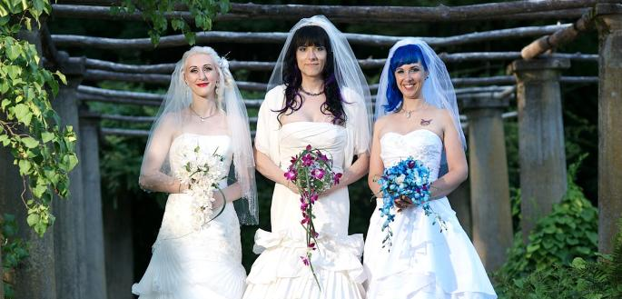

Slide 6
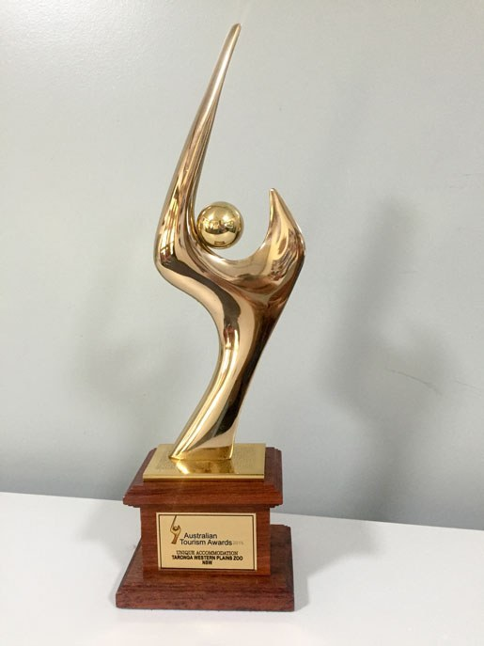

Slide 8
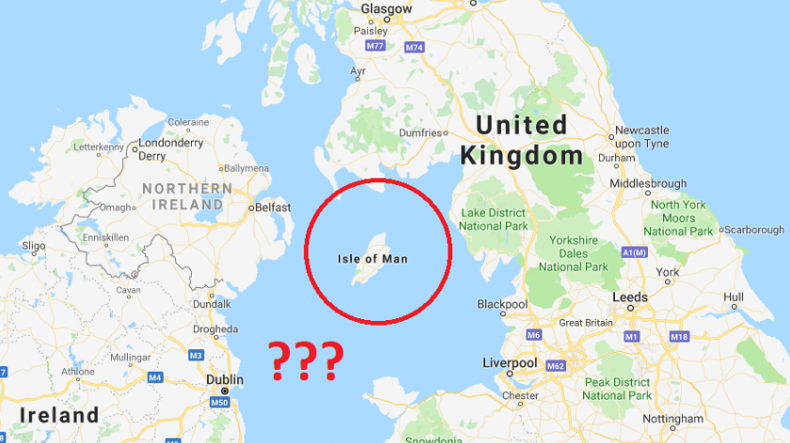

Slide 9


Slide 10
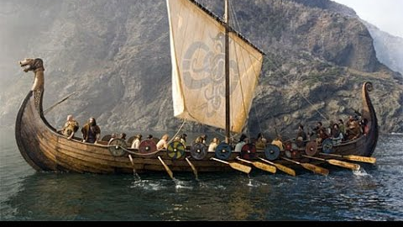

Slide 11


Slide 12


Slide 13
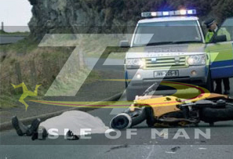

Slide 14

Life Lesson
When someone puts a road block in front of you in your life look around it and see if you cannot find a positive on the other side

Slide 15
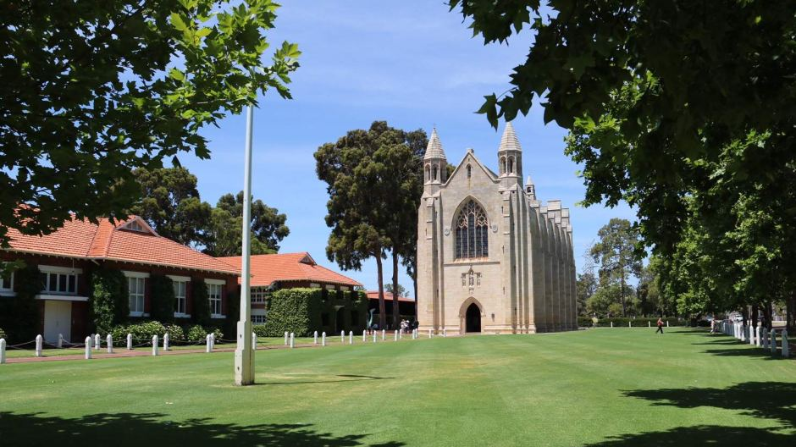

Slide 16


Slide 17
Life Lesson
Have the courage to change course even if others disagree with you

Slide 18


Slide 21
Life Lesson
Exceed a person’s expectations without looking for accolades or reward

Slide 22
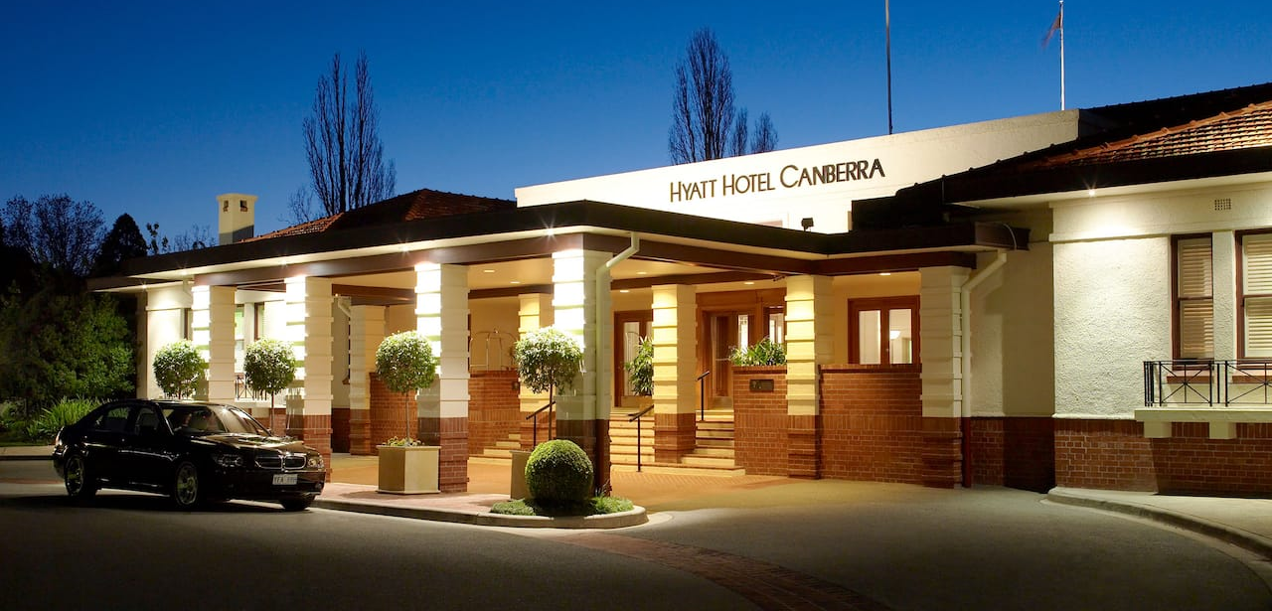

Slide 24
Life Lesson
No matter how difficult it may seem at the time always tell
the truth

Slide 26
Life Lesson
Sometimes no matter how prepared you think you are you will be thrown a curve ball. It is how you adapt and recover that matters

Slide 29
Life Lesson
Aspire to be great at what you do and when you achieve it do it again even better

Slide 30
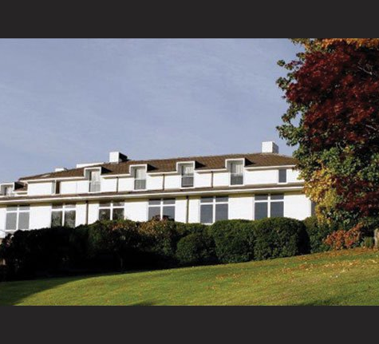
The Commonwealth Club
Canberra

Slide 31
Life Lesson
When you come to a fork in the road in life do not be afraid to take the road less travelled

Slide 32
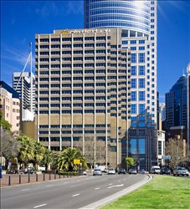
The
Australian
Club
Sydney

Slide 33
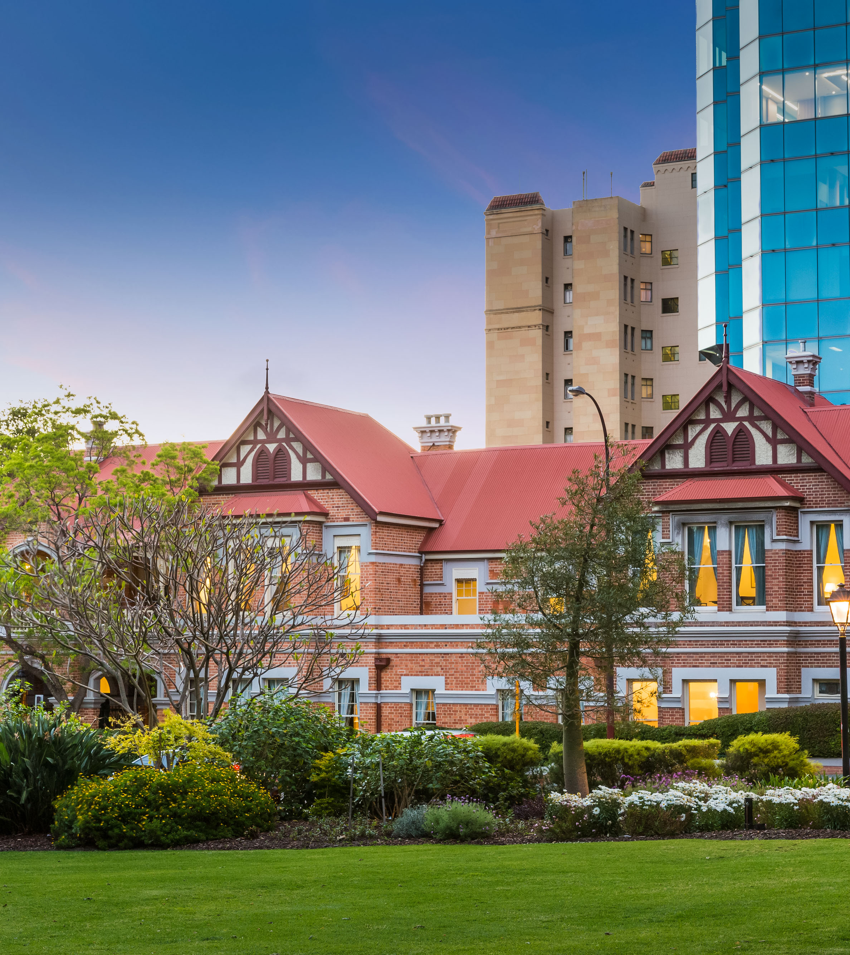
The
Weld Club
Perth

Slide 34
Life Lesson
The Secret to Life is Making
Your Vocation your Vacation

Slide 35


Slide 36


Slide 37
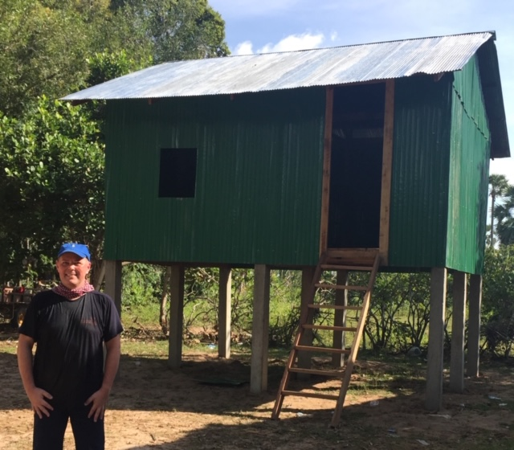
Cambodia
2015

Slide 38
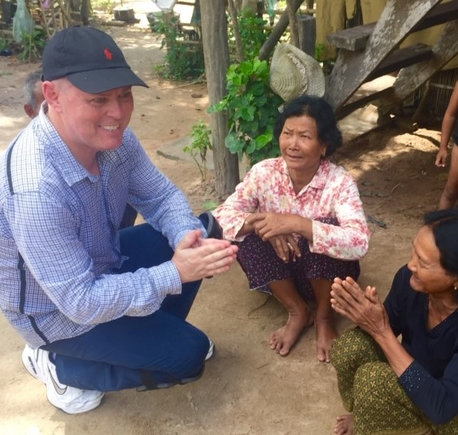
Cambodia
2015
Redefined my definition of poverty
Changed my life priorities
Reinforced my commitment to Rotary

Slide 39
Life Lesson
We make a living by what we get. We make a life by what we give.” ―Winston S. Churchill

Slide 40
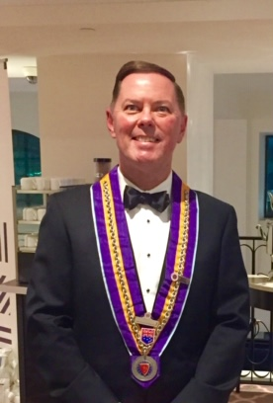
Chaine des
Rotisseurs
Established 1248

Slide 41
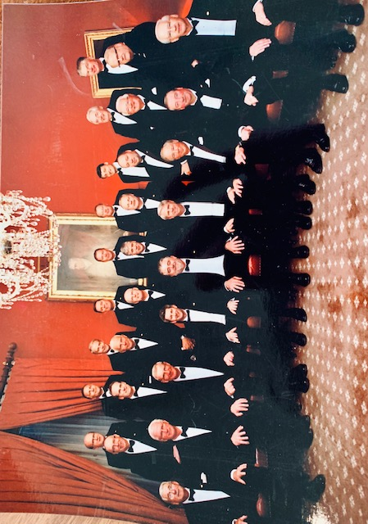

Slide 42

Chairman 2019-2022

Slide 43
AFTER ALL I WAS
MEANT TO BE
A CHARTERED ACCOUNTANT

