Slide 1
How to Edit your Profile in ClubRunner *this demo shows how to update member information including Classification In addition to this powerpoint tutorial, you can watch the ClubRunner tutorial here: http://clubrunner.helpserve.com/Knowledgebase/Article/View/357/0/how-do-i-login-to-my-clubrunner-website

Slide 2
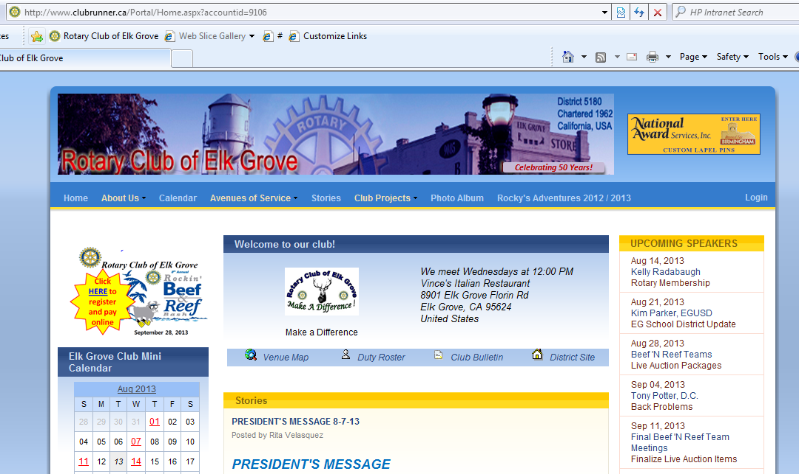
Step 1: Go to the EGR website: www.elkgroverotary.org
www.elkgroverotary.org

Slide 3
Step 2: Click Login

Slide 4
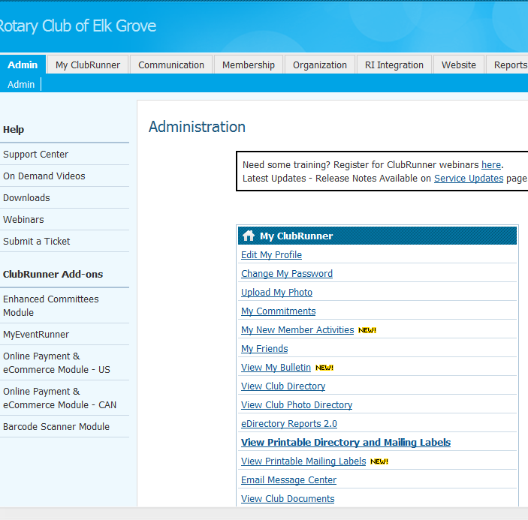
Step 3: In the “My ClubRunner” section, click on Edit My Profile

Slide 5
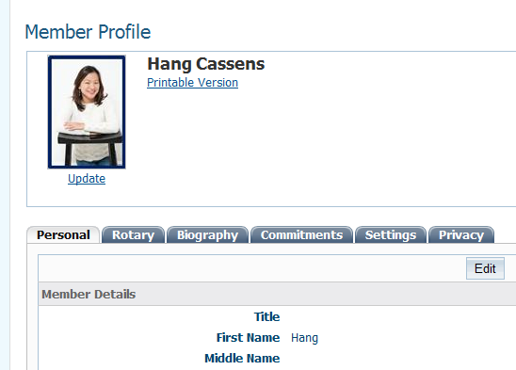
Step 4: Click on the “Rotary” tab.
*While here in the “Personal” tab, be sure to validate/edit your personal information (i.e. email address, address, phone, etc.)

Slide 6
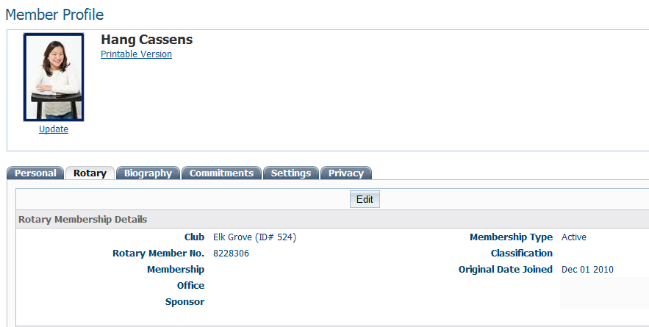
Step 5 : Click Edit to change or add your Classification

Slide 7
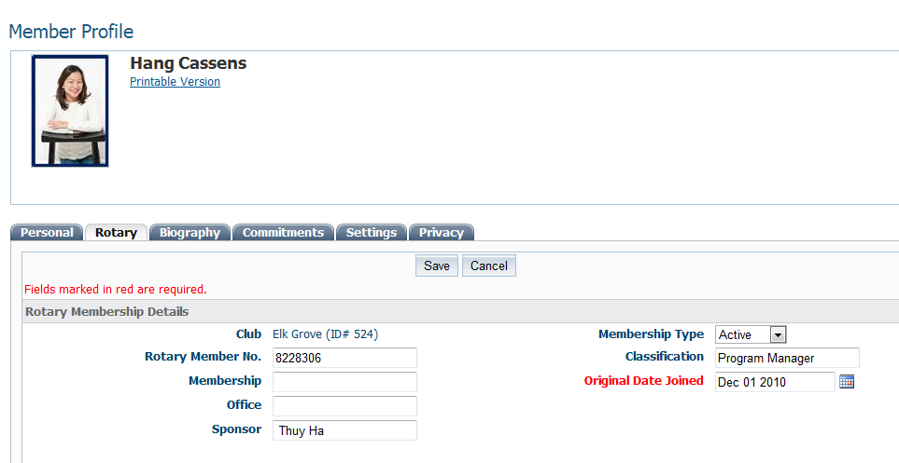
Step 6 After you input the Classification information, click Save (Note: Classification is the same as on your red/blue badge)
While here, be sure to also include your Sponsor (the person who pinned you)

Slide 8
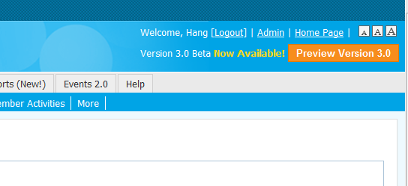
Step 7 : Logout when completed. You can look around and make other edits while you’re in your profile. You can make changes at any time.

