Slide 1
2nd Annual Rotary Zones 21b & 27 Membership Summit
Rotary Coordinator David Norris
November 13, 2015

Slide 2
Rotary Does Not Have A Membership Problem

Slide 3
Rotary Has A Leadership Problem….

Slide 4
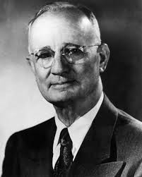
Napoleon Hill - Positive Mental Attitude – The Science of Success (1960)
Definiteness of Purpose Example #14
The Rotary Club
“The Rotary Club movement began as an idea conceived in the mind of Paul Harris, a lawyer who was seeking a way of extending his personal acquaintanceship for the purpose of building up his law practice without violating the ethics of the legal profession. It was just a simple idea, born in an humble heart. But it was backed with definiteness of purpose. So the idea grew until today it circles the earth and brings men of nearly every nationality together in a spirit of friendly fellowship.”

Slide 5
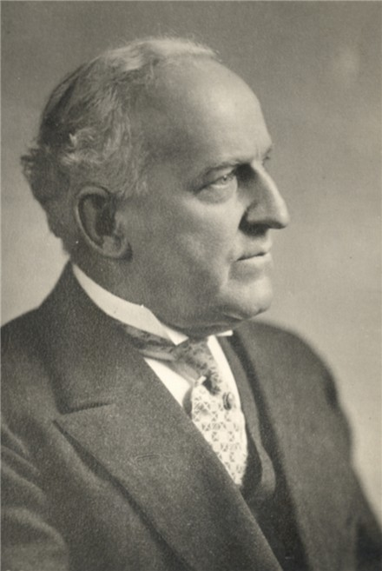
ALLEN D. ALBERT,
Terre Haute. Indiana, U. S. A.
5th President. Rotary International, 1915-16.
Rotary Vision: Development of the individual Rotarian to become his “best self” in service to others.

Slide 6
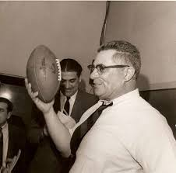
Return to fundamentals of basic blocking and tackling!
“Gentlemen!
This is a football!”

Slide 7
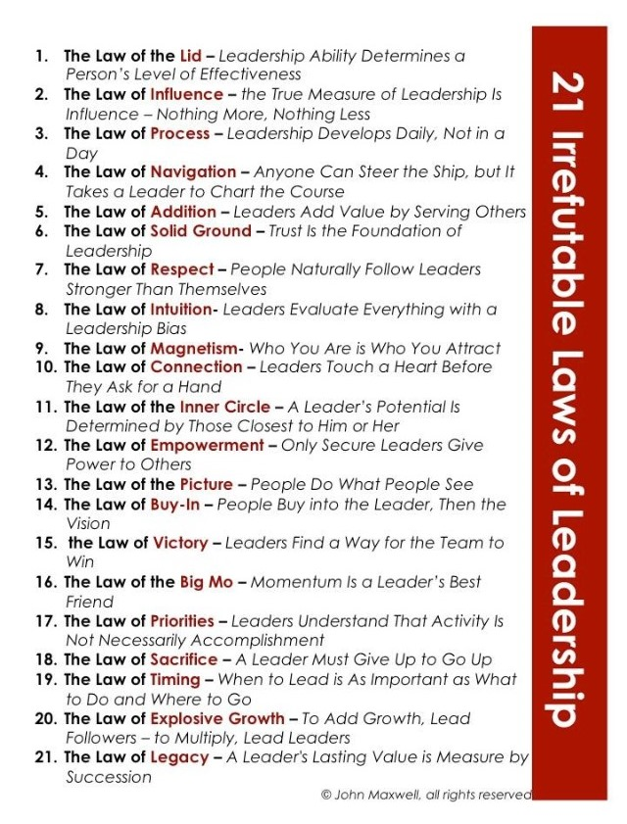
Notes:
Return to and study and learn the fundamental 21 Irrefutable Laws of Leadership

Slide 8
Rotary Has A Leadership Problem….
John C. Maxwell’s 21 Irrefutable Laws of Leadership
Law #2 The Law of Influence – Leadership is influence, nothing more, nothing less, and everything rises and fall on Leadership.
Notes:
And here is why I say it….Law #2 of John Maxwell’s 21 Irrefutable Laws of Leadership says that Leadership is influence, nothing more, nothing less, and everything rises and falls on Leadership….including the membership growth and membership retention of Rotary Clubs.

Slide 9
Rotary can be the best leadership training ground ever…..
…..Being a Rotary Club President is the best job in Rotary……
I made the conscious decision to be the best Rotary Club President the Canyon Rotary Club ever had…
Notes:
Rotary has been for me and can be for anyone else, the best leadership training ground ever. I believe that being a Rotary Club President is the best job in Rotary. Back in 2000, I was elected President of my Rotary Club in Canyon, Texas and was told about the 21 Irrefutable Laws of Leadership and in particular Law #2. In that chapter, John Maxwell writes that when CEOs of companies ask him what they can do determine the leadership potential and ability of their employees, John tells them to get them to leading volunteers. It is when you lead volunteers that true leadership comes out because one must lead in the purest sense because all you have is your own ability to influence others to accomplish the goals and objectives of the organization. No paycheck to dangle over their heads….only your own ability to influence others. After reading that I made the conscious decision to be the best Rotary Club President the Canyon Rotary Club ever had. Shortening up the story, I attended PETS, grew my club a net of 6 members and garnered 13 new Paul Harris Fellows, one of them was me…..after 15 years in Rotary, I had not given a dime to the Foundation…..and then was chosen District 5730 Club President of the year. I tell you that not to impress you but to impart to you what can happen when one raises one’s level of awareness as to their own leadership ability. Leadership is a choice, not a title. The same holds true for Club Membership Chairs, or any other position in Rotary.

Slide 10
Rotary Membership Retention……..
The problem is never in the problem…..
The problem is in the thinking about the problem!
Law #8 The Law of Intuition:
Leaders Evaluate Everything With a Leadership Bias
Notes:
Rotary Leadership at any level, just like anything else is not exempt form any of the laws, principles, levels, or axioms of leadership. Everything rises and falls on leadership. And leaders evaluate everything with a leadership bias.

Slide 11
Leadership, including Rotary Leadership……..
….. Takes two things for success:
1st is intentional growth - study
2nd is leadership experience -evaluated
Both are different and both are necessary.
Notes:
When making that conscious decision to step up into my leadership potential and raise the lid of my leadership ability, I have learned that leadership, including Rotary Leadership takes two things for success. The first in intentional growth. This is the study of leadership through books, seminars, with the whole intention and purpose of learning what leadership is….expanding ones awareness of what leadership is and what one’s individual leadership lid is. The second is leadership experience. Experience has been called the best teacher. Not true. Evaluated experience is the best teacher. Both of these are different and both are very necessary.

Slide 12
Rotary can be the best leadership training ground ever…..
Law #3 – The Law of Process
Leadership develops daily, not in a day
Notes:
Law #3 of The 21 Irrefutable Laws state Leadership develops daily, not in a day. This is the combination of the two very different and necessary things I just mentioned. One does not just read a book or go to a leadership seminar and become a leader. It takes daily study. It takes daily experience and evaluating that experience daily. Leadership develops daily, not in a day.

Slide 13
Rotary can be the best leadership training ground ever…..
Being a Rotary leader requires Buy In..
Law #14 The Law of Buy-In
People buy into the Leader, then the vision
Notes:
Like I said earlier, Rotary can be the best leadership training ground ever for those that choose it. Understanding BUY IN is critical. Law #14 of the 21 Irrefutable Laws states People buy into the leader, then the vision. Whether one is elected a Club President or appointed or asked to be a Club Membership Chair, or Assistant Governor, people must buy into the leader first regardless of how they got to the position. While it is said that where there is no vision the people perish, without a leader that people will follow, the greatest vision in the world goes nowhere. A corollary of this is people don’t buy into worthy causes. They buy into worthy leaders that support worthy causes. Can you see how being a leader that people buy into support the worthy causes of the leaders….influence……

Slide 14
Leadership Law for Rotary Membership Retention
Being a Rotary Leader requires connecting with others to get the job done…..
Law #10 –The Law of Connection:
Leaders touch a heart before they ask for a hand
Notes:
Here’s how that works. Being a leader, especially a Rotary Leader requires connecting with others to get the job done. This is Law #10 the Law of Connection – Leaders touch a heart before they ask for a hand. Now let me back up a little and bring up The 5 Levels of Leadership. The first level is Position. This is title and rank. This is true in all aspects of business, the military, etc however it is what makes Rotary the best leadership training ground ever. You get a promotion or a position. Congratulations! You are now president of your Rotary Club. Level One position leadership means people follow you because they have to. And we all know that in the volunteer world nobody has to follow anybody however we do have positions with leaders that believe their title is their leadership and hence, their power. It is perfectly OK to enjoy one’s election to a Rotary Position however Level One Position Leadership is not where one wants to stay for any length of time. The Holy Grail of leadership is Level 2 Permission…people follow you because they want to. Remember the Law of Buy in? Permission level is the relationship level. This is the Rotary Membership Retention level. This is why people stay in or leave Rotary. We as Rotarians make retention some kind of mystery and hard to achieve. The truth is it is very simple…treat others as you would want to be treated. Every member of a Rotary Club needs three things. The first is a friend in Rotary to whom he or she can constantly turn, who will walk beside him, who will answer his questions, who will understand his problems. The second thing is an assignment. Activity is the genius of Rotary. Thirdly, Rotarians must be nourished by the concepts of Rotary. They must understand what it is when we say Service Above Self. I suspect they want to undertand or they would not have joined. To keep them, we must nourish them.

Slide 15
Leadership Axioms for Membership Retention
People do not care how much you know until they know how much you care…….
People will not remember what you did however they will remember how you made them feel.
Notes:
Along with the Law of Connection are two leadership axioms. People do not care how much you know or what your title is until they know how much you care. And people will not remember what you did, what you failed at or succeeded at however the will remember how you make them feel. Can you see how this relates to membership retention? Can you see The 4 Way Test in this? Whether you are a Club President or a Rotarian, you are a leader when it come to this. It is in your job description to build positive relationships with all members of a Rotary Club both new and old. This is where the best practices of membership retention come in. It is not just giving a new member a job or assignment which by the way much be done, it is also making people feel good about where they are and who they are with and what they are doing. People will not remember what you did however they will remember how you make them feel.

Slide 16
Rotary can be the best leadership training ground ever…..
…..Being a Rotary Leader requires setting priorities and sacrifice
Law #17 The Law of Priorities:
Leaders understand that activity is not necessarily accomplishment
Law #18 The Law of Sacrifice:
A leader must give up to go up
Law #5 The Law of Addition:
Leaders add value by serving others
Notes:
Being a Rotary leader requires priority and sacrifice. There are two types of Rotary Leaders in any position. I will use Club President as an example. What kind of Rotary Club President are you. Are you moving the Rotarians in the Club forward accomplishing the goals and objectives set forth in your vision or….are you just running the weekly meeting? Now there is a reason a Rotary Club dies…..you just eat and meet. It is proven fact in the Rotary world that when a Rotary Club takes on a service project and as many Rotarians in the Club as possible are involved that the club becomes vibrant, grows, and money just seems to appear. This is the law of priorities where a leader knows understands that activity is not necessarily accomplishment. Do you ever have those days where it all just runs together with a bunch of activity and nothing is accomplished? Leaders take leadership seriously and take action to move him or herself and the organization he or she leads forward. You can apply that to Club President and any position, including membership chair. It does take some sacrifice. A leader must give up to go up. Sacrifice is the exchange of something of great value or something of even greater value. While not really a sacrificing something of great value, can you not imagine giving up NCIS Marathon to make a difference, doing something that makes a difference, with people who make a difference, at a time that makes a difference? It is for me.

Slide 17
If you are going to be a shepherd you must be willing to smell like the sheep.
Notes:
I will end this now. Thank you all for listening in. It is my prayer that I added some value to each of you today. You have certainly added value to me by taking time this afternoon to listen in. Jennifer…..Thank You for setting this up. I hope to see you and everyone on this call in a couple of weeks in Dallas at the Hyatt DFW for the 2nd Annual Rotary Zones 21b and 27 Membership Summit on Friday and Saturday, November 13 and 14. This is not your normal Rotary meeting like a PETS, or Assembly, or Conference. This is leaders coming together to learn together and work together on building and growing Rotary Leaders. This Summit is about getting good so we can help make others good. And that is the book that I am a co-author of. My short chapter that Jennifer can provide you with a PDF copy of has a lot of Rotary and Happy State Bank in it. All of the laws and axioms I have spoken about are put into action in my Rotary story. Please feel free to call on me if I can ever be of service and support to any of you, your business and of course, your Rotary Club. Live today well!

Slide 18
Leadership Axiom
As a leader you have got to get good, so you can help other people get good. If you don’t get good, they don’t get good. If you don’t reach your potential, they don’t reach their potential.
Notes:
Here is the bottom line….no matter what we do in Rotary, it is our own personal dedication to our own growth as a leader, regardless of position. Without a dedication and commitment to personal growth, our Rotary will not grow. We as leaders have got to get good, so we can help other people get good. If we don’t get good, nobody gets good. If we don’t reach our potential, nobody reaches their potential…..

Slide 19
Leadership Axiom
To grow your Rotary Club you have to grow your Rotarians. To grow your Rotarians, grow yourself.
Notes:
One simple axiom is true for anything including Rotary and that is to grow your business you have to grow your people and to grow your people you have to grow yourself……to grow your Rotary Club you have to grow your Rotarians. To grow your Rotarians, grow yourself…..set the example….people do what people see. Until we find our “why” we will never find our way. My why or mission in life is to be the absolute best version of myself so I can help to make this world the absolute best version of itself. I joined Rotary because I was told to. I stayed in Rotary because Rotary allows me the opportunity to be the best version of myself. Here’s what I know…..until we find our why, we will never find our way. Leadership opportunities are everywhere in Rotary and while being a club president is the best job in Rotary, it is not the only leadership job in Rotary. Just being in Rotary and serving others, adding value to others, connecting with others, getting through to others, helping others to grow in their leadership. There is a vast difference between management and leadership. In management you get people to do things. In leadership, you help a person become someone.

Slide 20
Until we find our “why”, we will never find our way.

Slide 22
David Norris can be reached at…..
dnorris@happybank.com
DavidNorris@JohnMaxwellGroup.com
DavidNorris@LifeMasteryInstitute.com
www.JohnMaxwellGroup.com/DavidNorris
www.DavidNorris.LifeMasteryInstitute.com
806-679-9326

Slide 23
2nd Annual Rotary Zones 21b & 27 Membership Summit
Rotary Coordinator David Norris
November 13, 2015

