Slide 1
PEO Training – Club Central
NEPETS Training
Rotary.org
Rotary Club Central
Notes:
(Introduction: presenter welcomes everyone, introduces him/herself, etc…)
[click]

Slide 2
ROTARY CLUB CENTRAL
Learning Objectives:
Introduction to Rotary Club Central
Entering Goals
Your club
Service
Foundation / Giving
Notes:
Our learning objectives for this session are:
(Presenter clicks through and verbalizes the learning objectives)
Getting to know Rotary’s Leadership, the staff and the way we can support you in achieving our overall objectives
Exploring the new website and the main online resources and tools
The Semi-annual report and the recent changes approved by the Board at its January 2014 meeting.
Understand the importance of Rotary’s New Visual Identity

Slide 3
ROTARY CLUB CENTRAL
Centralizes information
Eliminates paper forms
Fosters continuity in leadership
Enable clubs to track their progress
Creates transparency
Showcases the important work that Rotary clubs do worldwide
Notes:
FIRST OF ALL, WHY IS ROTARY CLUB CENTRAL SUCH AN ESSENTIAL RESOURCE FOR YOUR CLUB?
[click] It centralizes information. It provides access to all the data that was previously available from several reports.
[click] It eliminates some paper. It replaces paper forms for membership and Rotary Foundation goals as well as the Planning Guide for Effective Rotary Clubs.
[click] It fosters continuity in leadership. Club leaders change annually, so by offering them the ability to see a history of goals and achievements, it creates continuity among leaders.
[click] It enables clubs to track their progress. Club leaders can determine whether the goals they’ve set are realistic and make changes if needed.
[click] It creates transparency. All club members are able to see club goals.
[click] It showcases the important work that Rotary clubs do worldwide. Until now, Rotary has not had a vehicle for collecting information about the millions of service projects that Rotarians undertake. With Rotary Club Central, clubs can document the details of their projects, such as the number of volunteers and volunteer hours and a list of in-kind donations.
[click]

Slide 4
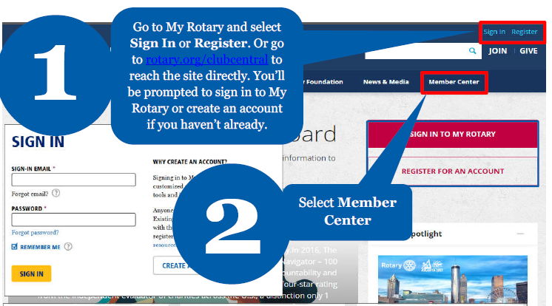
How to Access Club Central

Slide 5
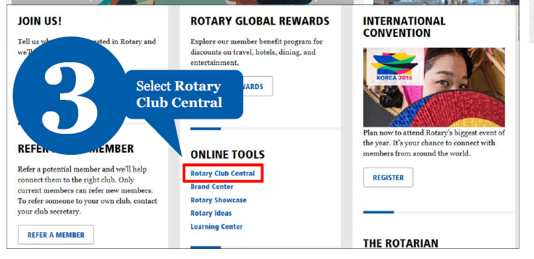
How to Access Club Central

Slide 6
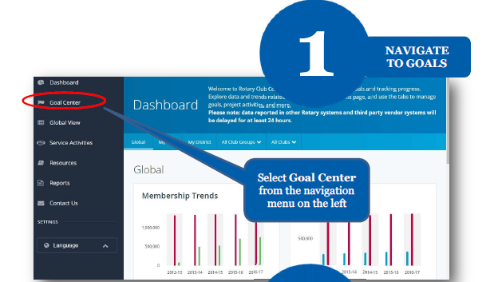
How to Set a Goal

Slide 7
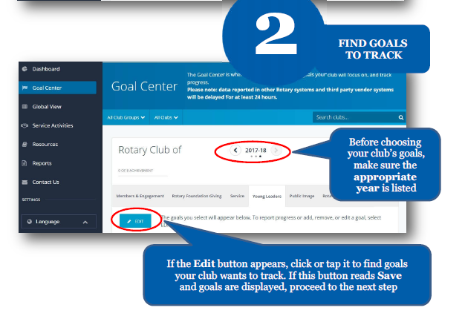
How to Set a Goal

Slide 8
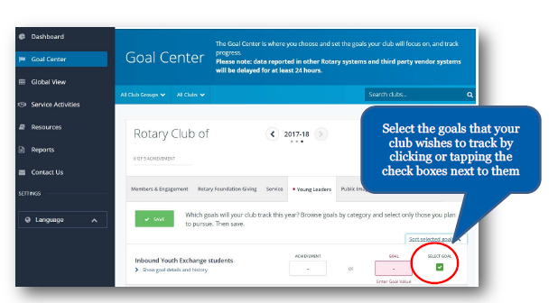
How to Set a Goal

Slide 9
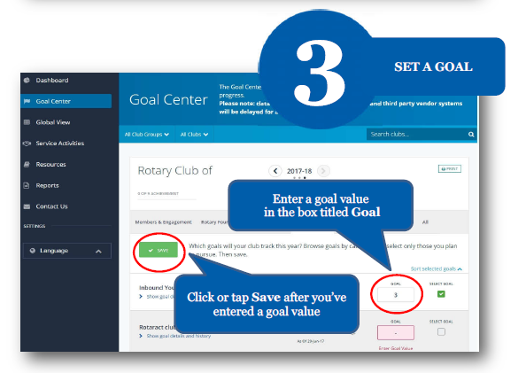
How to Set a Goal

Slide 10
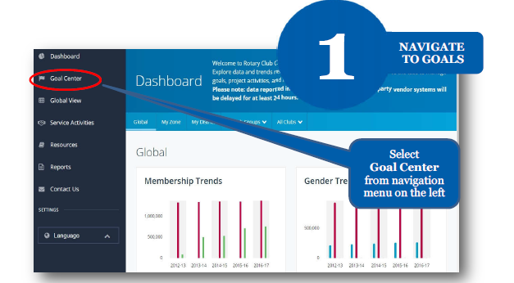
How to Report Progress on Goals

Slide 11
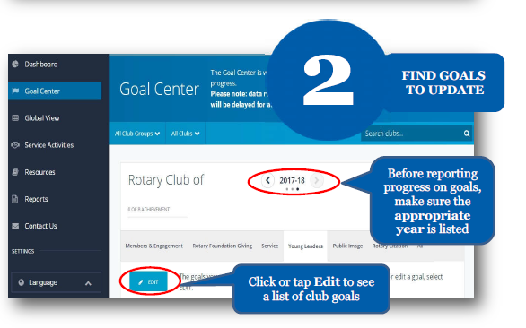
How to Report Progress on Goals

Slide 12
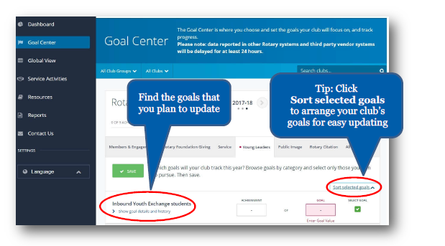
How to Report Progress on Goals

Slide 13
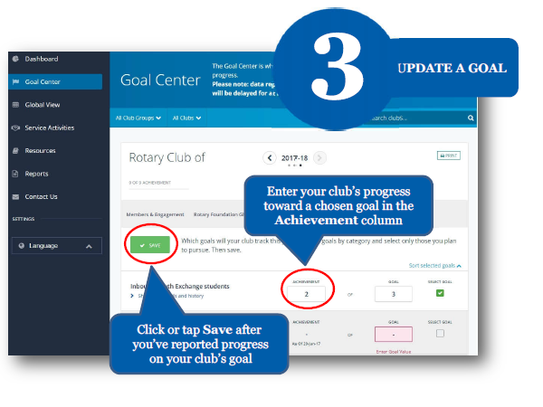
How to Report Progress on Goals

Slide 14
How to Record Service Activities

Slide 15
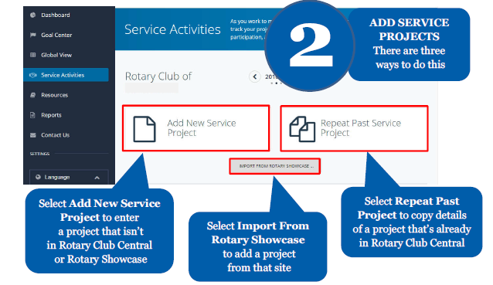
How to Record Service Activities

Slide 16
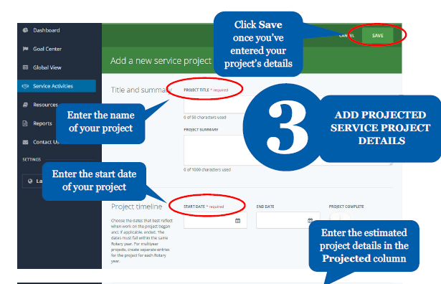
How to Record Service Activities

Slide 17
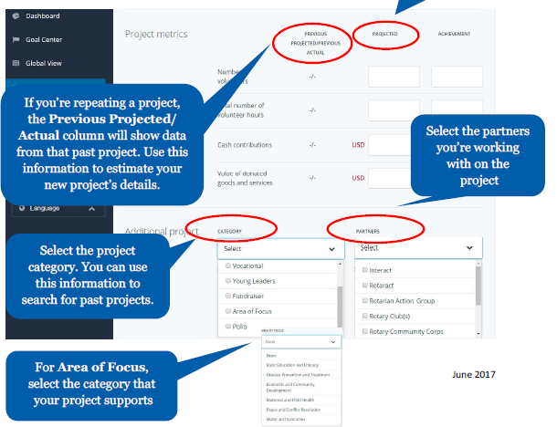
How to Record Service Activities

Slide 18
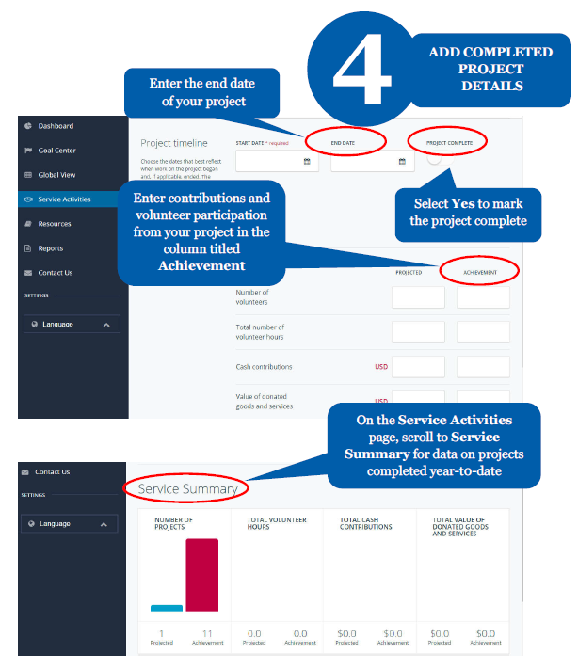
How to Record Service Activities

Slide 19
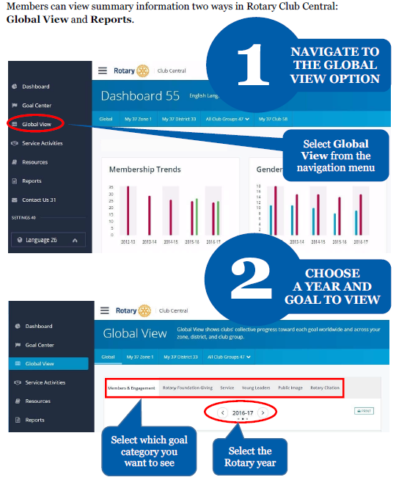
How to View Information

Slide 20
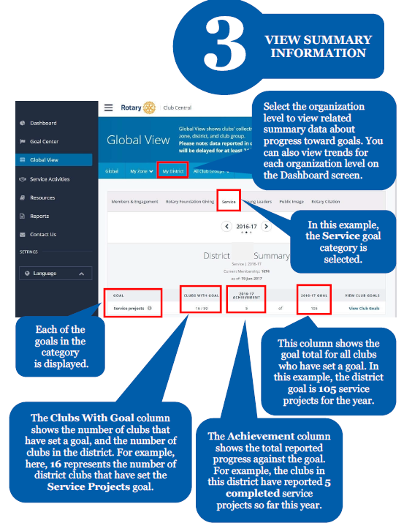
How to View Information

Slide 21
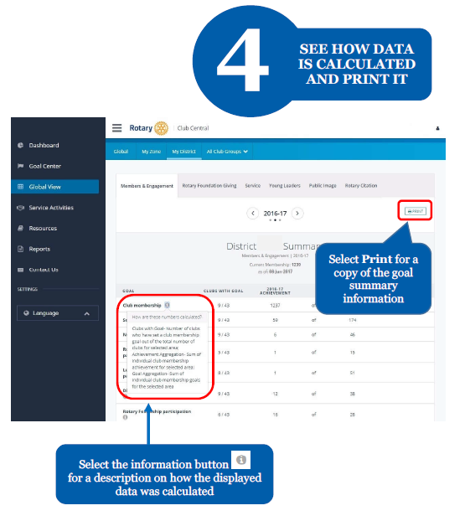
How to View Information

Slide 22
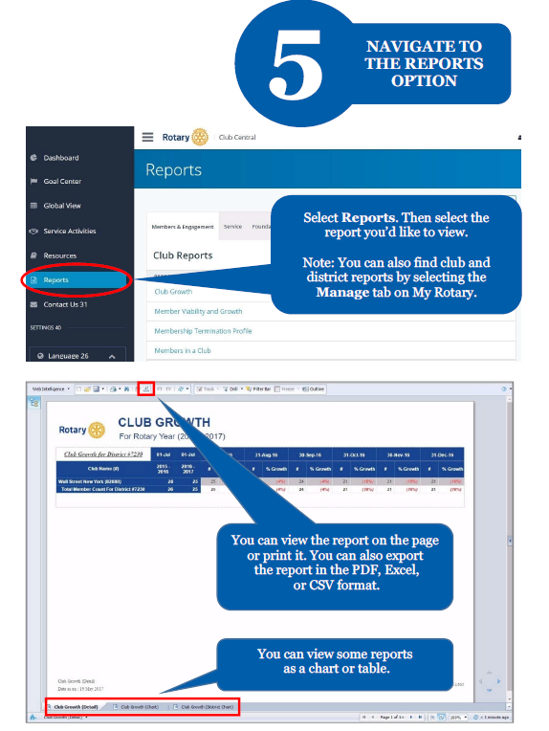
How to View Information

Slide 23
+Additional New Features
Service Projects and Activity Integration
Age and Gender Demographics
More Reports!!!
Coordinator View
Global View
Notes:
The final phase of this project is scheduled to be released in May 2013.
Here are some of the highlights planned.
-The Service Projects and Activities goal will be integrated with Showcase. This means that if a project is entered in Rotary Showcase, any of the relevant information can be linked to RC Central eliminating the need for duplicate entry. This will also allow projects entered in RC Central to be pushed out to Showcase for public view.
-Age and gender demographics will be added to the Club Snapshot as well as the Your Club tab. Clubs will not set specific goals for these, but by being able to visually compare last year’s information to the current year, clubs will be encouraged by (hopefully) seeing their progress towards a more balanced club.
-There are already existing reports in RC Central, but keep checking back to see new reports being added periodically. -There will be a Coordinator View, which will be just like the District View and allow Rotary Coordinators, Rotary Public Image Coordinators, Rotary Regional Foundation Coordinators, and their assistants to view goals and progress for their entire region. This will help them assist clubs and districts with their strategic planning.
-Finally, there will be a Global View which will allow everyone to see the sum of all the goals and progress entered into Rotary Club Central.

Slide 24
Questions ? Central
Notes:
(Answer any questions possible)
For more specific details about each goal and achievement, please refer to the Club Reference Guide. The District Reference Guide provides further information about the district-level features we’ve covered.
After using Rotary Club Central, we encourage you to provide any feedback directly on the Feedback link located at the end of the left-hand navigation bar in the tool.
Any additional questions can be directed to the Contact Center or your Club and District Support Representative.
Thank you.

Slide 25
Rotary International
https://www.rotary.org
https://m.facebook.com/rotary/

